Slide 1
Escape From Figma Island
UX Brighton - 6th November 2026
Why and how to start designing in code again

Slide 2
How we ended up on Figma Island
Designers can work in code again
A side project is the best way to learn
Five tips for working in code with AI
Closing thoughts

Slide 3
How we ended up on Figma Island
Designers can work in code again
A side project is the best way to learn
Five tips for working in code with AI
Closing thoughts

Slide 4

The year was 2005…

Slide 5

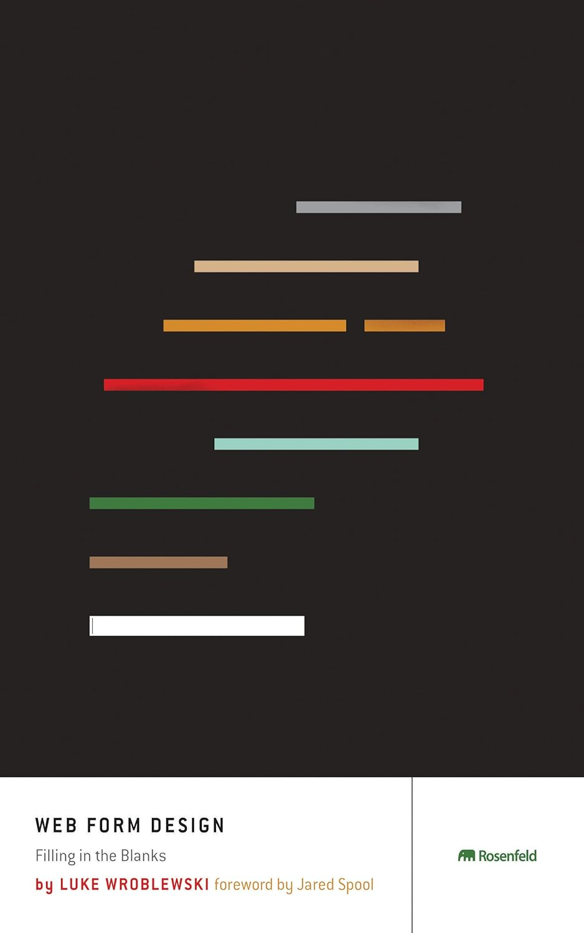
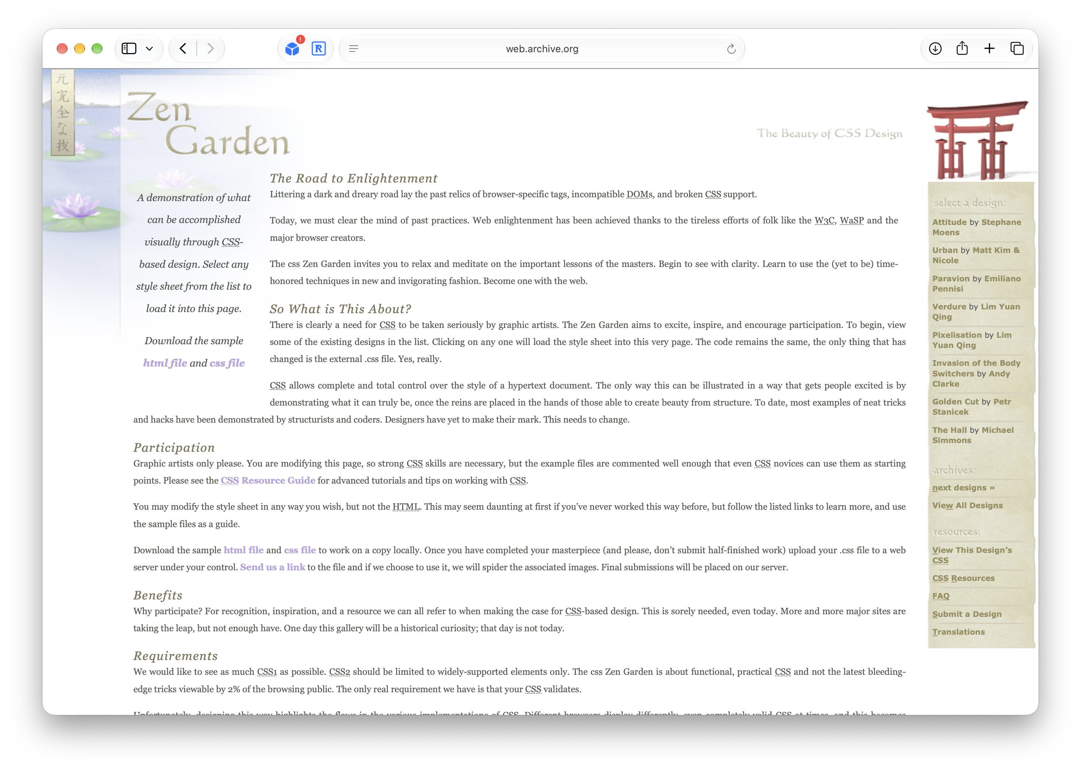

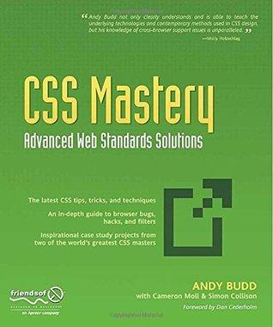
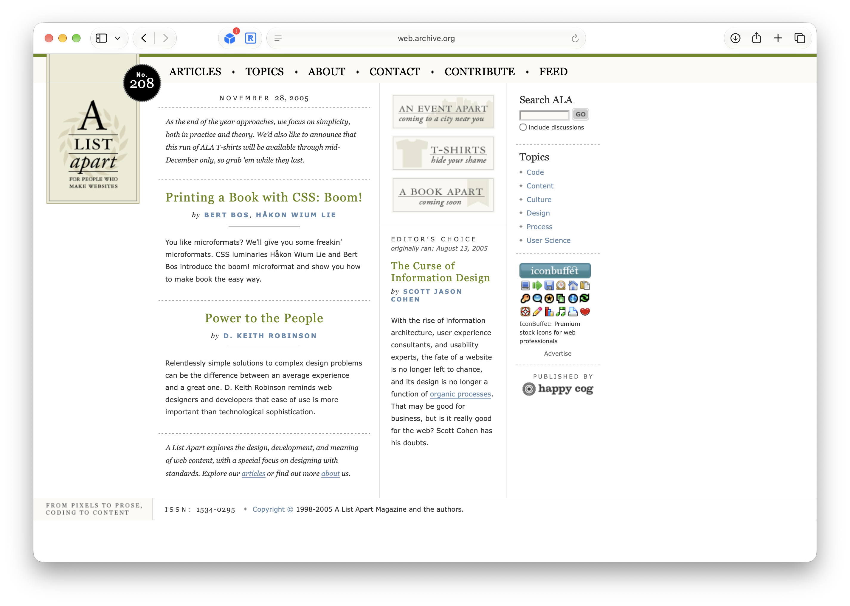
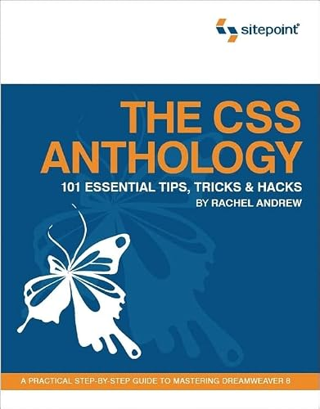
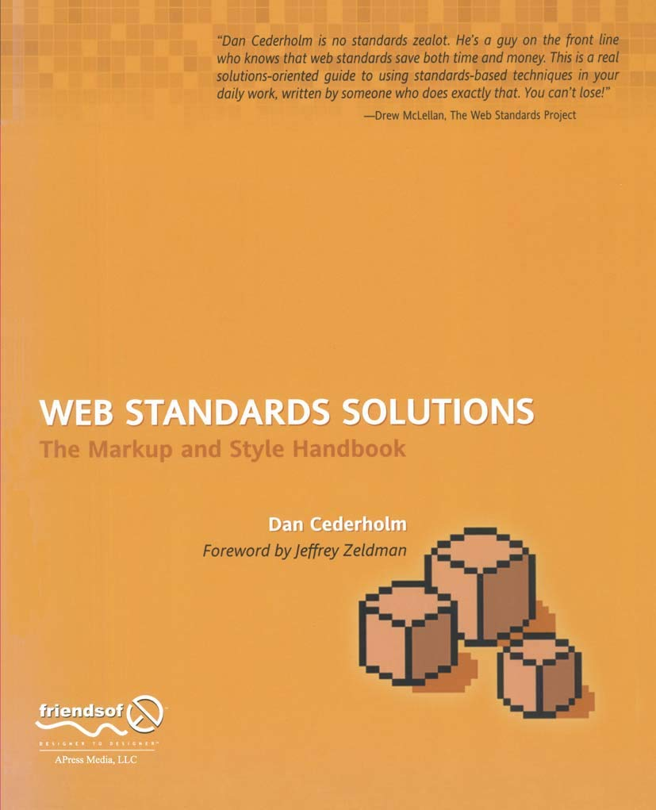
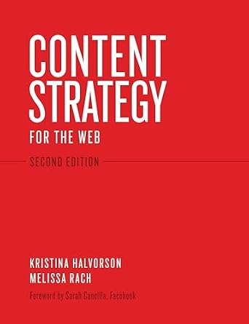

Slide 7
And then things got complicated…
Notes:
Web 2.0, iPhone

Slide 8

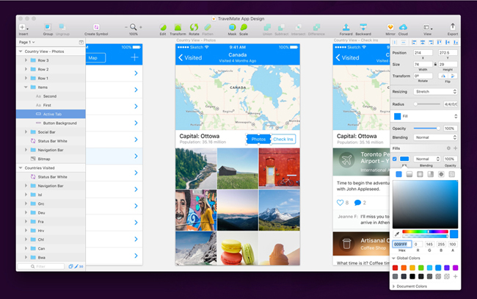
Designing in the abstract again

Slide 9
Stranded on Figma Island

Slide 10



Slide 11
How we ended up on Figma Island
Designers can work in code again
A side project is the best way to learn
Five tips for working in code with AI
Closing thoughts

Slide 12
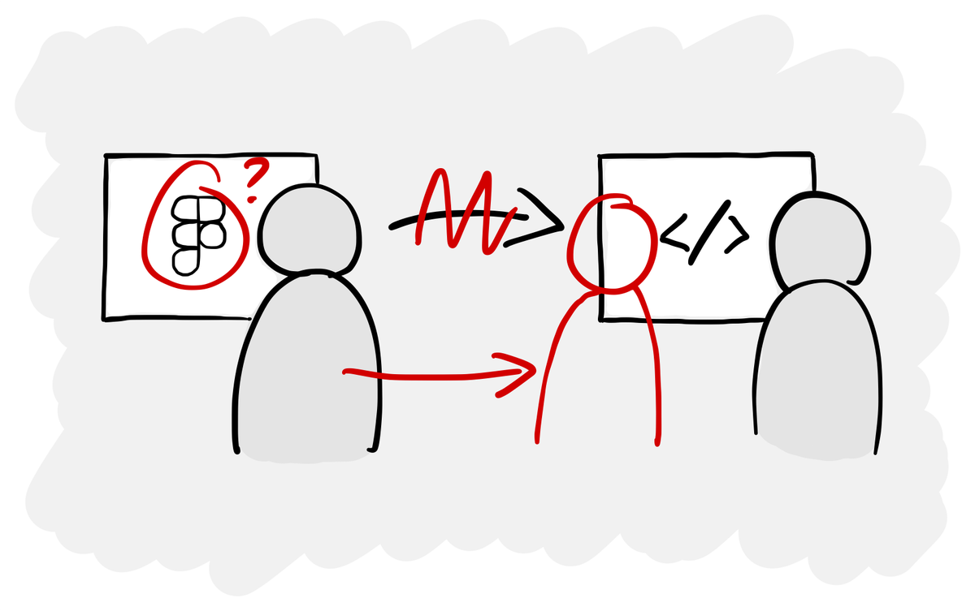
Old ways of working don’t make sense anymore

Slide 13
Notes:
Moving across the sea of handovers, starting to explore…

Slide 14
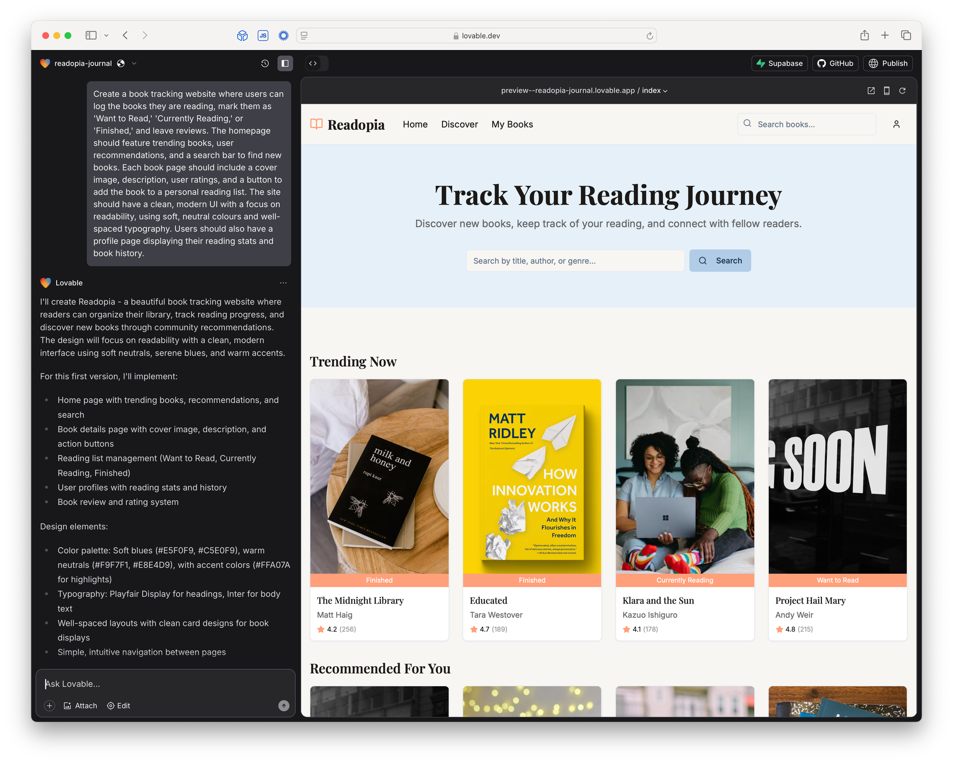
Lovable, Figma Make, etc. are a local maxima

Slide 15
Notes:
But beware of the local maximum that is prototype hill

Slide 16

Notes:
But beware of the local maximum that is prototype hill

Slide 17
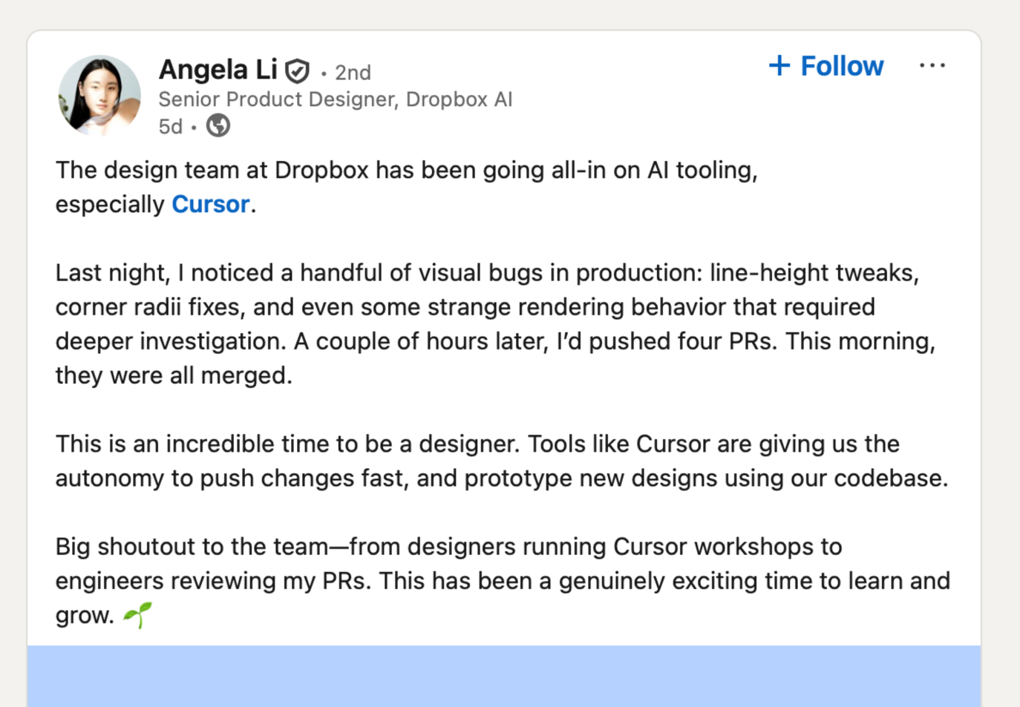
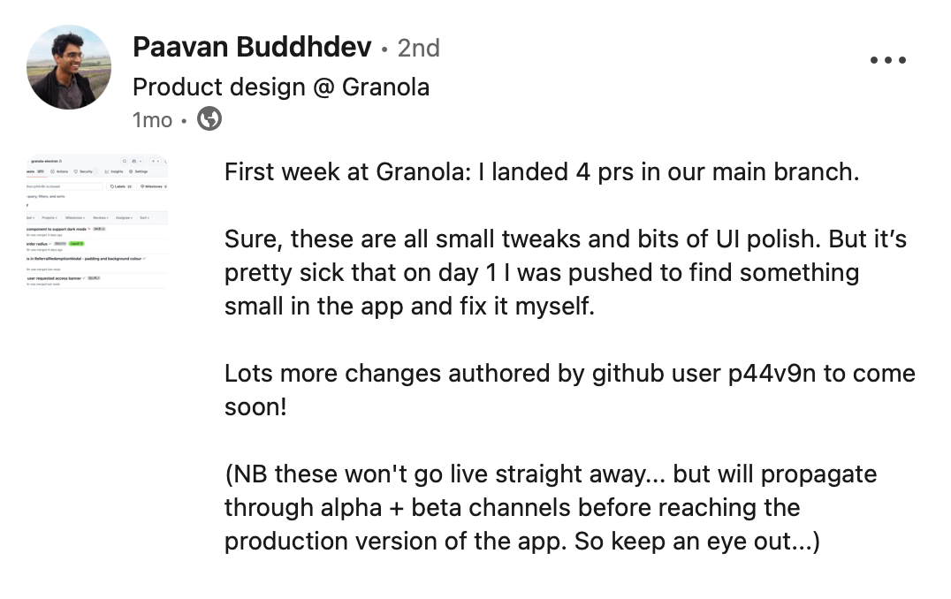
Designers are starting to work in code (again)

Slide 18
How we ended up on Figma Island
Designers can work in code again
A side project is the best way to learn
Five tips for working in code with AI
Closing thoughts

Slide 19
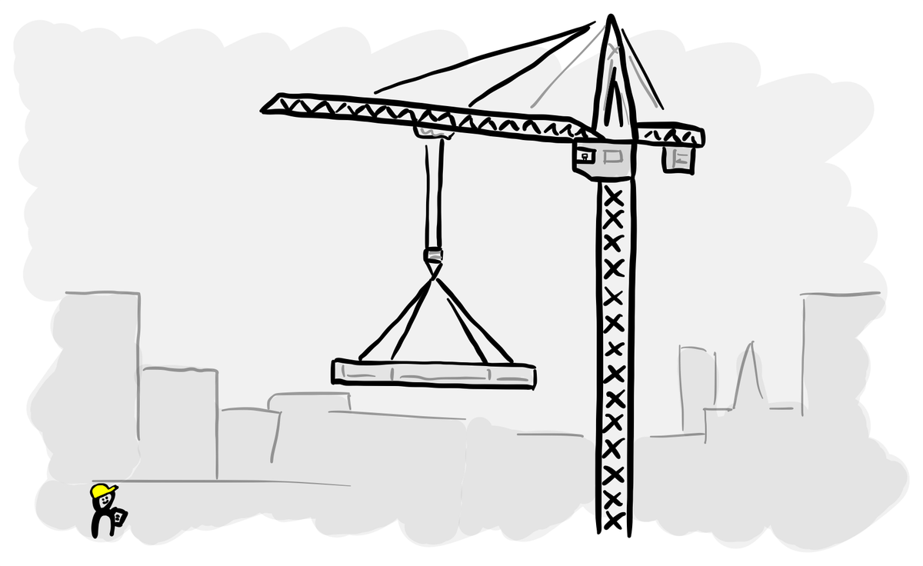
A side project is the best way to learn by doing

Slide 20
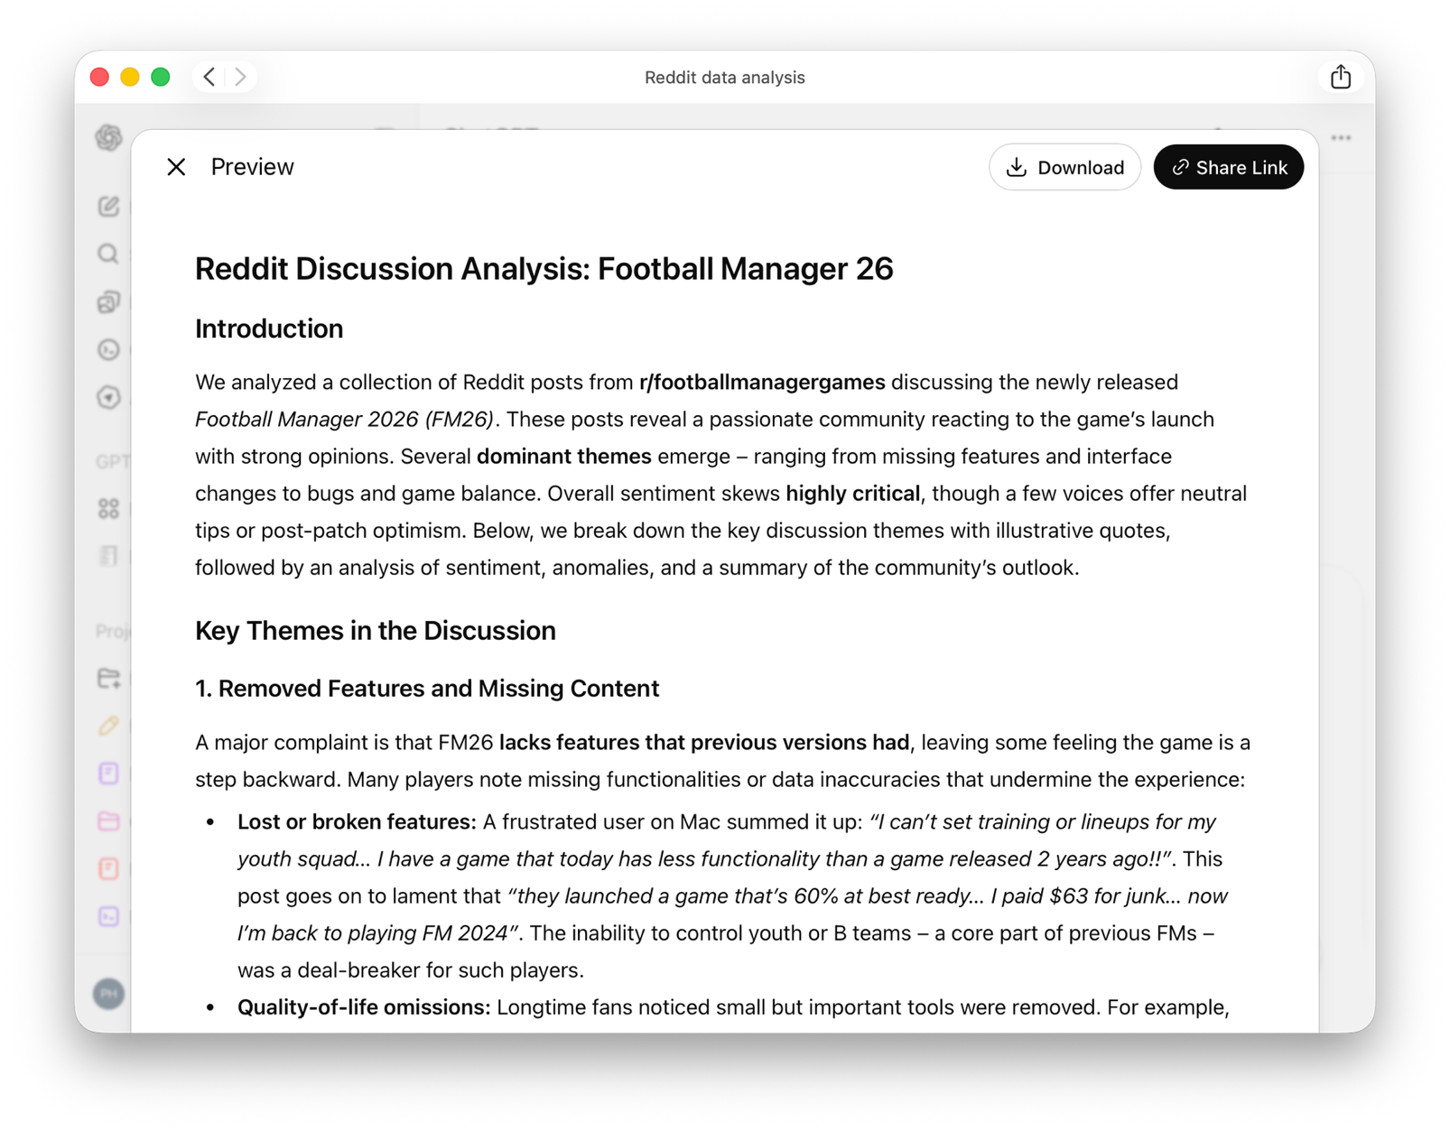
Reddit scraper

Slide 21
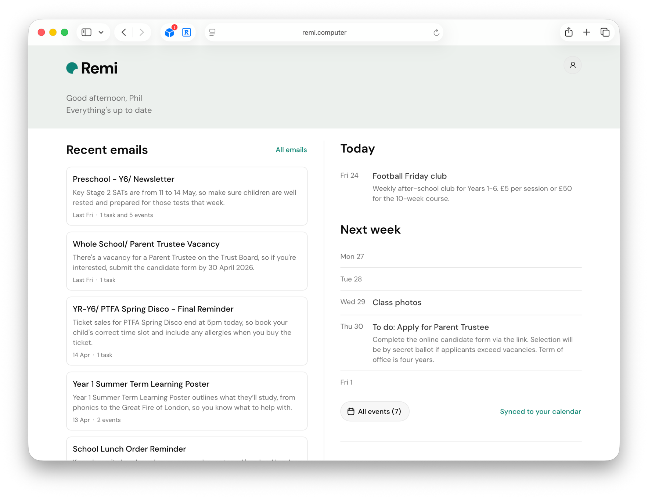
Remi – school email assistant

Slide 22
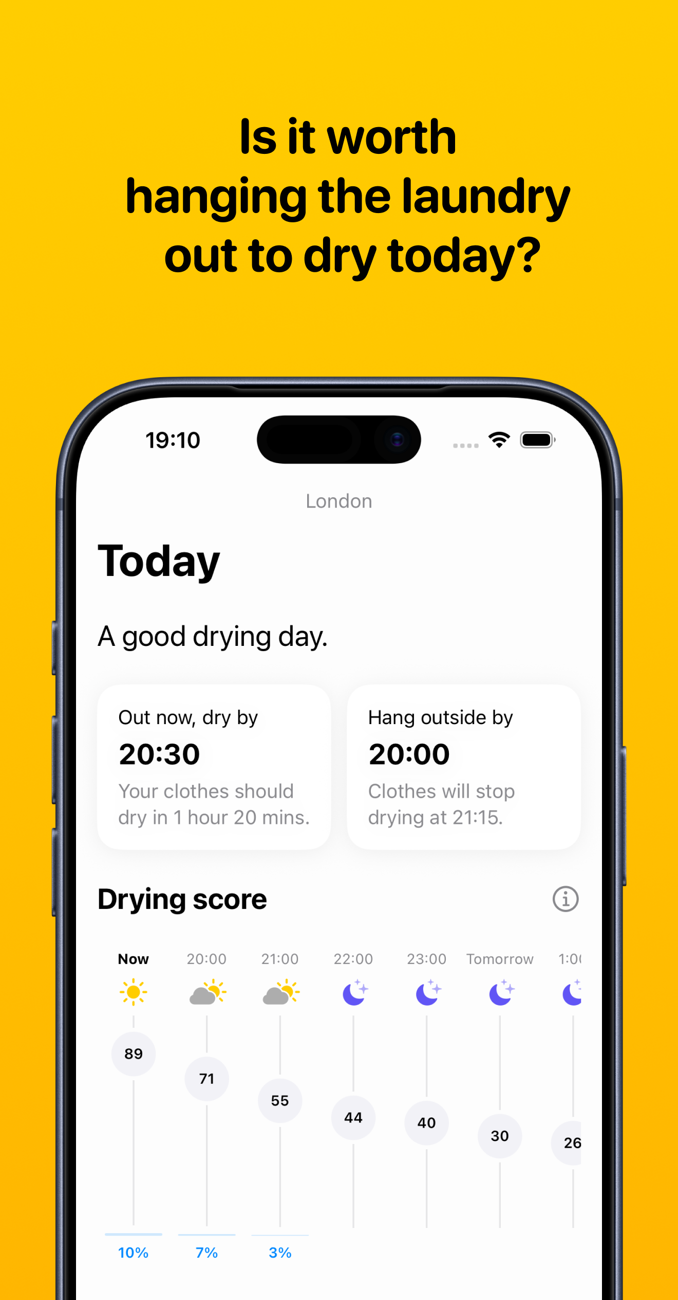
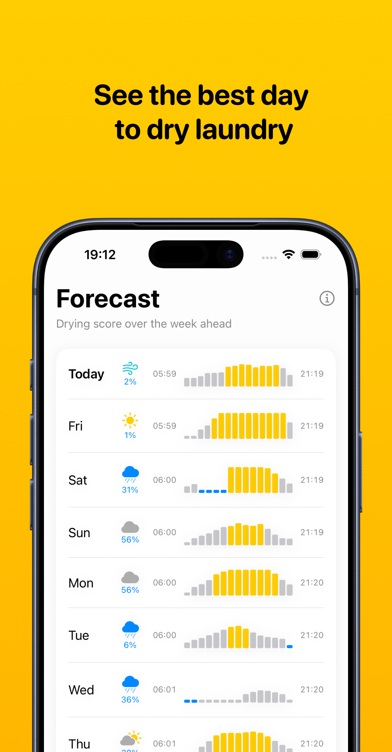
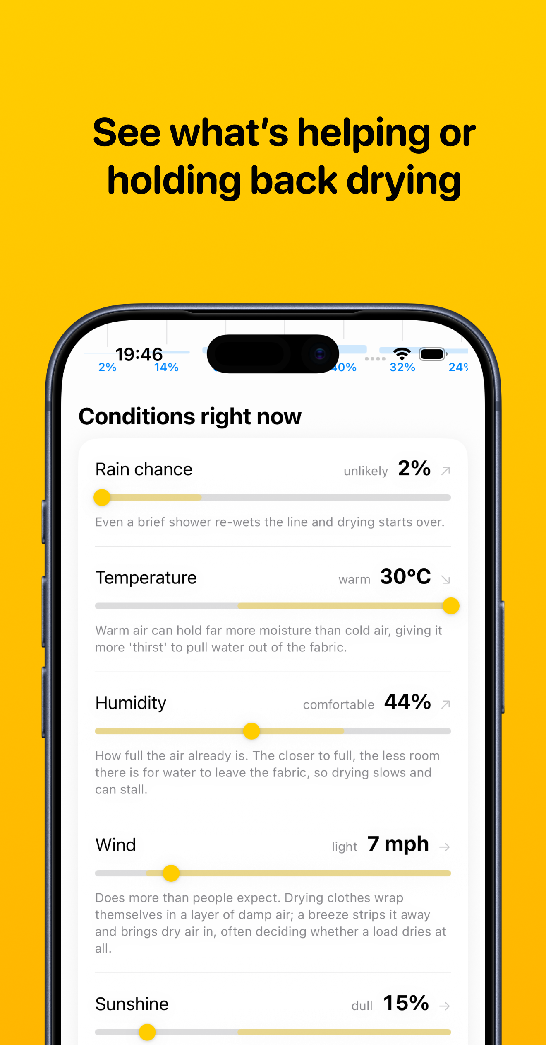
Pegs Out – will my laundry dry outside today?

Slide 23
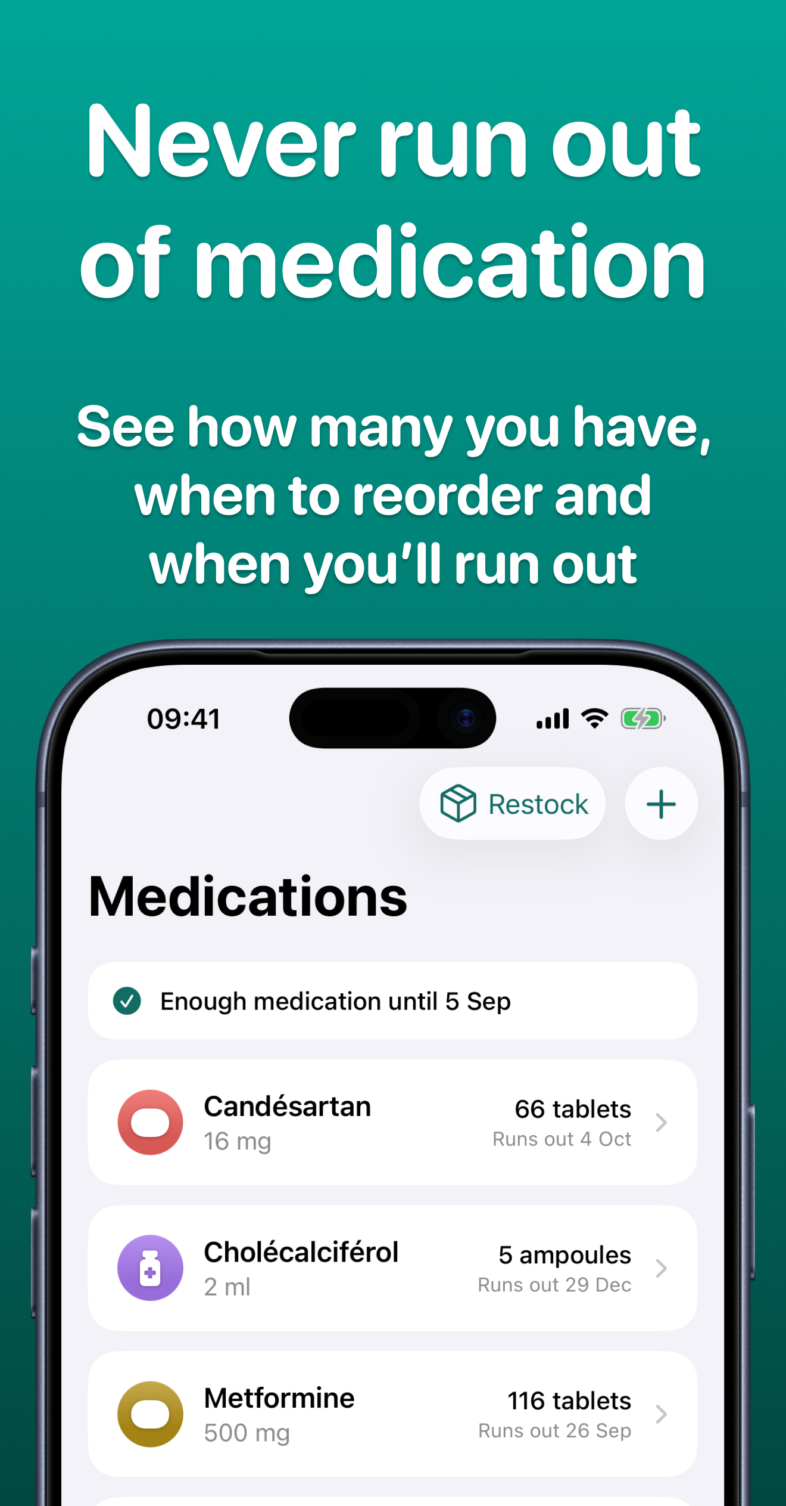
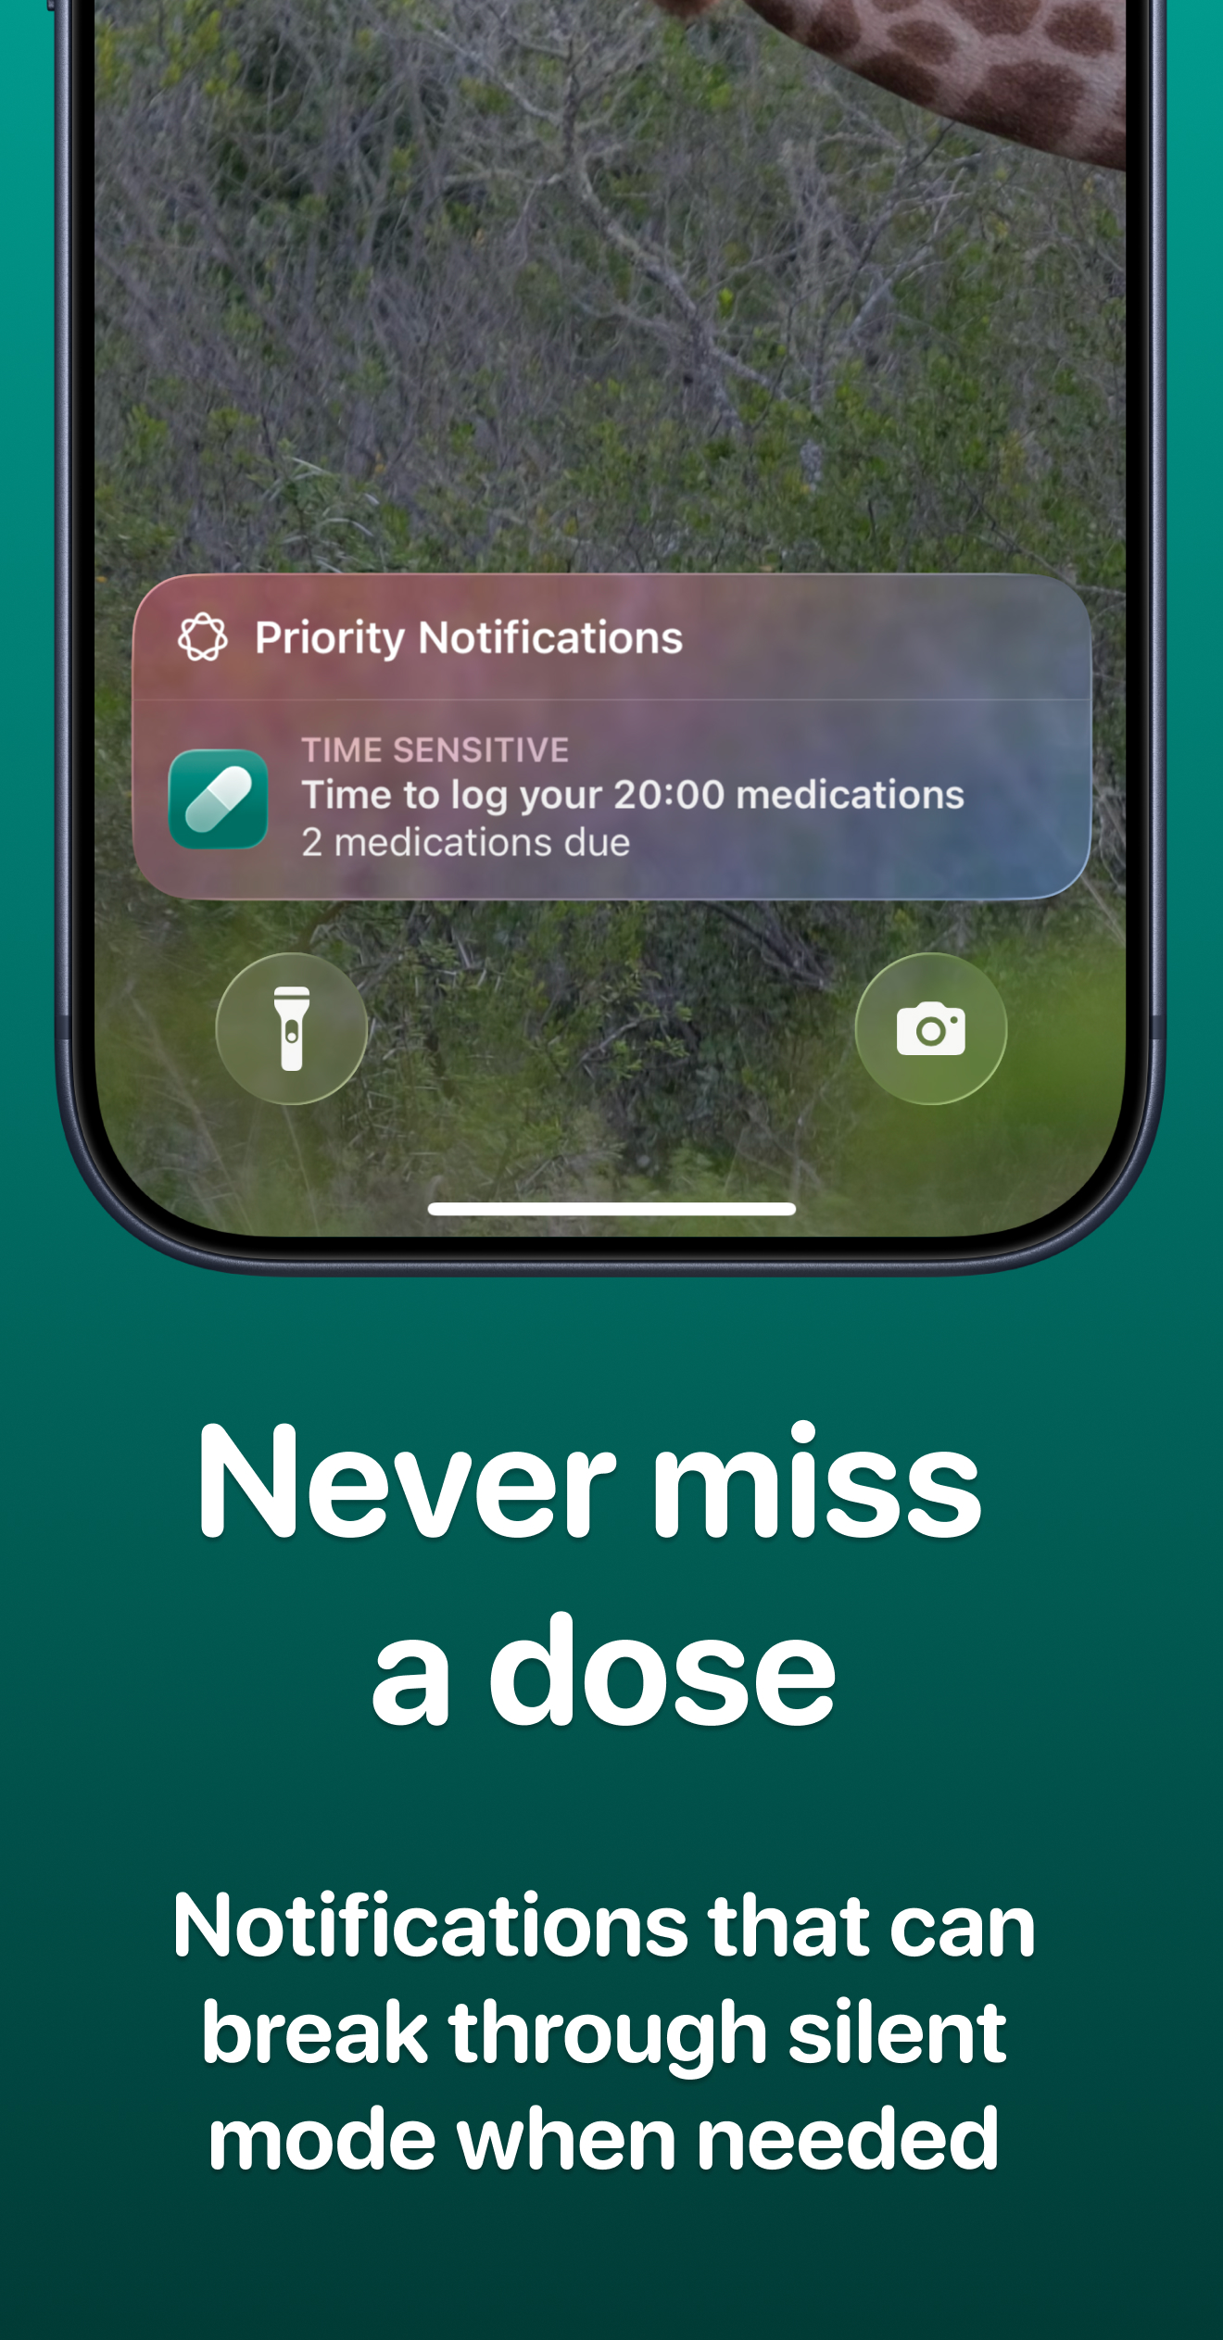
Pills In – medication app

Slide 24
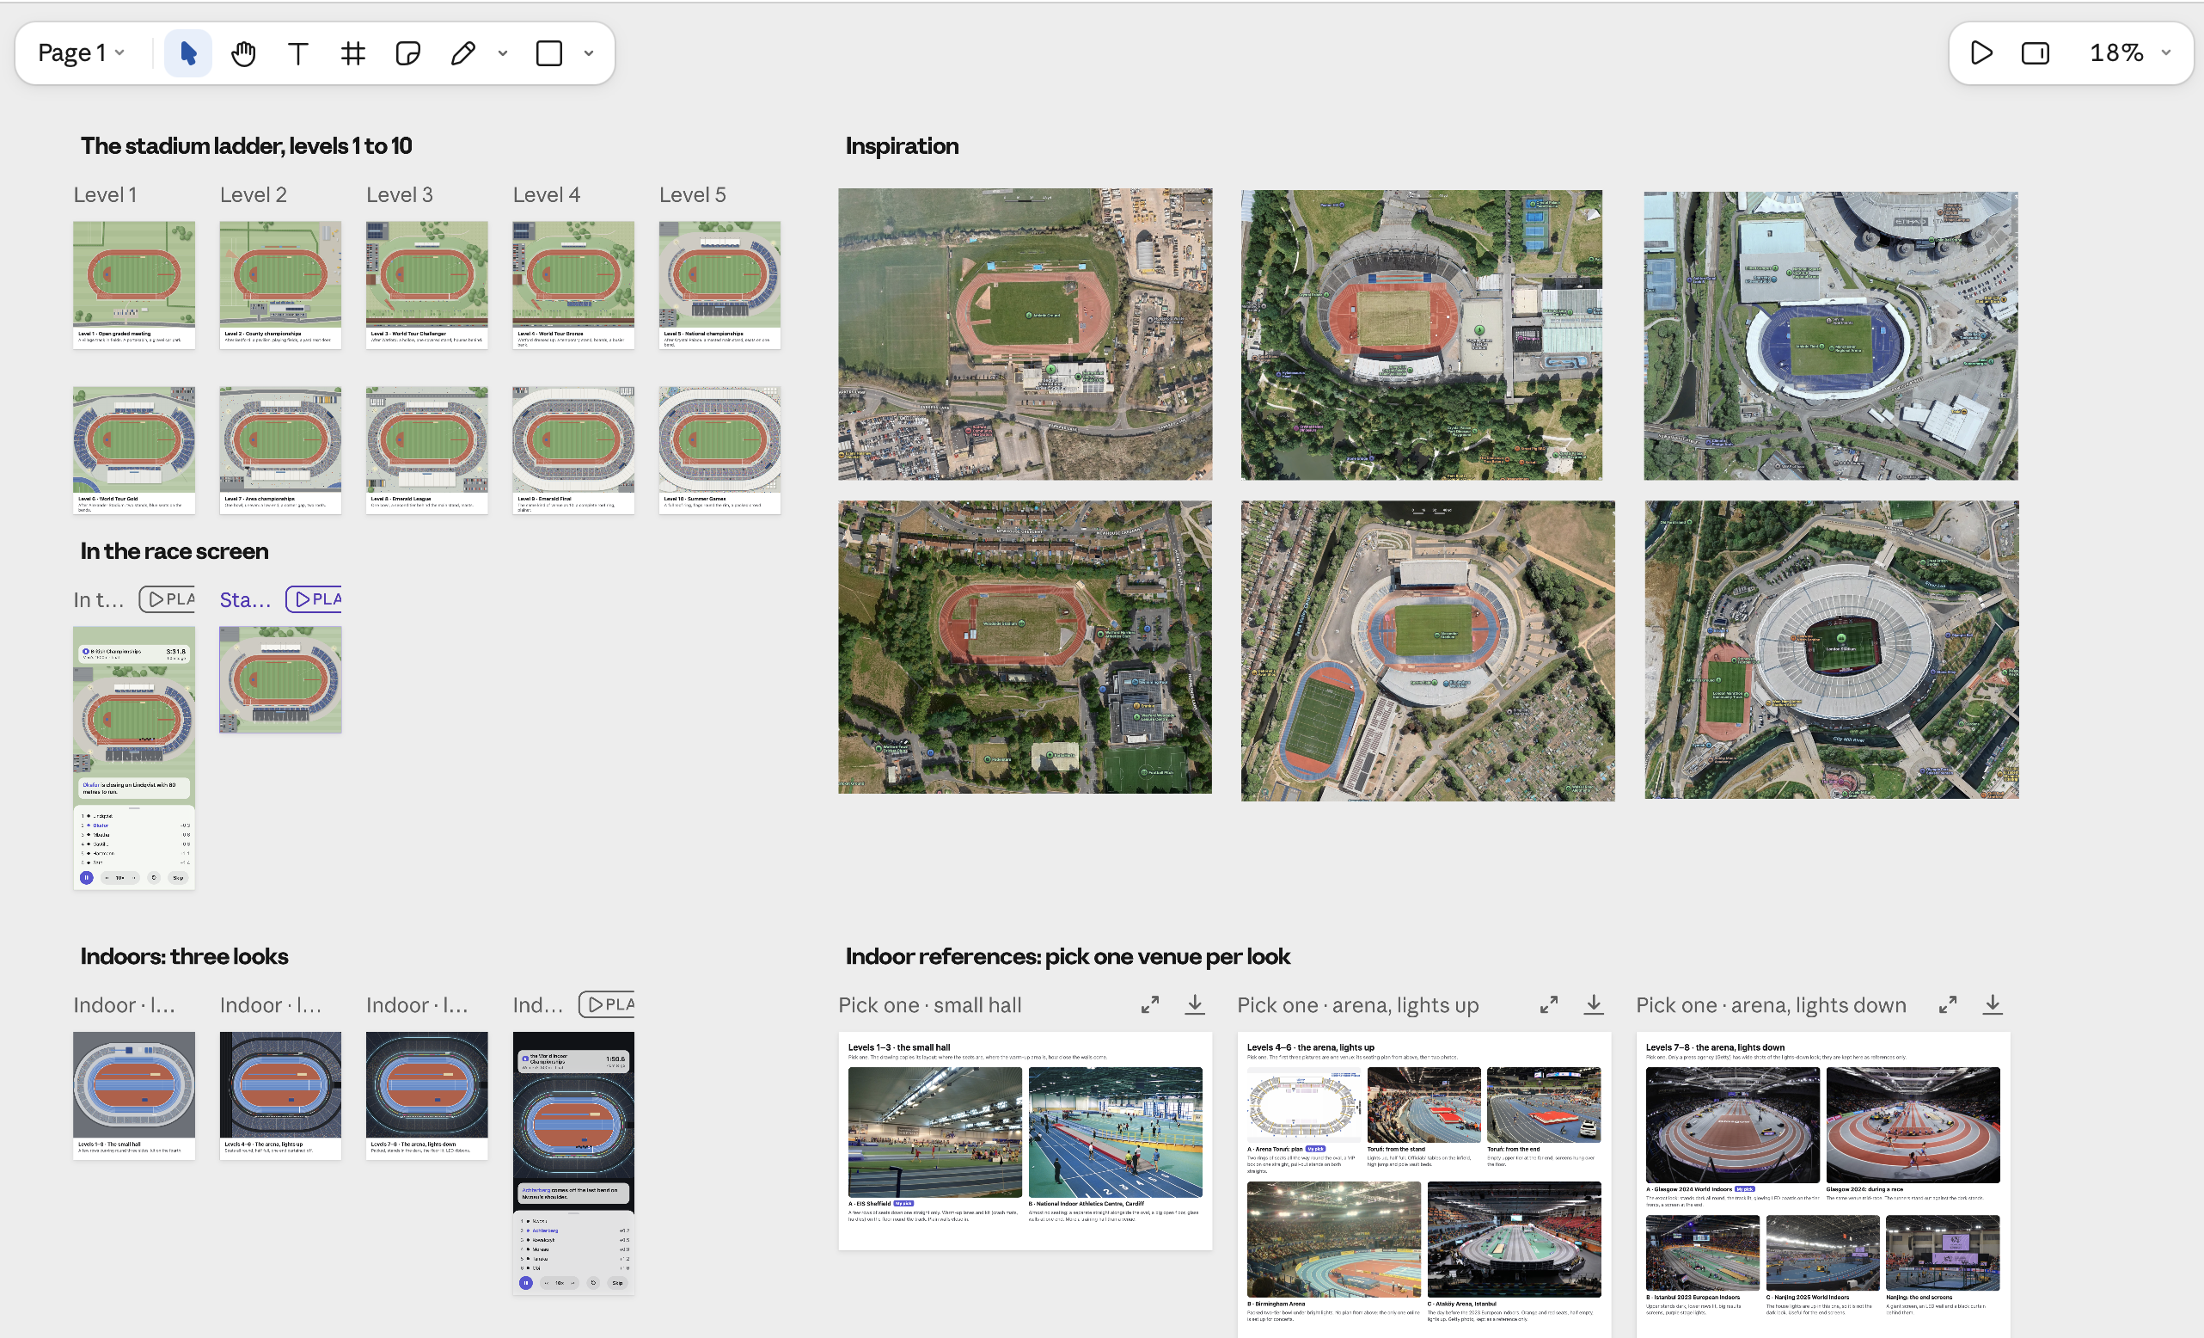
Track Club Manager – athletics game (WIP)

Slide 25
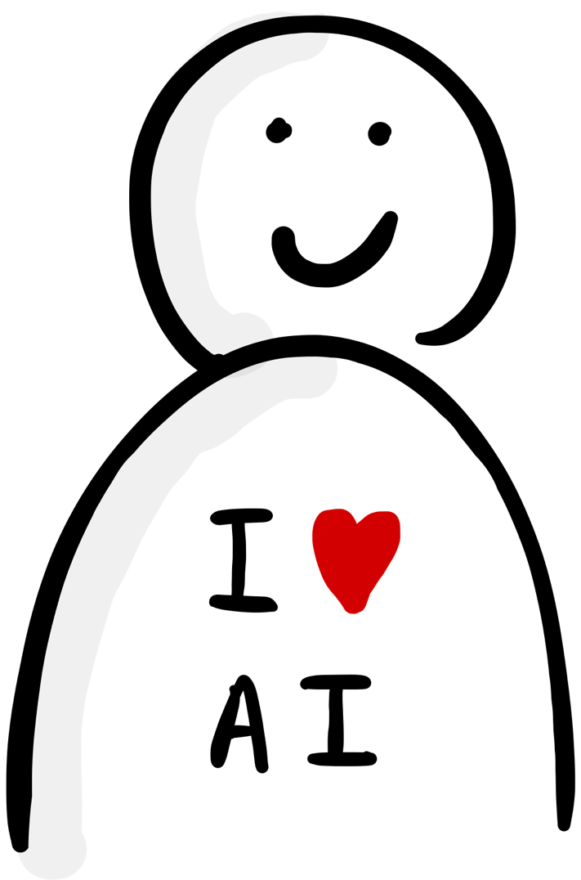
On a side project, you are the team
Brand
Research
Product management
Engineering
Architecture
Security
Marketing
Pricing
Legal

Slide 26
How we ended up on Figma Island
Designers can work in code again
A side project is the best way to learn
Five tips for working in code with AI
Closing thoughts

Slide 27
Five tips for designing and working in code with AI
You are the designer, AI is your assistant
Manage the work and the knowledge
Build your own design system in code as the source of truth
Design in the real product using jigs
Establish a repeatable workflow with skills

Slide 28
Five tips for designing and working in code with AI
You are the designer, AI is your assistant
Manage the work and the knowledge
Build your own design system in code as the source of truth
Design in the real product using jigs
Establish a repeatable workflow with skills

Slide 29
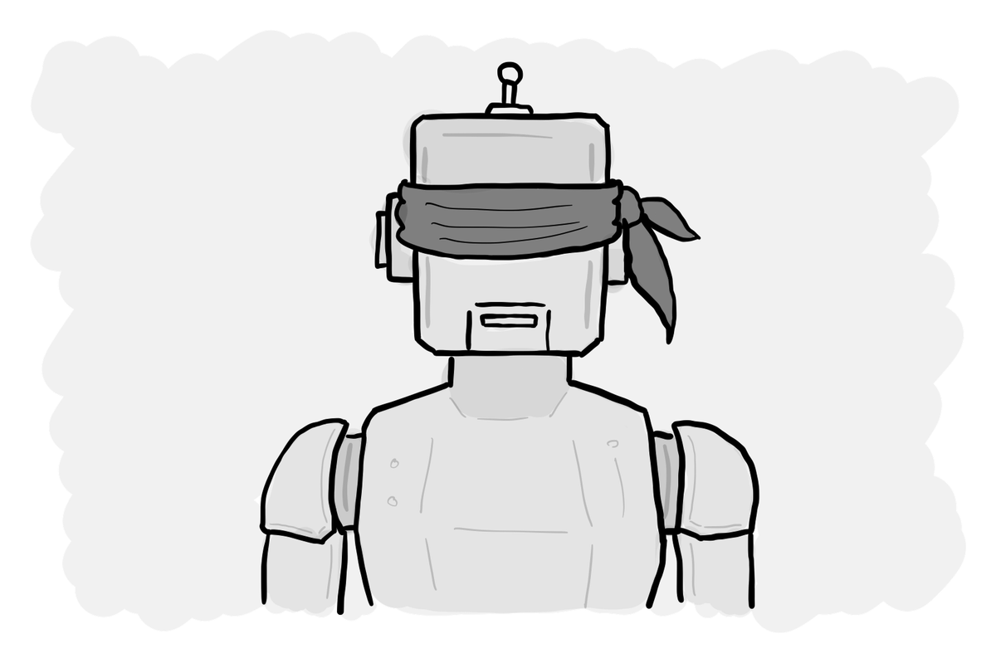
AI is bad at design

Slide 30
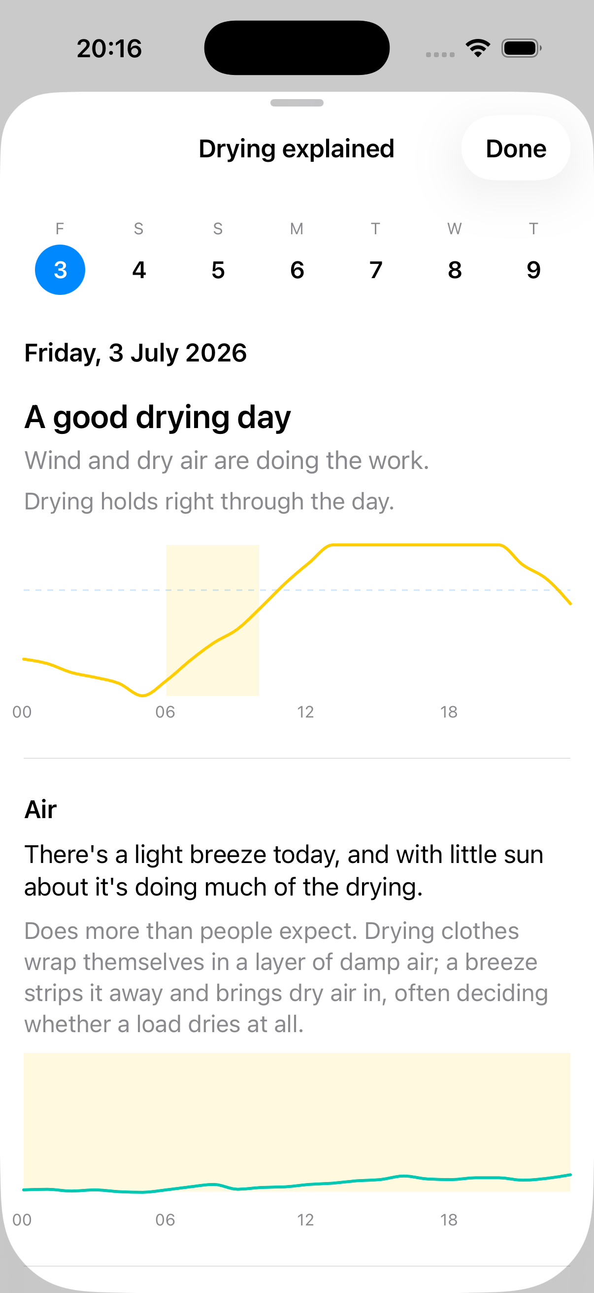
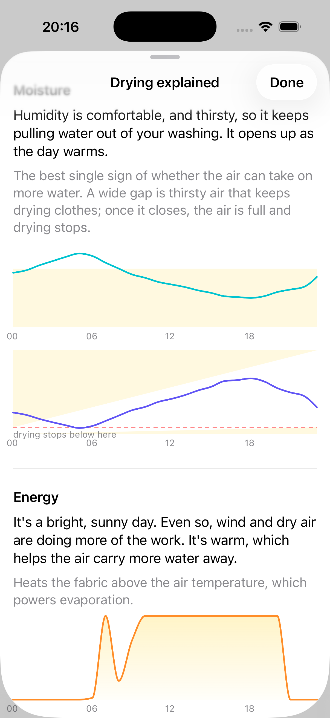
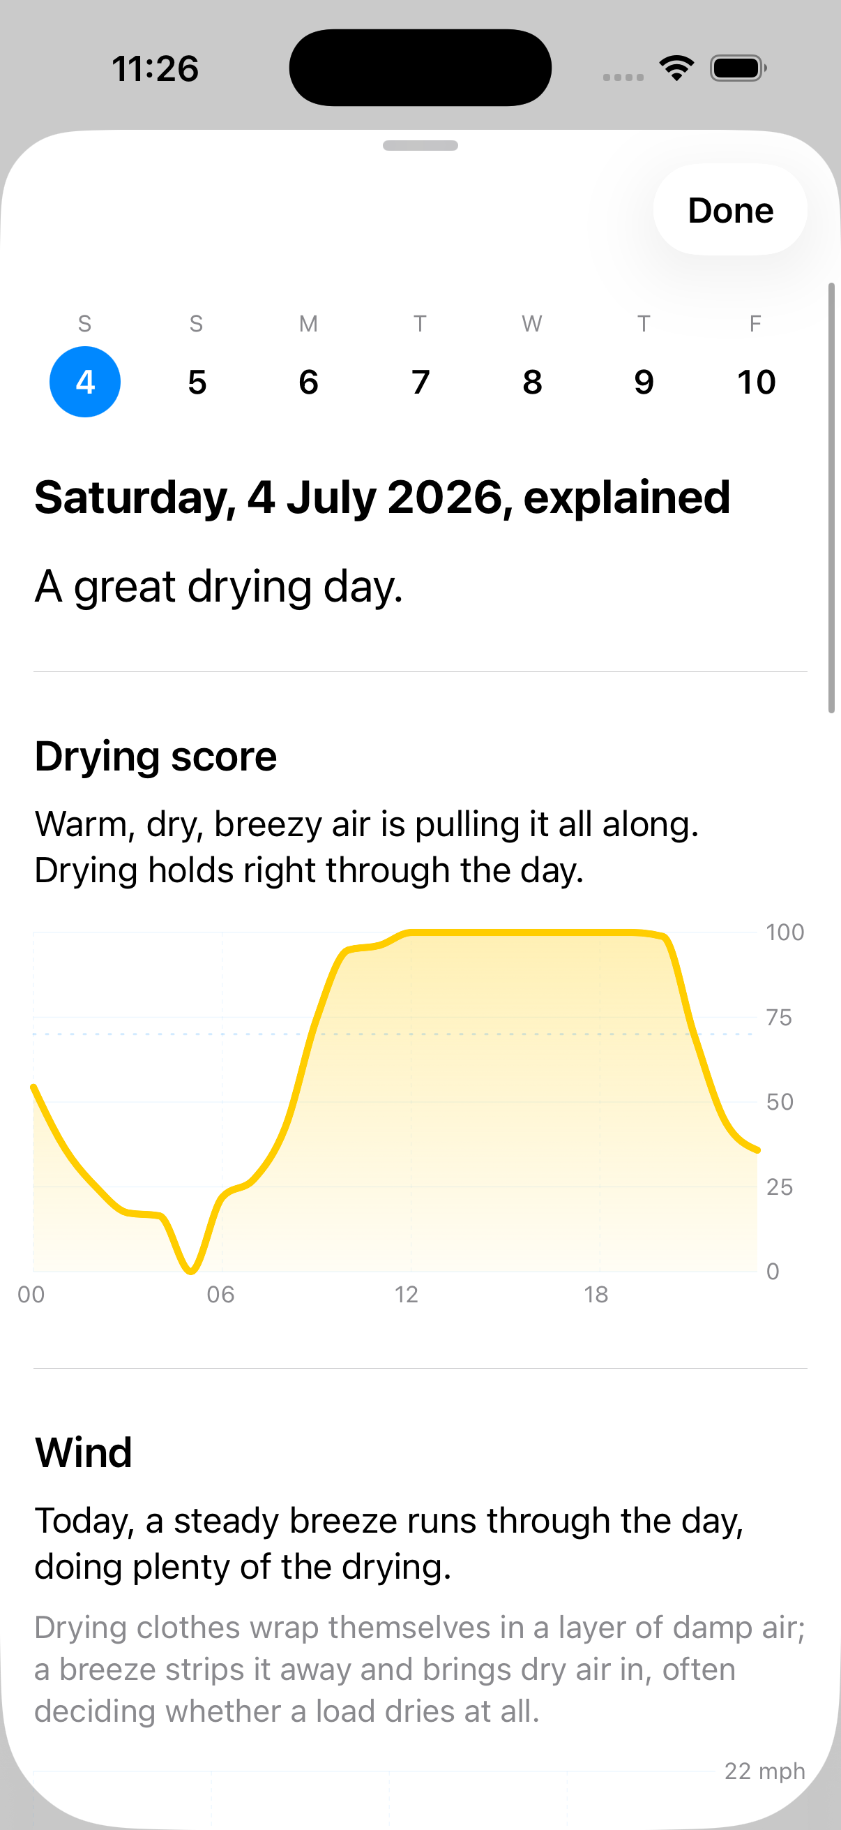
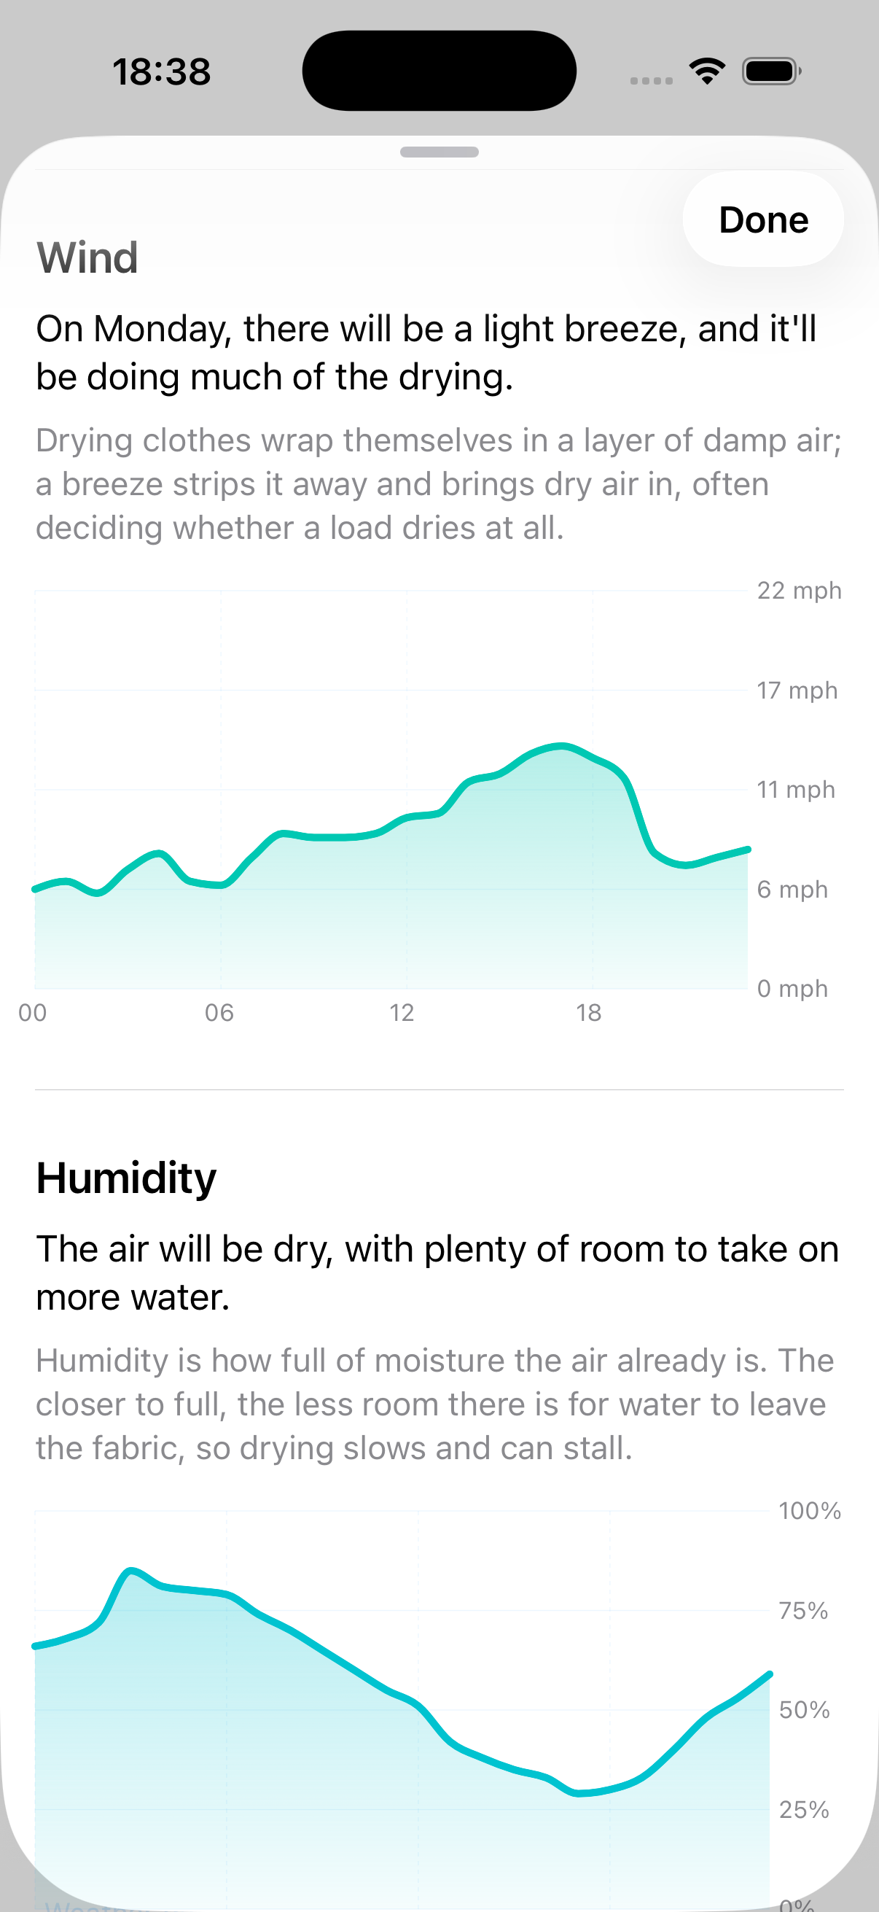
AI on its own
AI with your direction

Slide 31
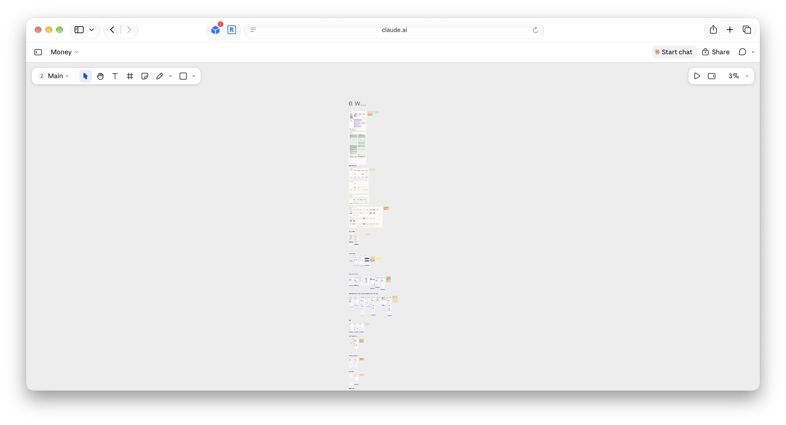
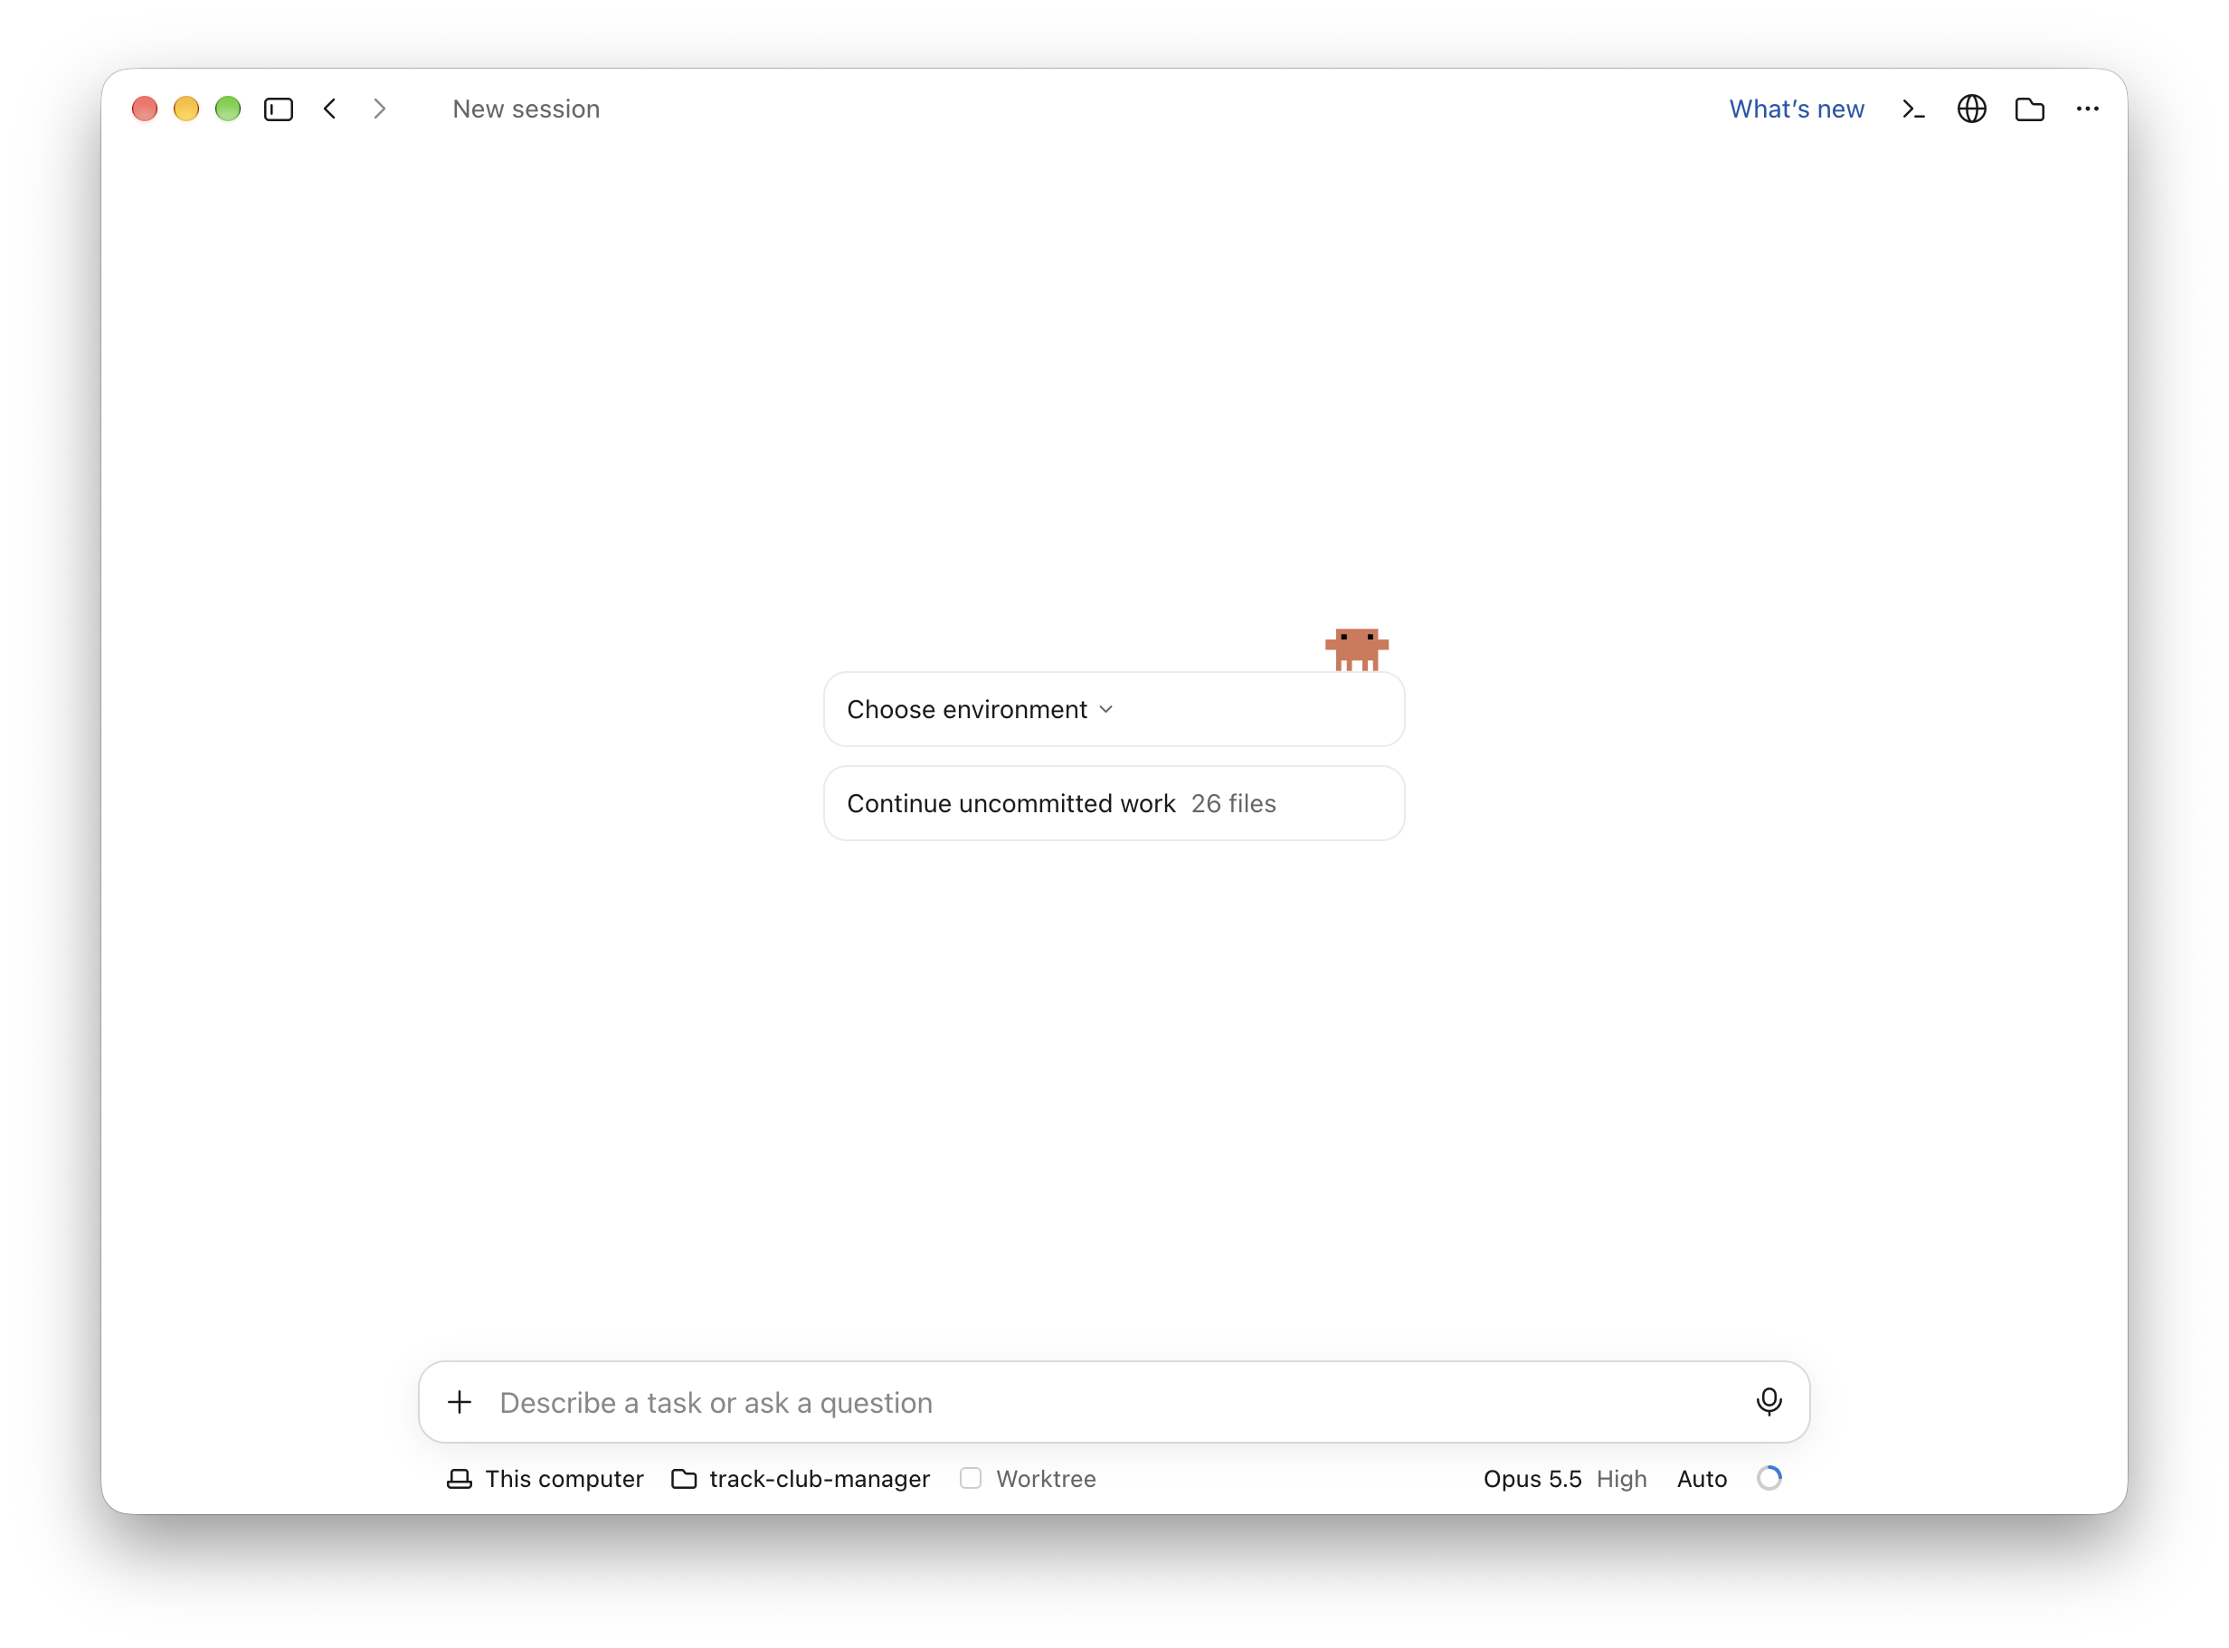
Working together on a canvas

Slide 32
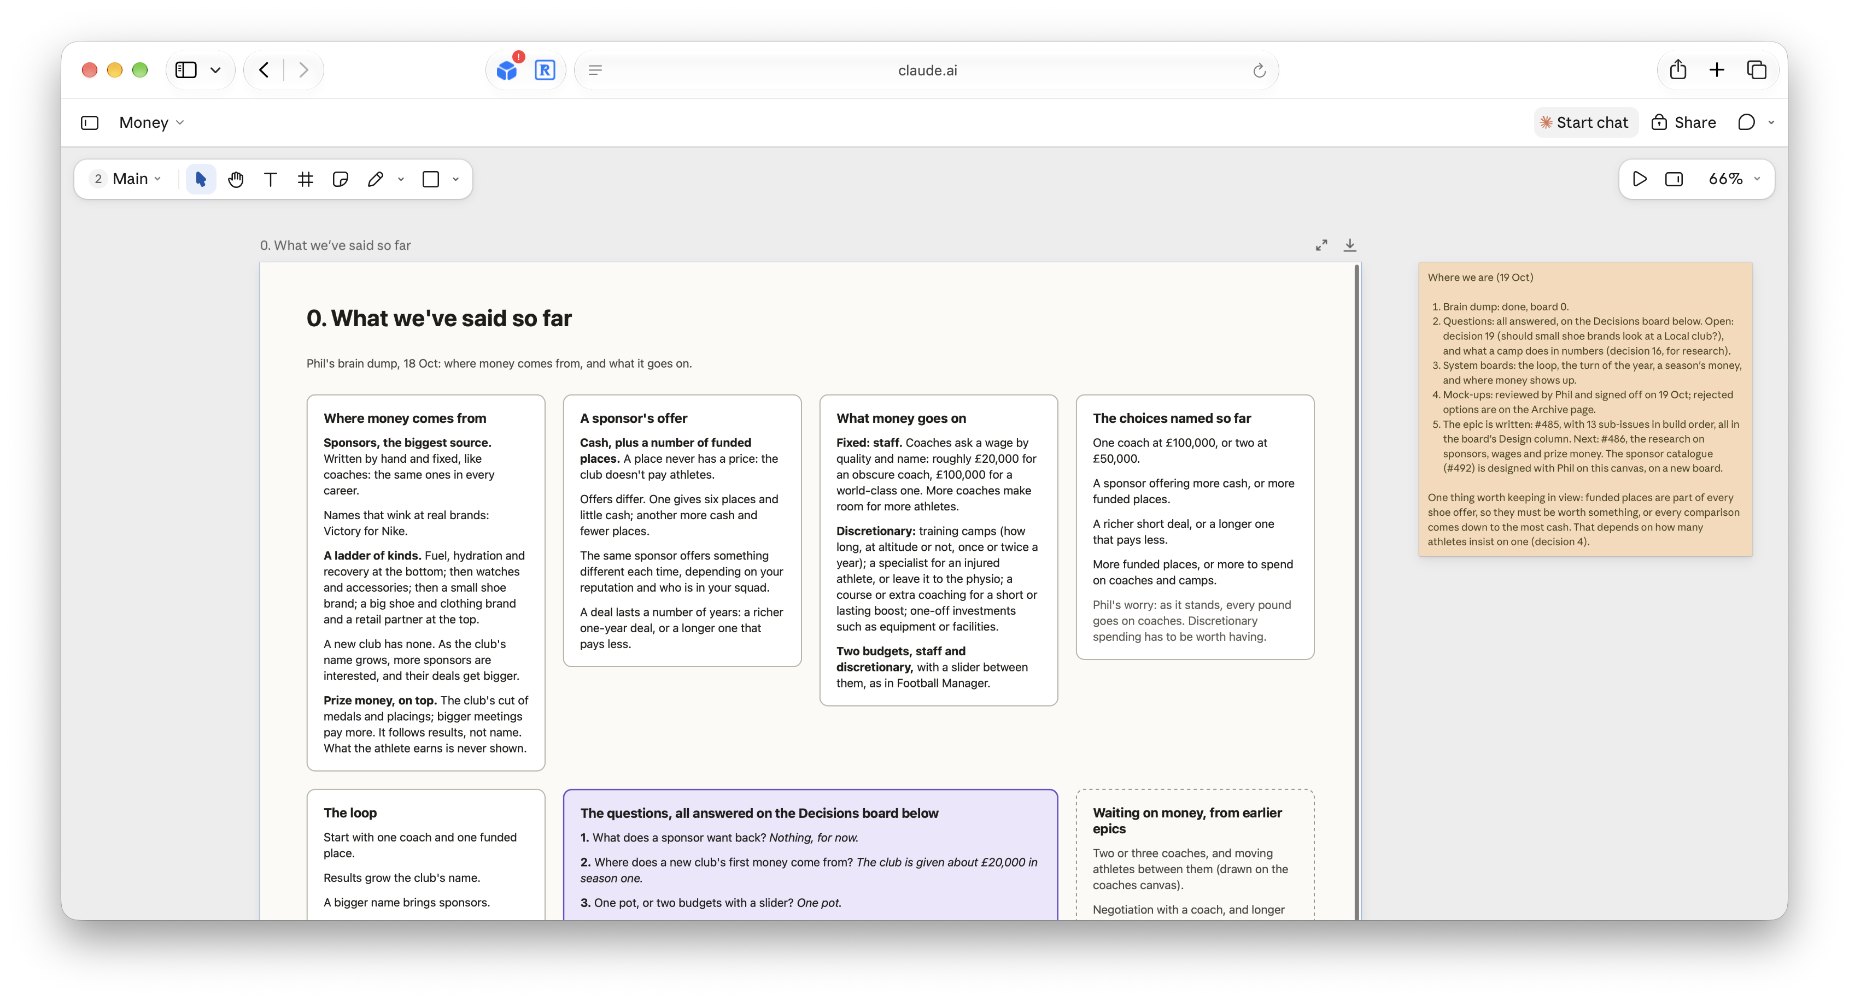
You design, AI assists

Slide 33
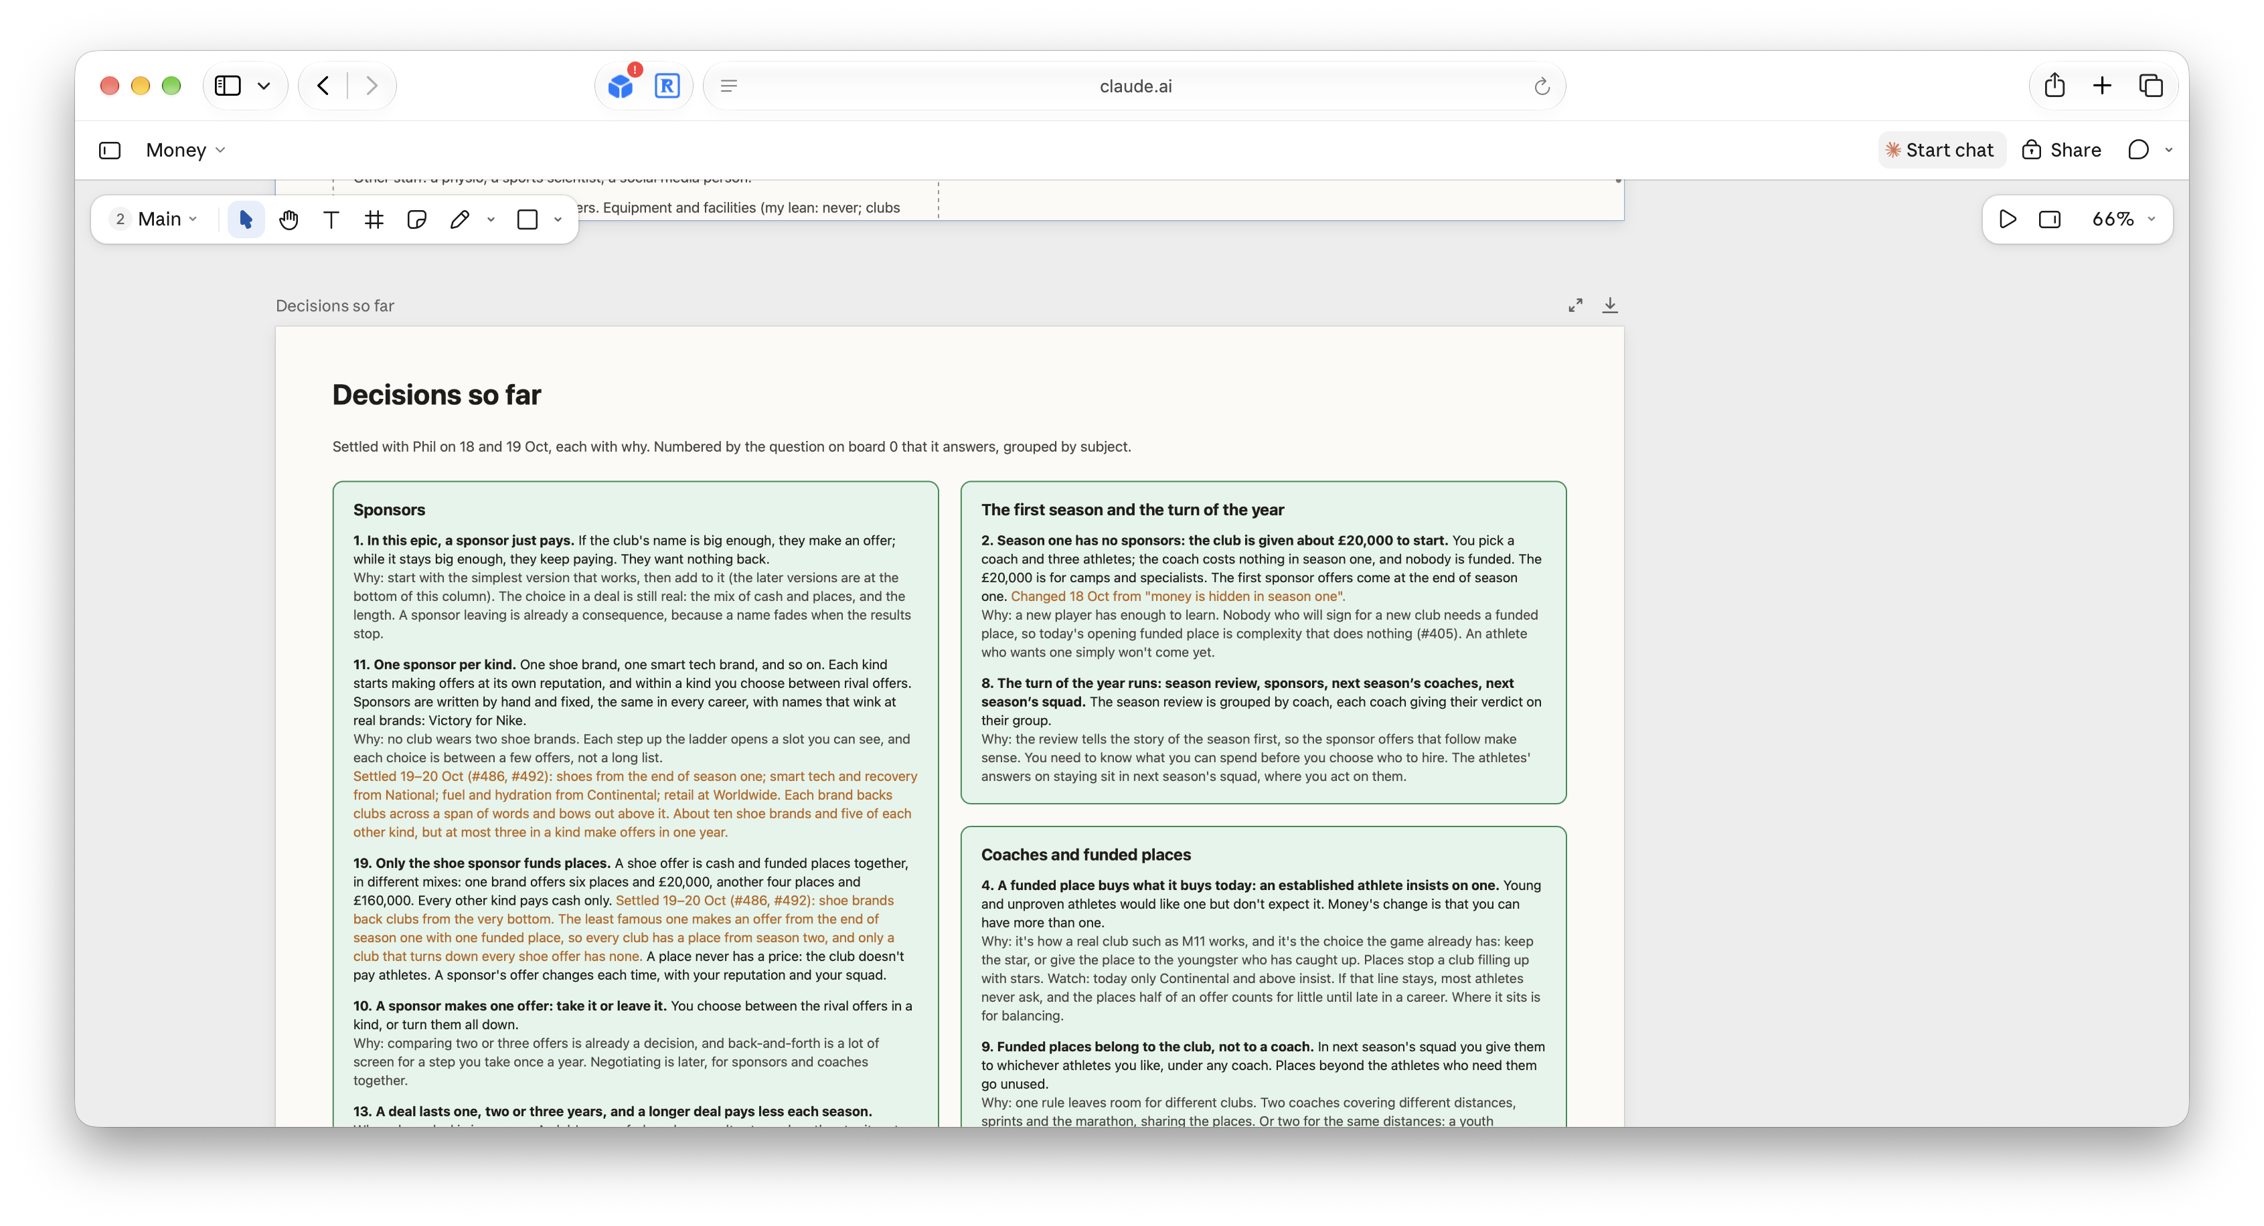
You design, AI assists

Slide 34
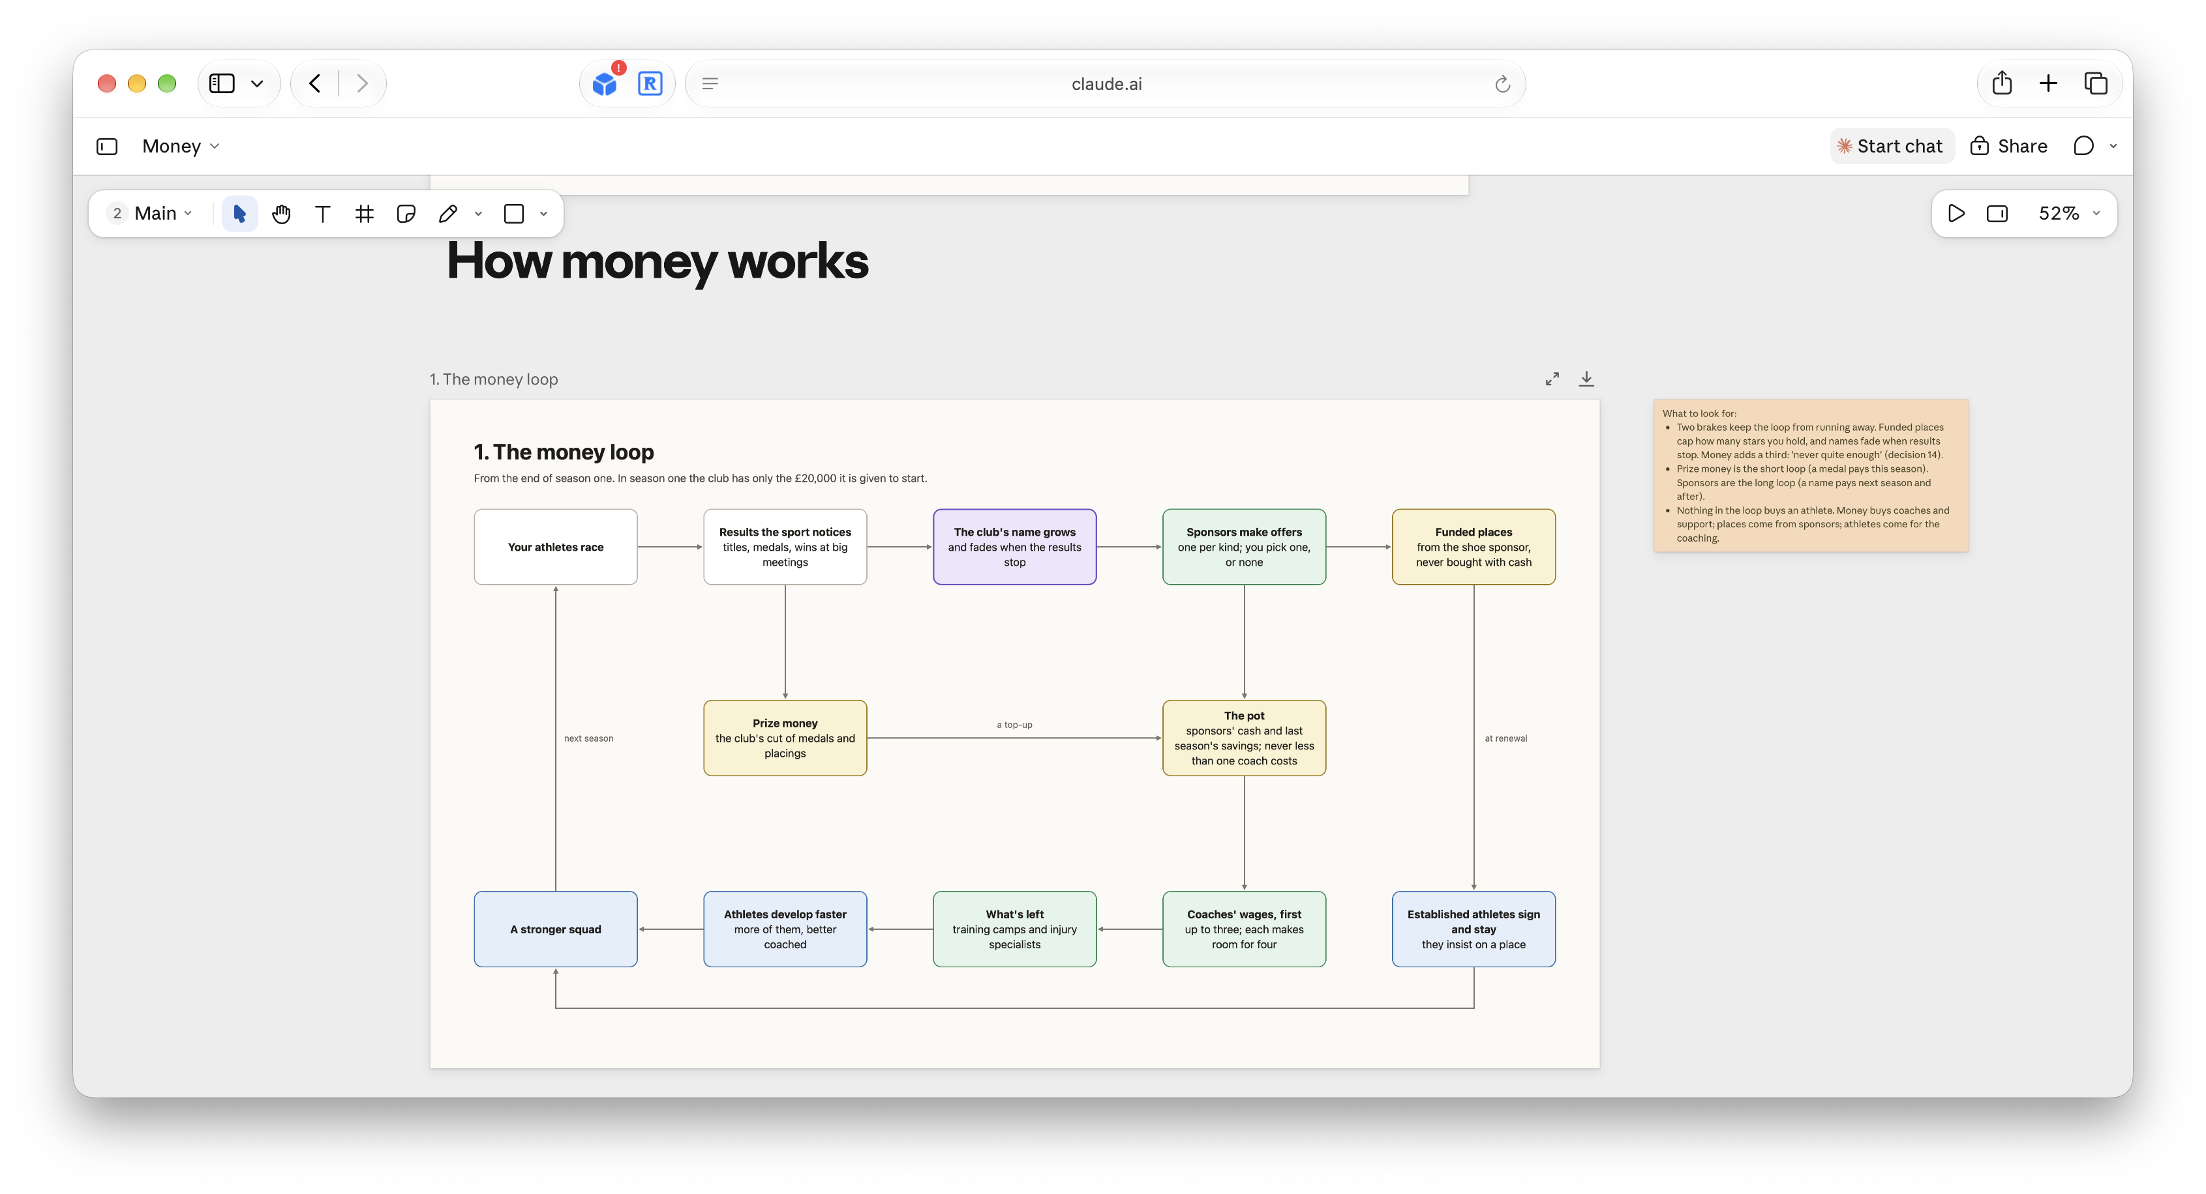
You design, AI assists

Slide 35
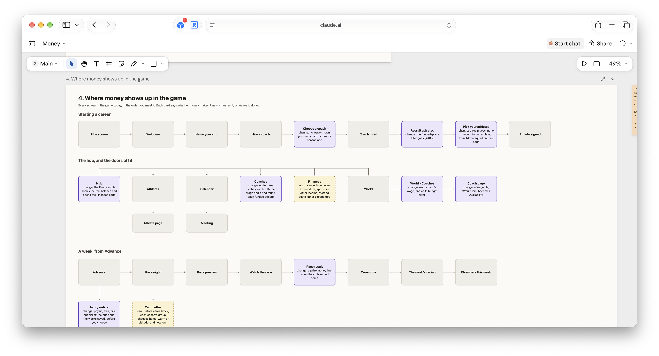
You design, AI assists

Slide 36
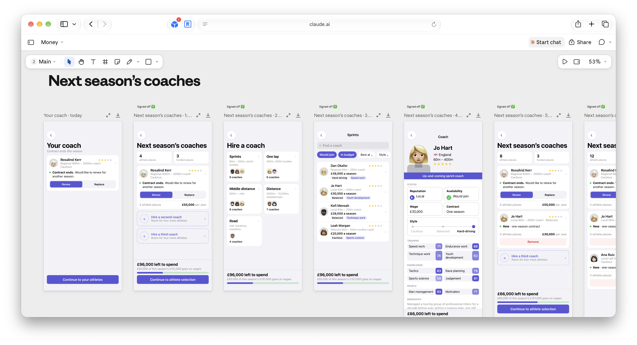
You design, AI assists

Slide 37
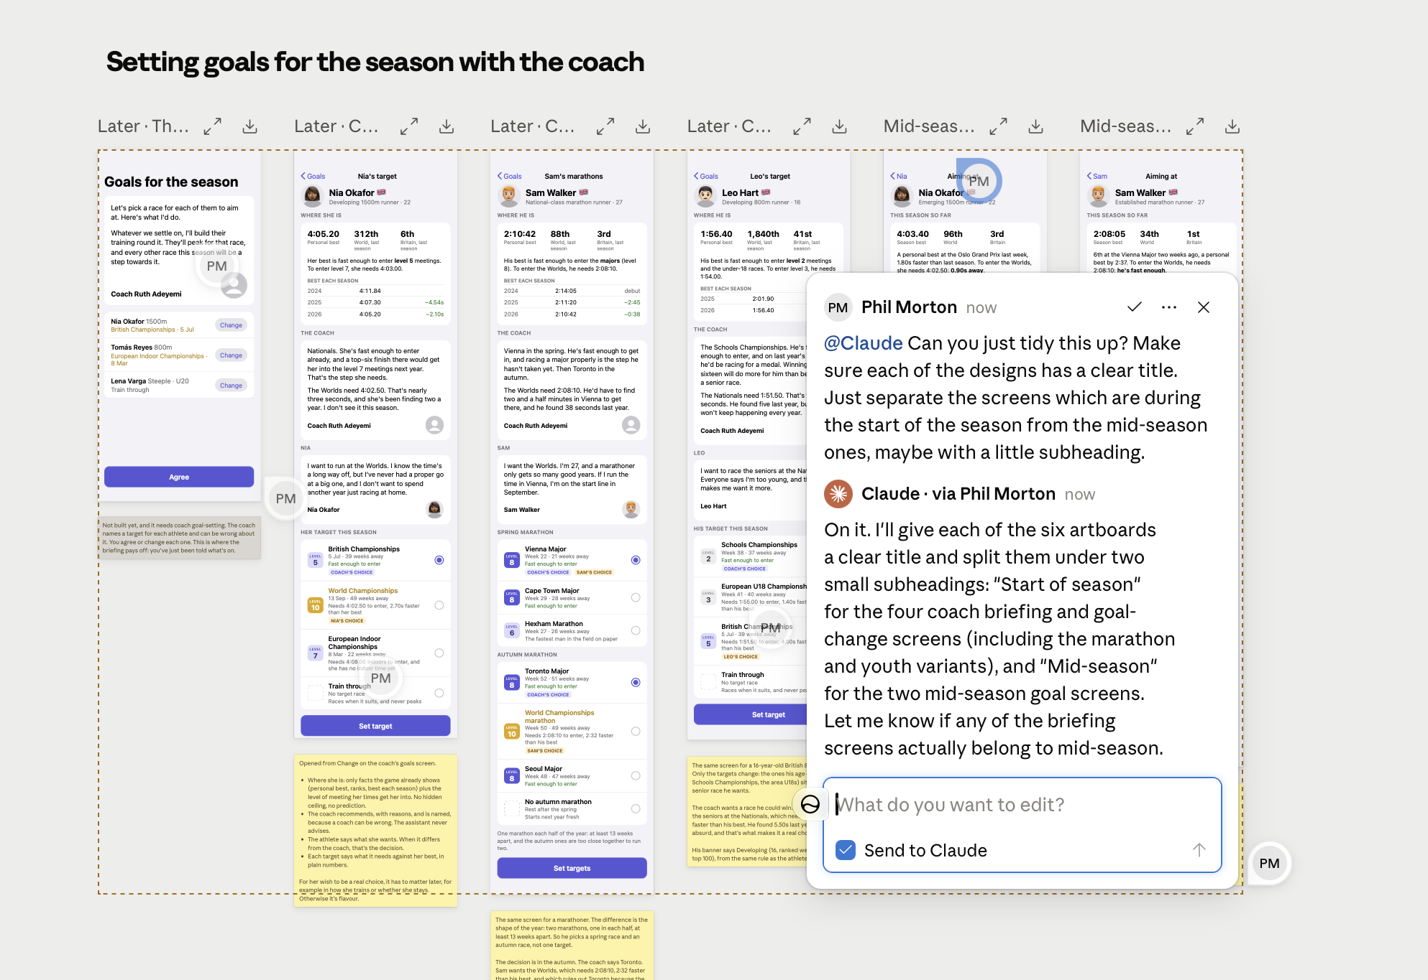
You design, AI assists

Slide 38
Five tips for designing and working in code with AI
You are the designer, AI is your assistant
Manage the work and the knowledge
Build your own design system in code as the source of truth
Design in the real product using jigs
Establish a repeatable workflow with skills

Slide 39
You need to manage your AI agent’s work
Notes:
Every time you start a new conversation, it’s forgotten everything (unless you give it context/knowledge)

Slide 40
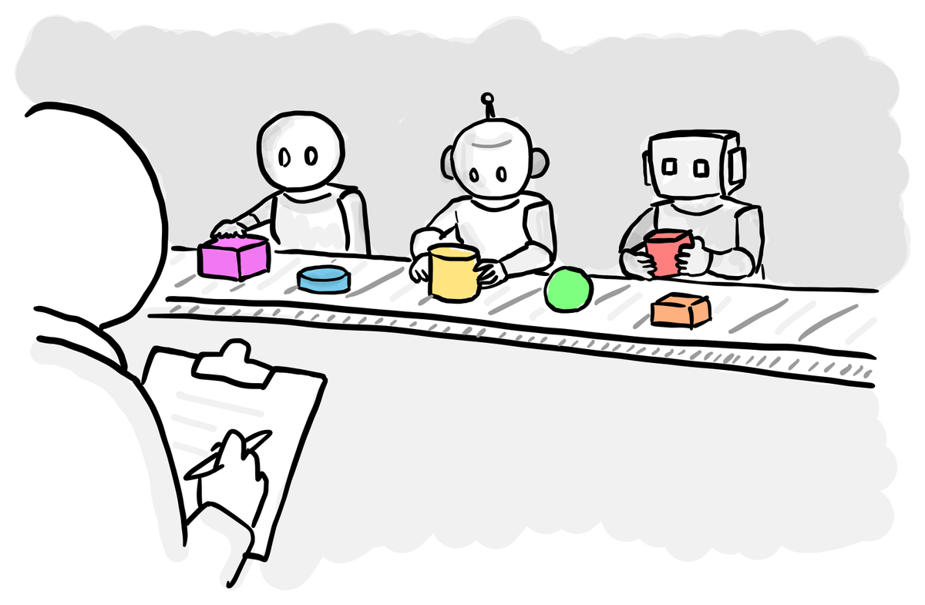
Break down work into little pieces

Slide 41
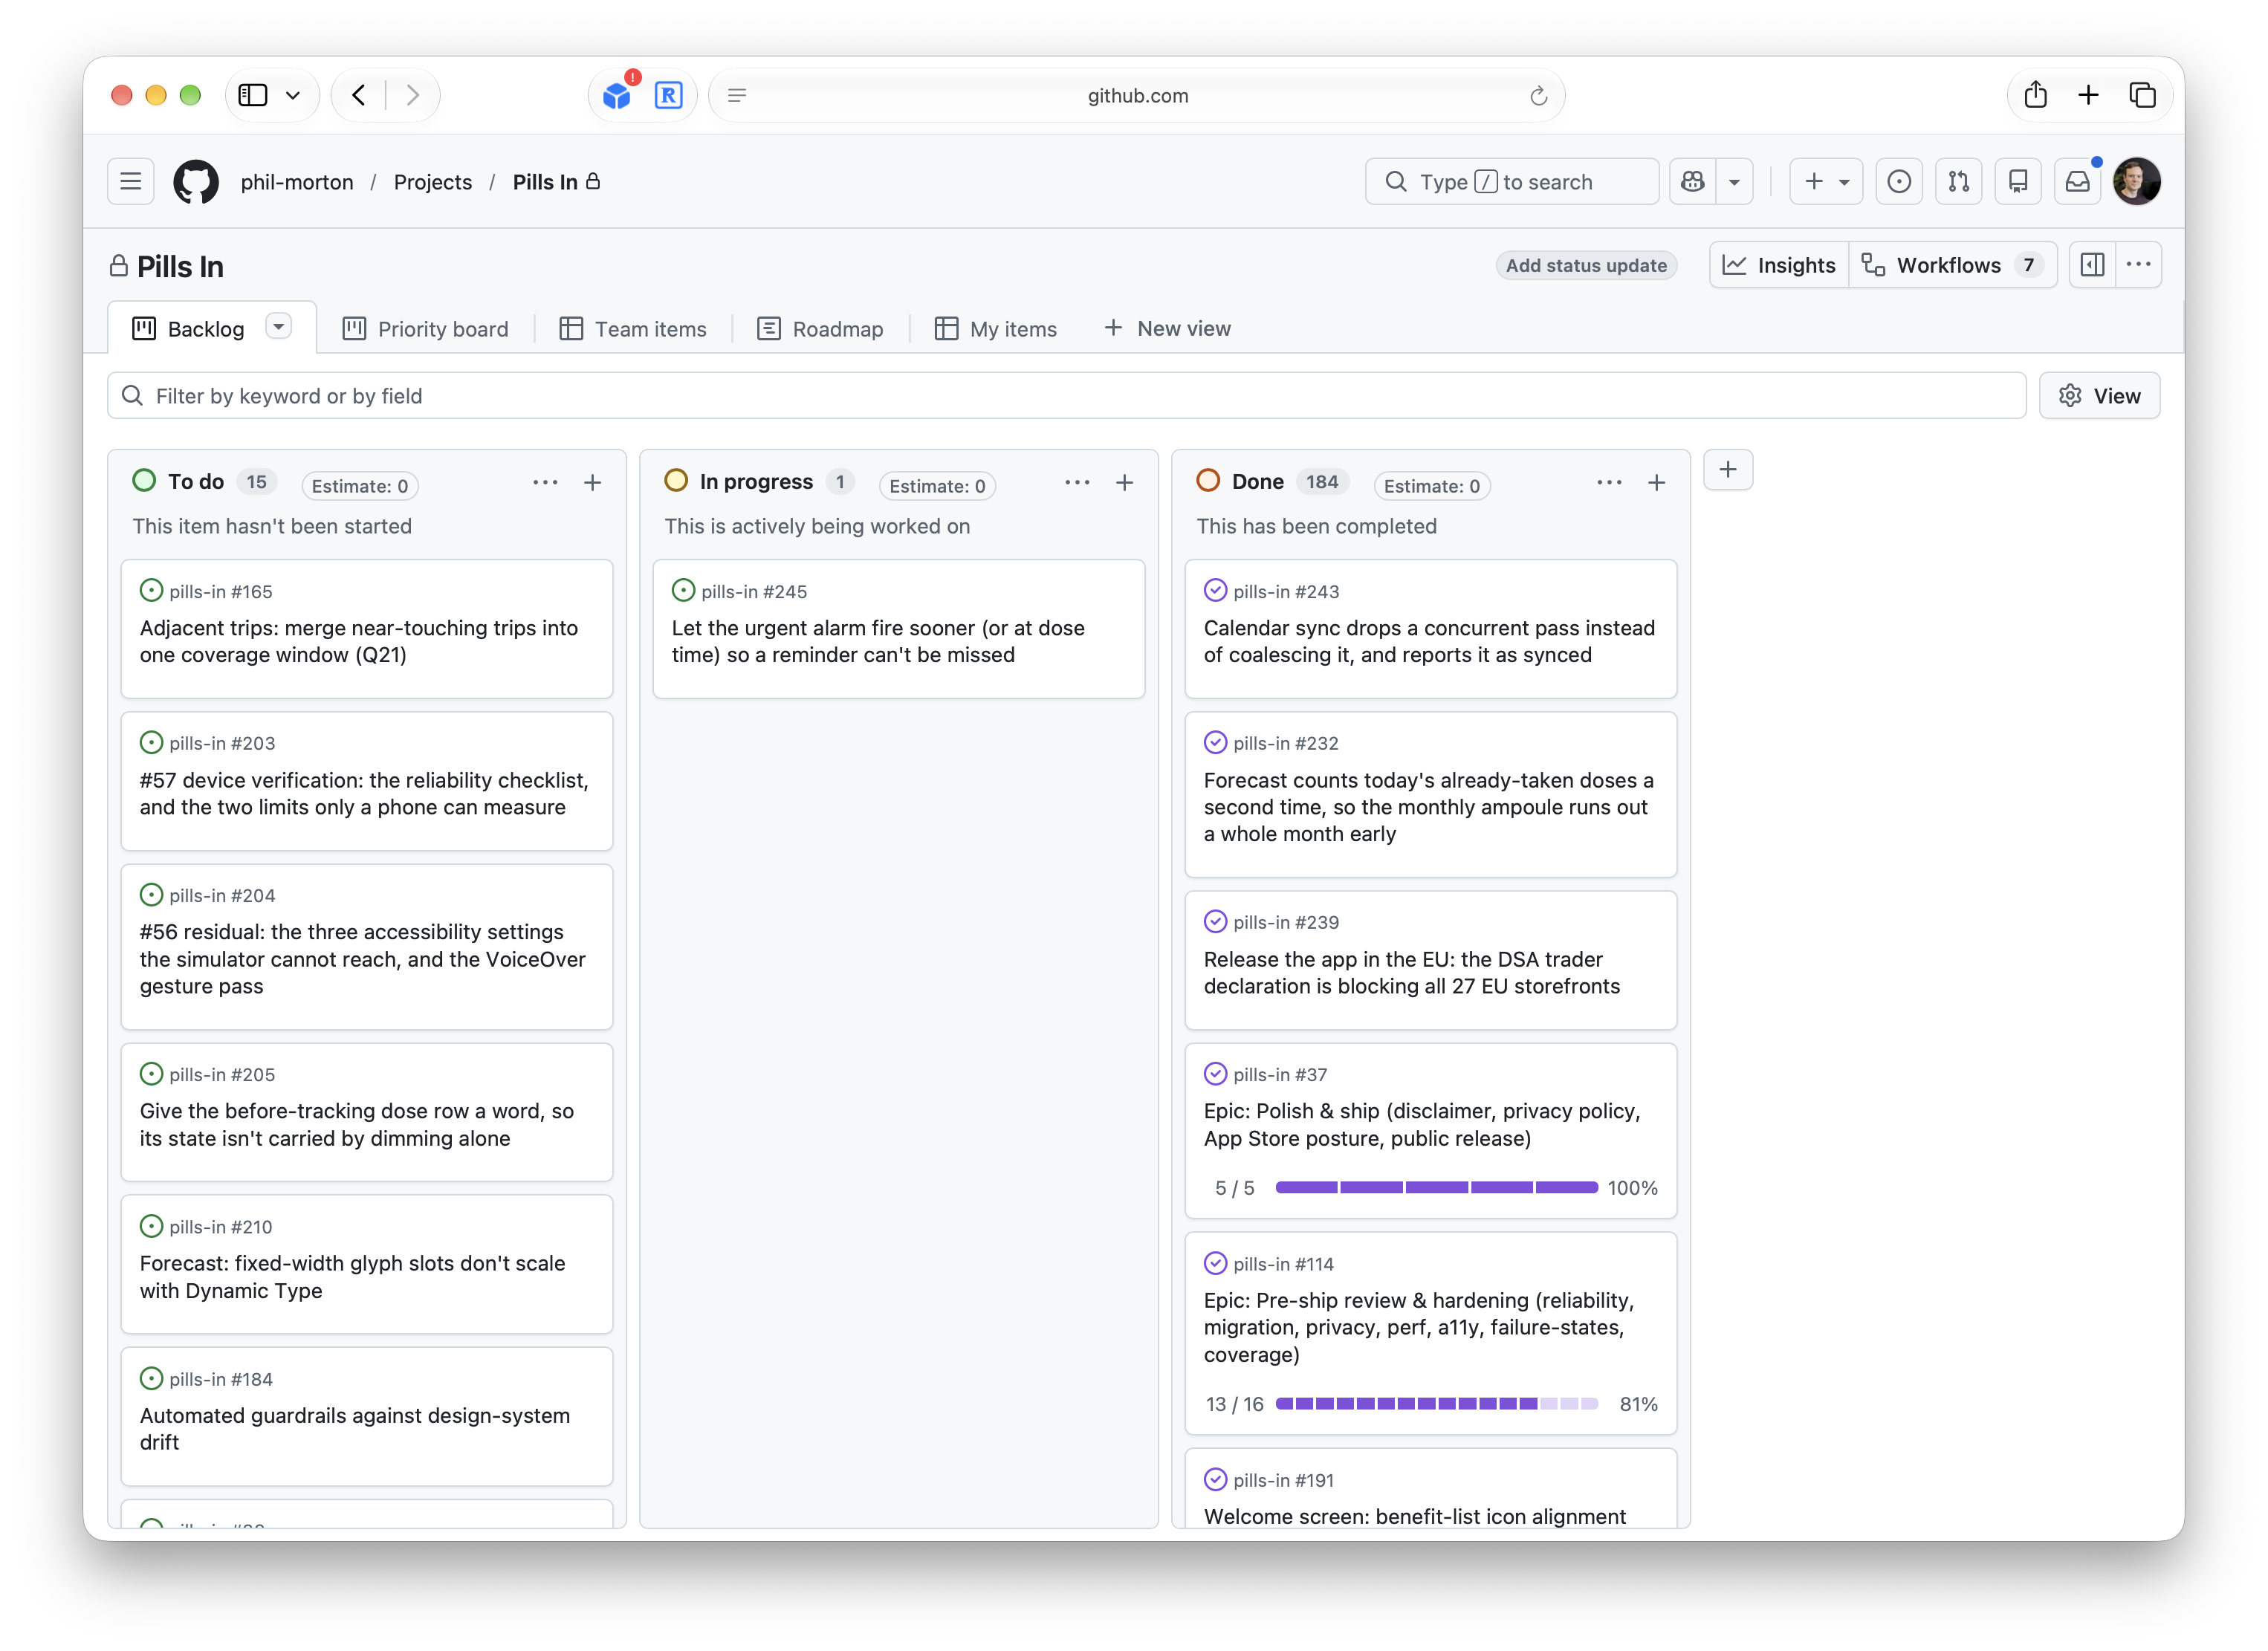
Managing the work using GitHub issues

Slide 42
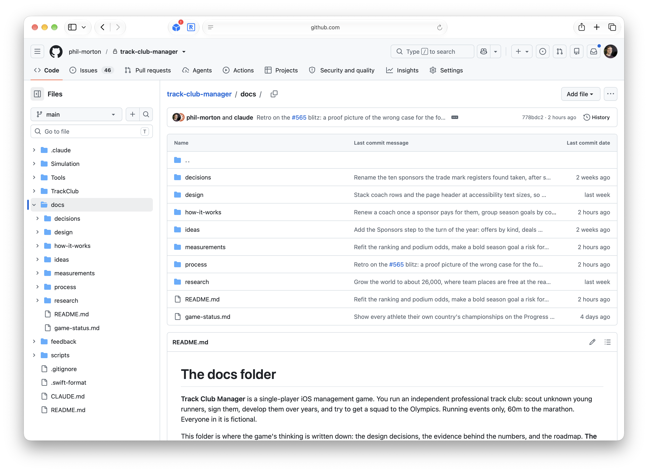
/docs – manage the knowledge

Slide 43
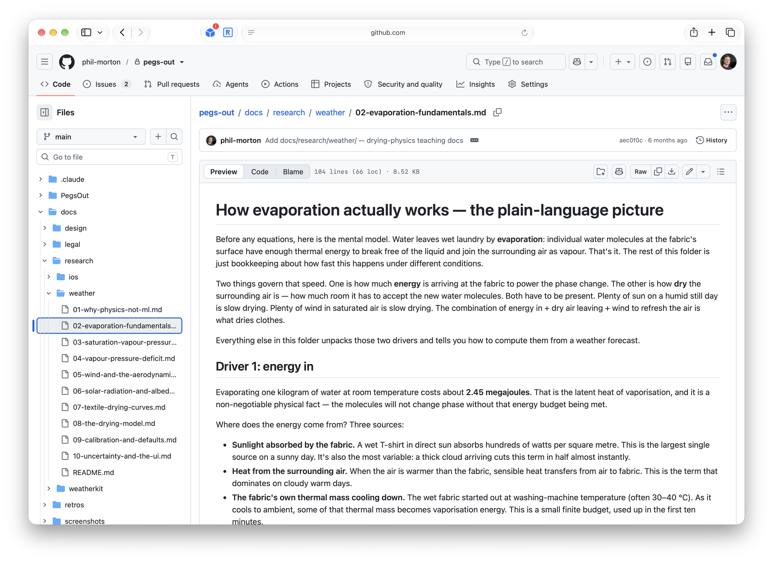
Research: your knowledge base

Slide 44
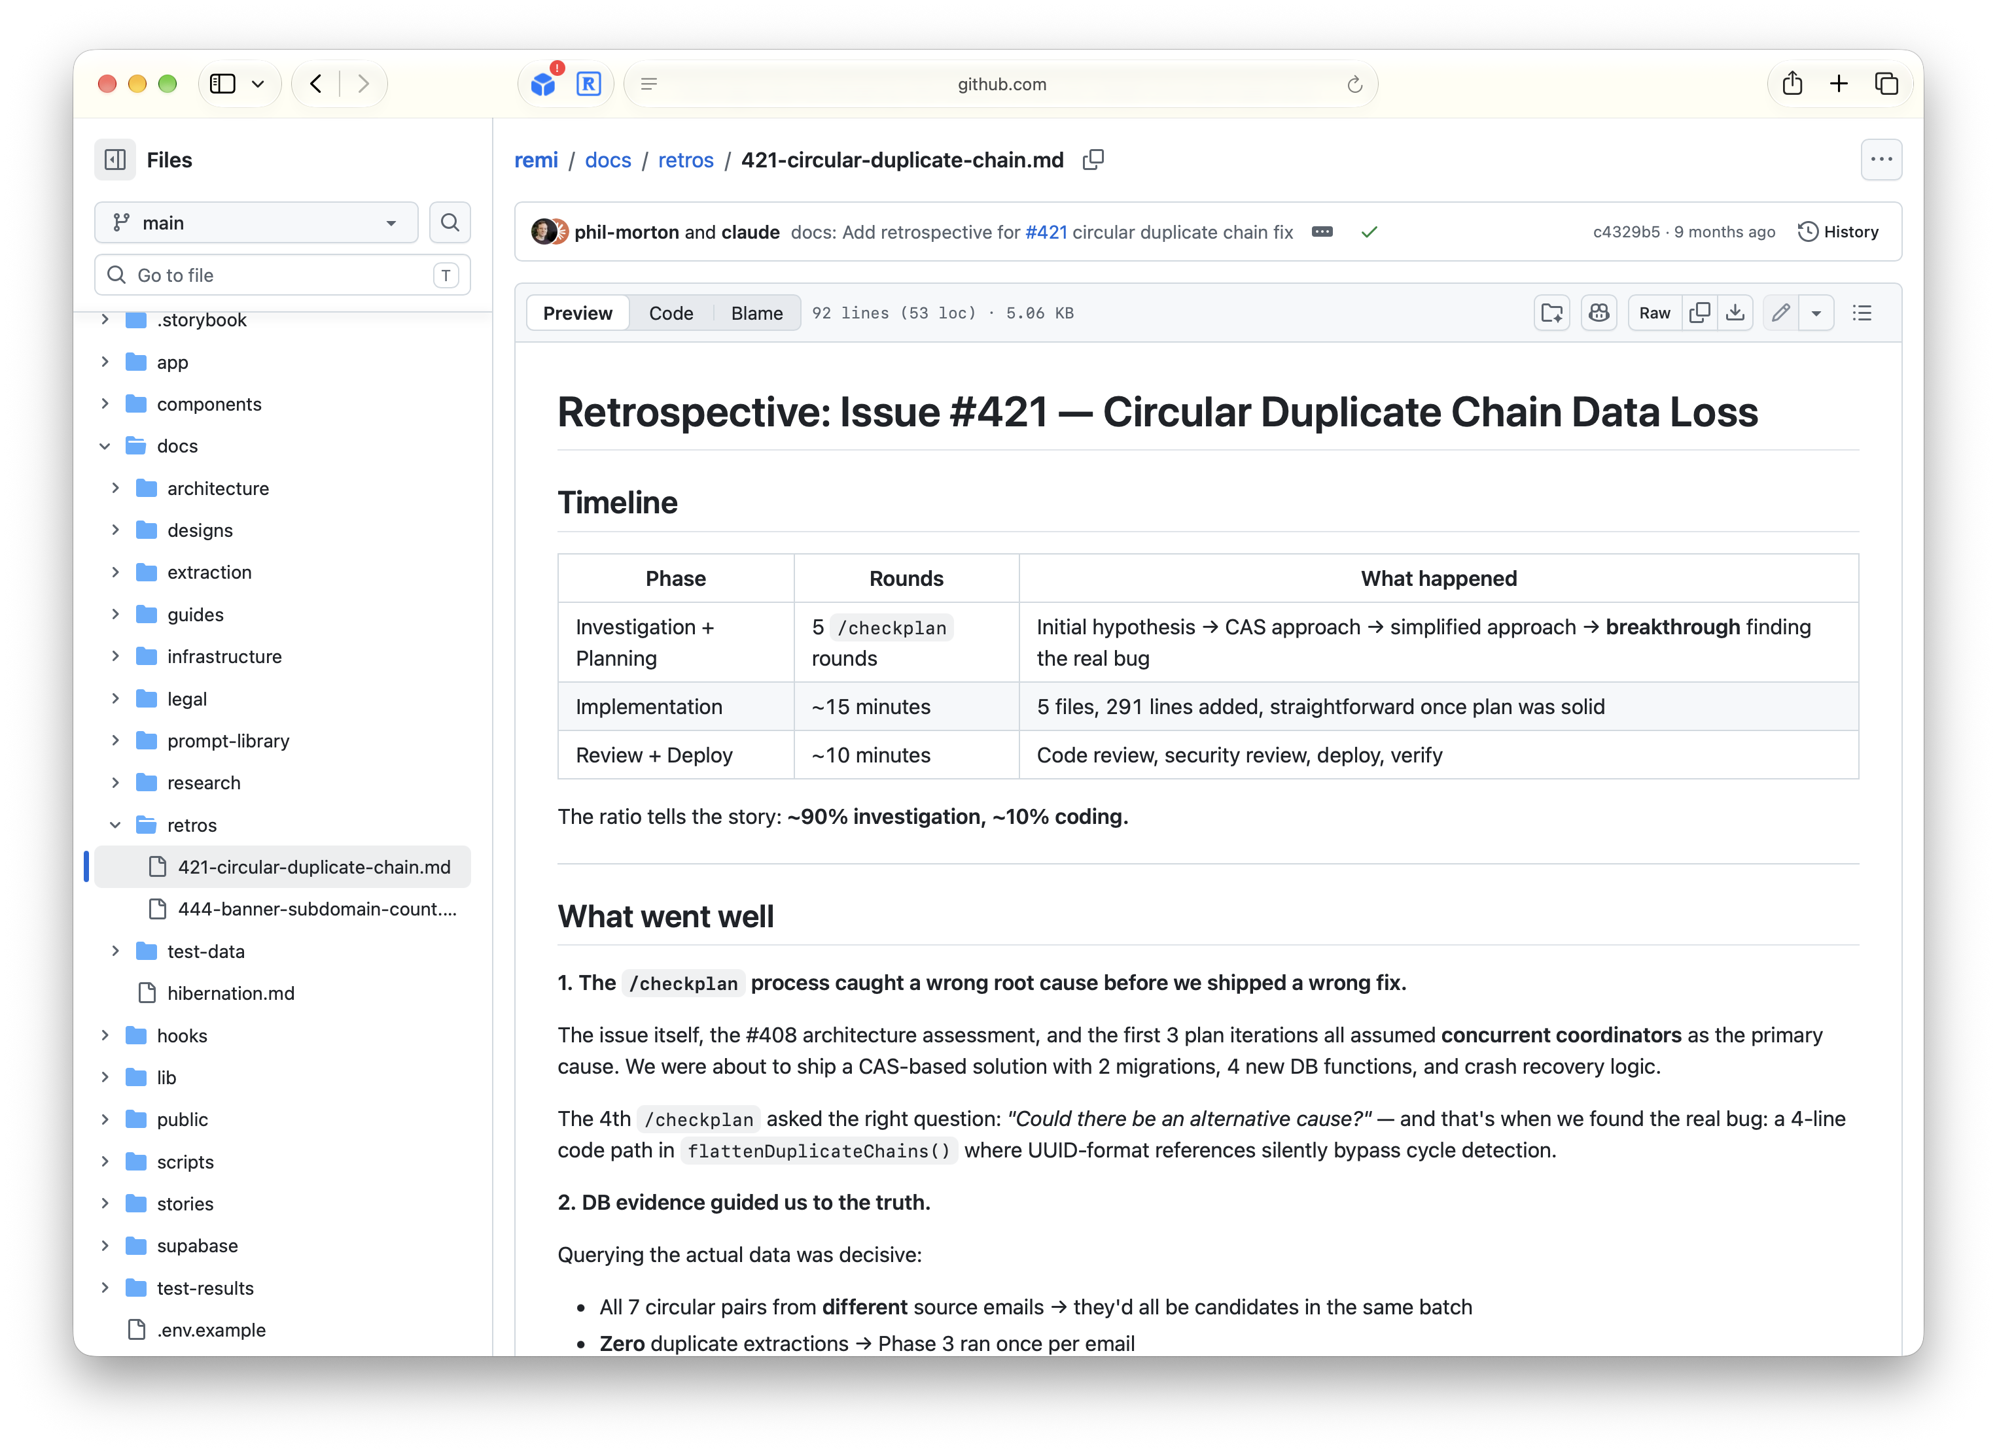
Retros: the agent learns from the work it does

Slide 45
Five tips for designing and working in code with AI
You are the designer, AI is your assistant
Manage the work and the knowledge
Build your own design system in code as the source of truth
Design in the real product using jigs
Establish a repeatable workflow with skills

Slide 46
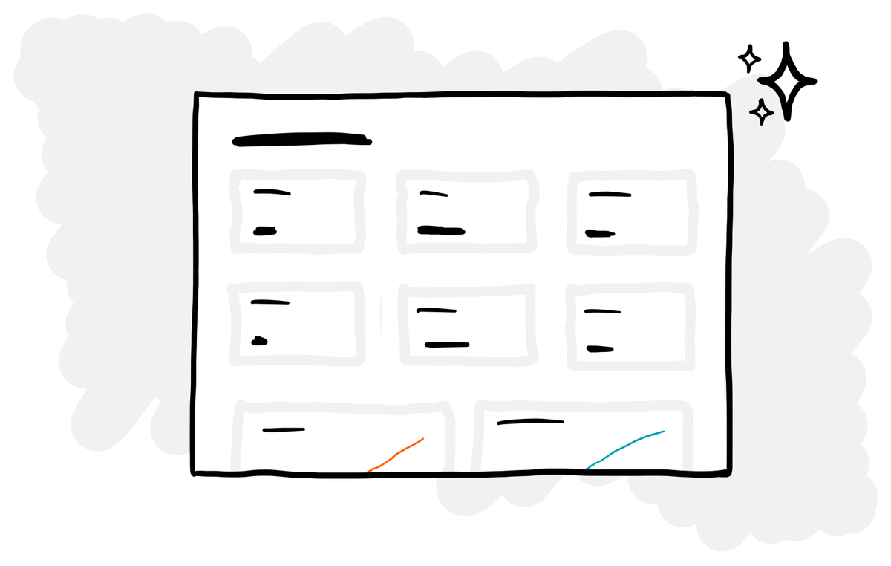
We all know the importance of a design system, and it’s easy to get your own in code

Slide 47
shadcn – coded design system in a box

Slide 48
shadcn – coded design system in a box

Slide 49
Storybook – see your coded design system

Slide 50
Storybook – see your coded design system

Slide 51
iOS apps – get AI to build your own in Swift UI

Slide 52
Five tips for designing and working in code with AI
You are the designer, AI is your assistant
Manage the work and the knowledge
Build your own design system in code as the source of truth
Design in the real product using jigs
Establish a repeatable workflow with skills

Slide 53
Using just enough Figma, and then designing the rest in code

Slide 54
Jigs

Slide 55
Five tips for designing and working in code with AI
You are the designer, AI is your assistant
Manage the work and the knowledge
Build your own design system in code as the source of truth
Design in the real product using jigs
Establish a repeatable workflow with skills

Slide 56
Software development is repeating the same process over and over again
Learn from it
Define the problem
Ship it
Explore options
Review it
Plan the build
Build it
Check the plan

Slide 57
Develop your own set of skills - stop repeating yourself and embed what works
“Can you double check the work that you’ve just done and make sure you haven’t missed anything?”
/codereview

Slide 58
Develop your own set of skills - stop repeating yourself and embed what works
/mockup
/retro
/plan
/finish
/checkplan
/codereview

Slide 59
Five tips for designing and working in code with AI
You are the designer, AI is your assistant
Manage the work and the knowledge
Build your own design system in code as the source of truth
Design in the real product using jigs
Establish a repeatable workflow with skills

Slide 60
How we ended up on Figma Island
Designers can work in code again
A side project is the best way to learn
Five tips for working in code with AI
Closing thoughts

Slide 61
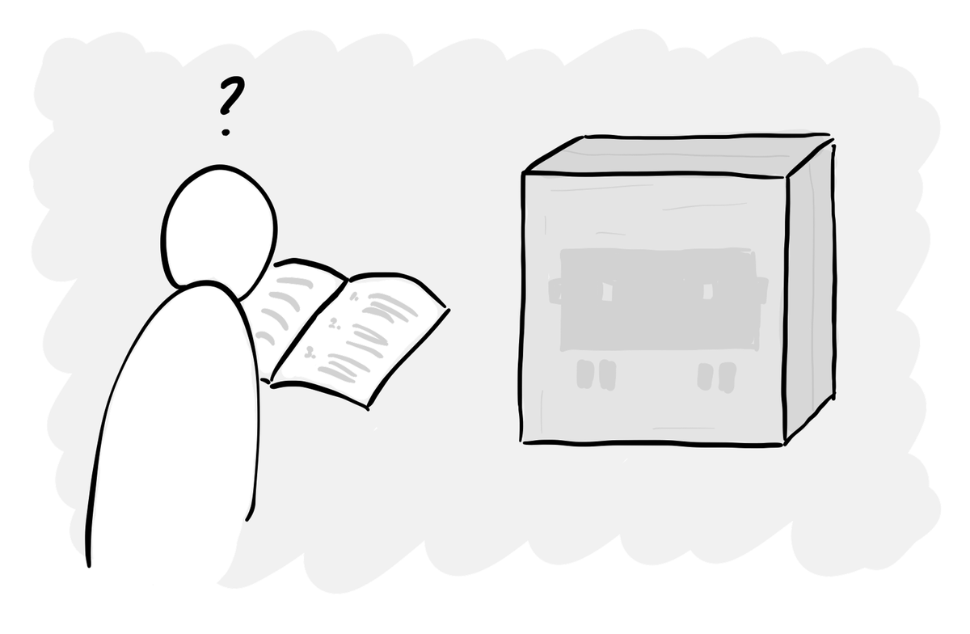
This can be overwhelming…

Slide 62
AI is the personal tutor and the safety net

Slide 63
Most people are still watching from the sidelines

Slide 64
No-one has it figured out yet

Slide 65
But we know current tools, methods and skills will need to change

Slide 66
Make progress despite the uncertainty, one step at a time

Slide 68
Thank you.
subscribe to my newsletter!
Phil Morton
foolproof.co.uk
philmorton.co

