Slide 1
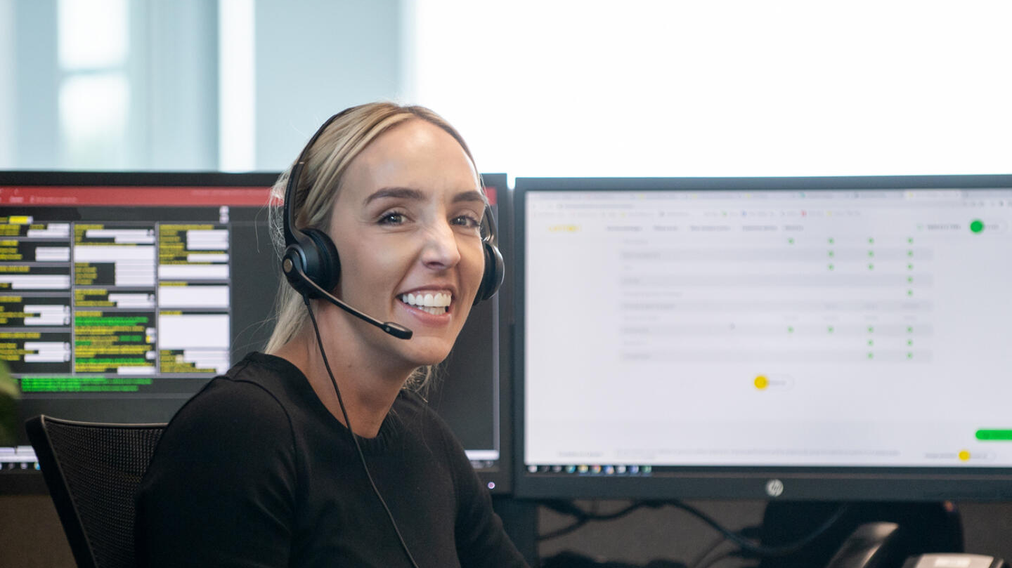

Beyond the Interface: Why Behaviour Is Your Biggest UX Problem
Pat Jordan

Slide 2
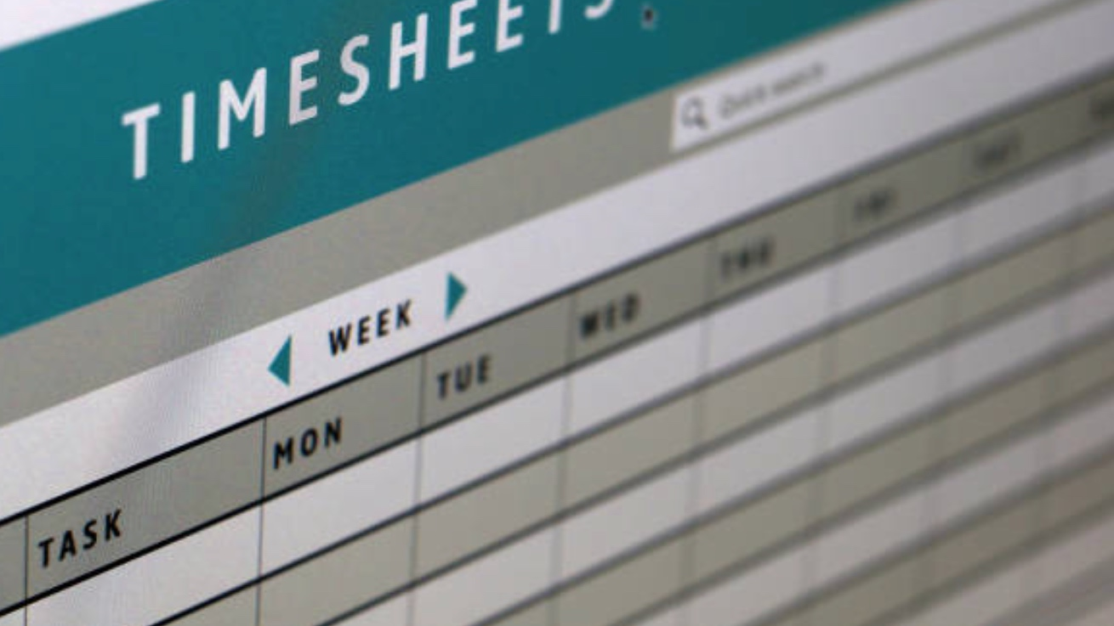

Slide 3
Contents
Building blocks of user experience
Impact of behaviour on UX
Behaviours affecting UX
  High Performance
  Advocate for the User
  Anticipate Behaviours
  Think Differently

Slide 4
Building blocks of user experience
Functional attributes. What the product or service does, how well it is made
Aesthetic attributes. The look and feel of a product or service
Interface. The design of the user interface, ease and enjoyment of use
Marketing. The messages and channels used to market the product or service
Brand. The brand image associated with the product and service
Price Point. How much the product or service costs
Behaviour. The behaviour of the employees of product and service suppliers

Slide 5
Impact of Behaviour on UX
Employees’ behaviour has huge impact on user experience
Can negate or enhance other UX efforts
Improvements can be made at low cost

Slide 6
Behaviours Affecting UX

Slide 7
High Performance

Slide 8
Responsiveness
Noticing and rapidly responding to users’ needs
Being proactive in anticipating problems and finding solutions
Exceeding expectations

Slide 9


Slide 10
Flipping (Inverse Benchmarking)
Observe what competitors do badly
Resolve to do these things well
Design behaviours accordingly

Slide 12
Thoroughness
It can be important that the person in the system carries out their assigned role thoroughly
Missing steps can have significant consequences
Tools and protocols can enable this

Slide 13


Slide 14
Advocate for the User

Slide 15
Fight for (not Against) the User
Encourage employees to put themselves in the user’s mindset
Make sure that they are happy with the resolution
Understand the potential consequences

Slide 16


Slide 17
Show Goodwill
Assume users are honest
Respond proportionately to user errors
Find a fair and simple way forward

Slide 18
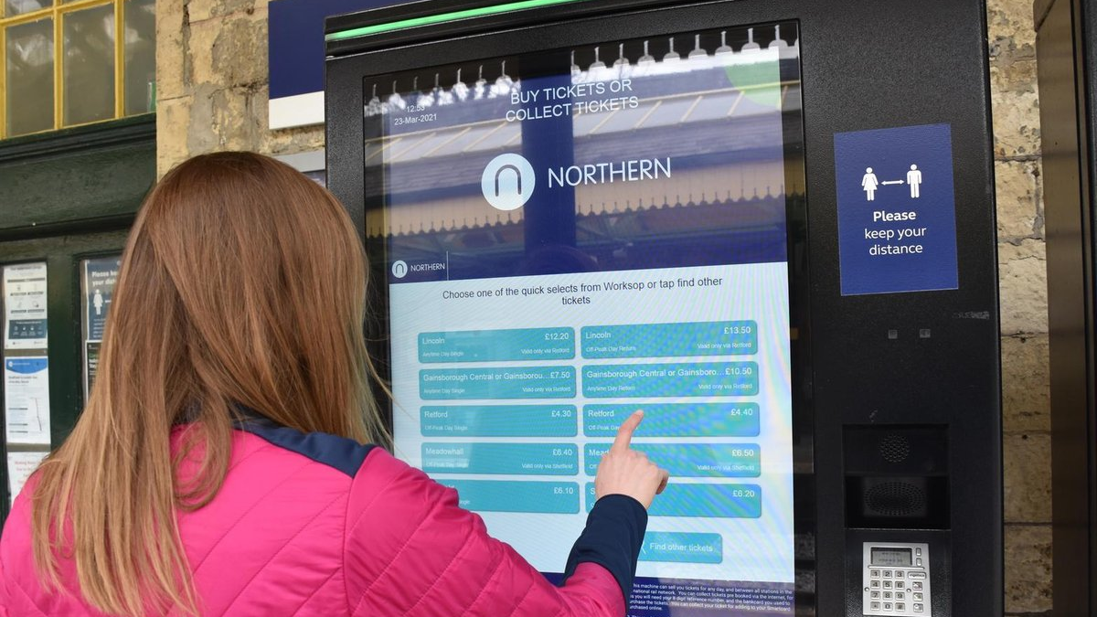

Slide 19
Act with Integrity
Be open about system drawbacks
Listen to users’ concerns
Address them in a timely way

Slide 20
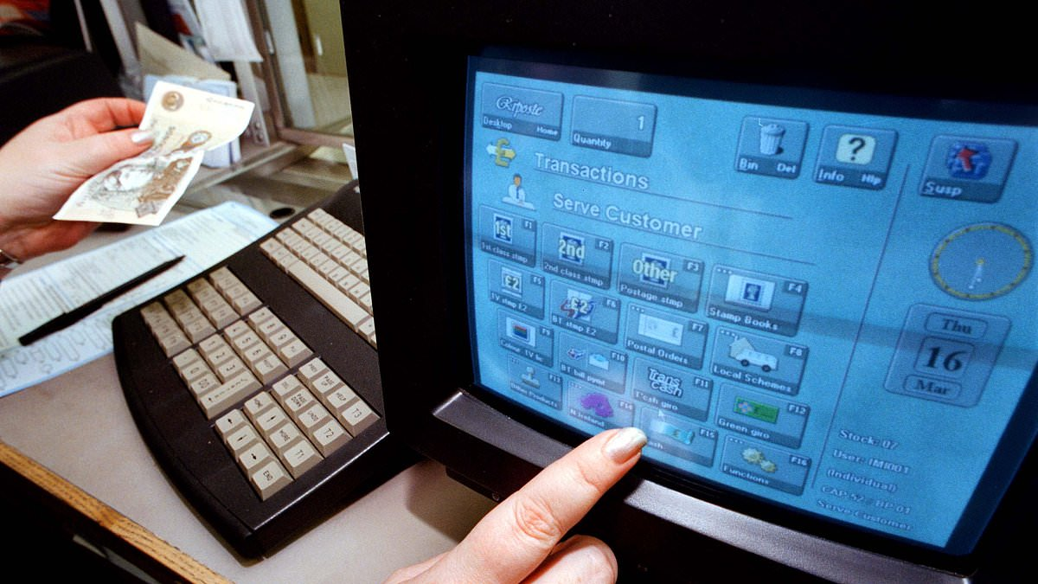

Slide 21
Anticipate Behaviours

Slide 22
Professional Norms
Often behavioural issues are hiding in plain sight
These can cause the system in which they are embedded to break down severely
Mitigating these can have enormous benefits

Slide 23


Slide 24
Cultural Norms
The culture and customs of a culture influence human-human interaction
These may have unintended consequences
Don’t assume what works in one culture works in another

Slide 25


Slide 26
Systemic Incentives
System-driven behaviour can influence user experience
Can be driven by measures or metrics
Unintended consequences of delivering other benefits

Slide 27
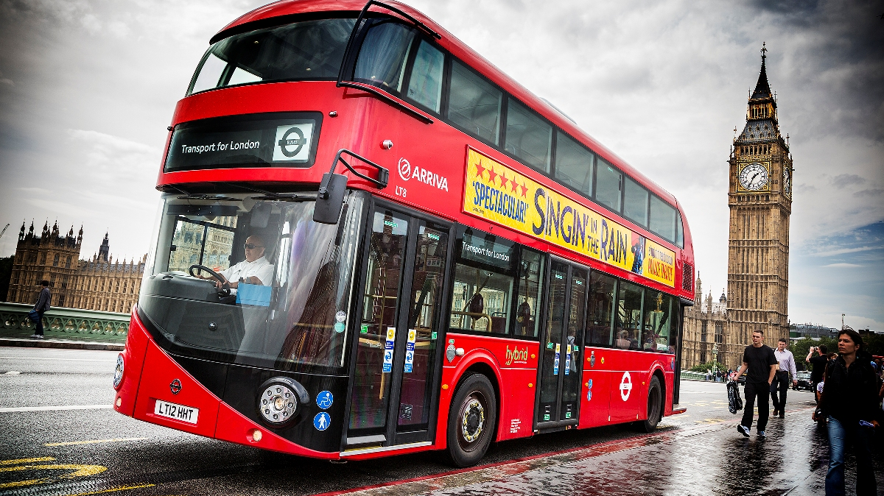

Slide 28
Think Differently

Slide 29
Reframing
Casting something “negative” in a positive light
Pointing out the benefits
Creating a new narrative

Slide 30


Slide 31
Creating (Good) Drama
Memorable moments
Behaving out of the ordinary (in a good way)
Creating a story

Slide 32
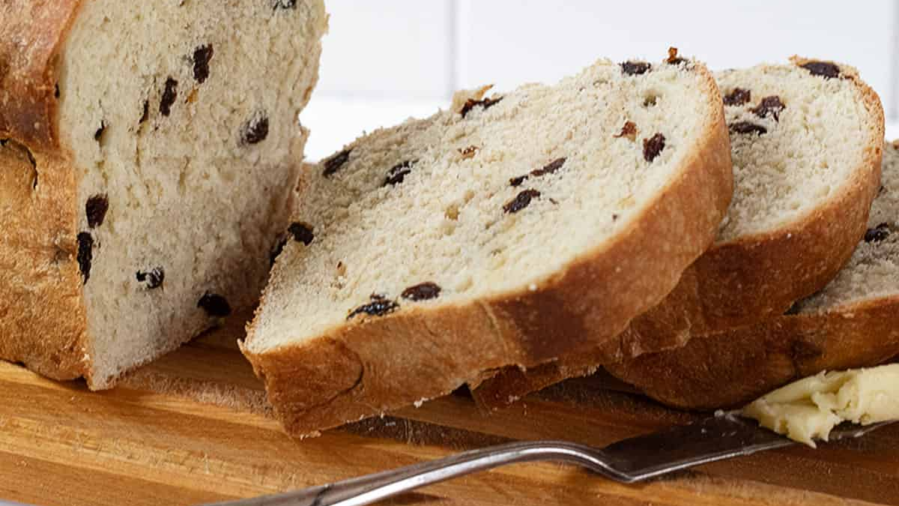

Slide 33
Affirming Behaviours
Giving users personal positive affirmations can be powerful
These can boost users’ mood and improve the user experience
Sometimes they can be profound

Slide 34
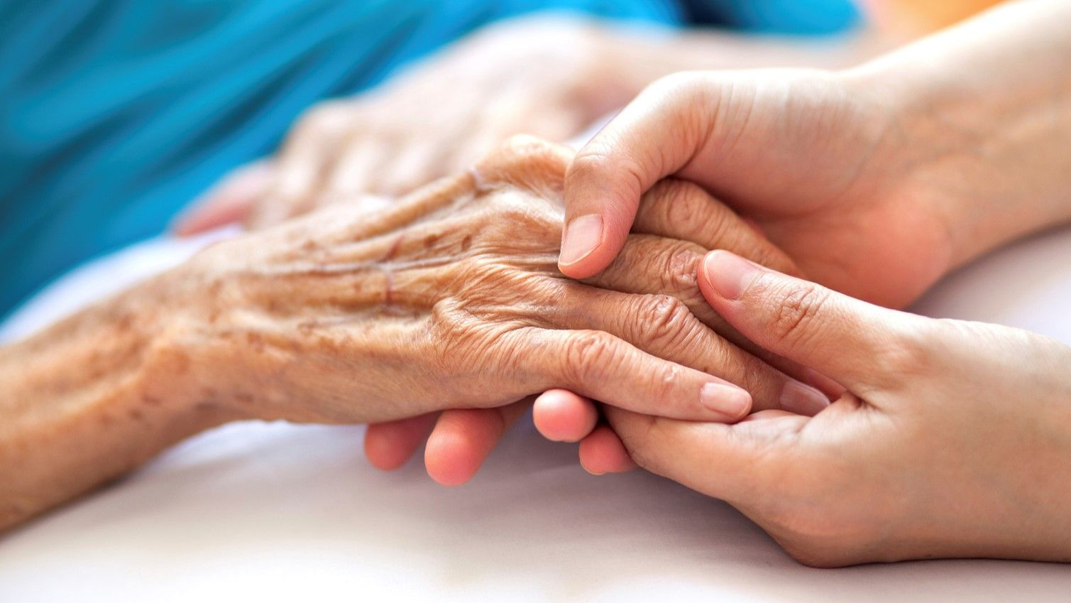

Slide 35
Behaviours Enhancing UX
HIGH PERFORMANCE
Responsiveness
Flipping
Thoroughness
ADVOCATE FOR USER
Fight for User
Show Goodwill
Act with Integrity
ANTICIPATE BEHAVIOURS
Professional Norms
Cultural Norms
Systemic Incentives
THINK DIFFERENTLY
Reframing
Drama
Affirmation

Slide 36
For further information contact:
Professor Patrick W. Jordan
T: 07736 437953
E: p.jordan@mdx.ac.uk

