Slide 1
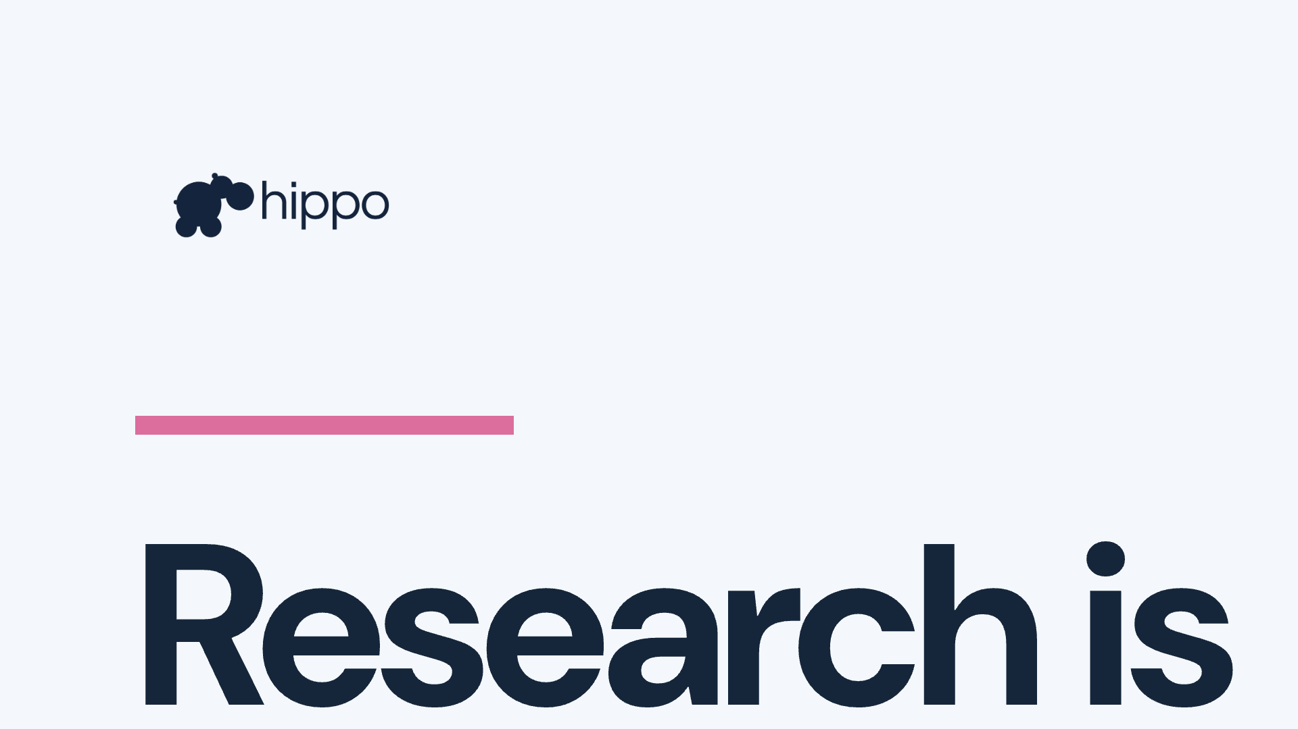

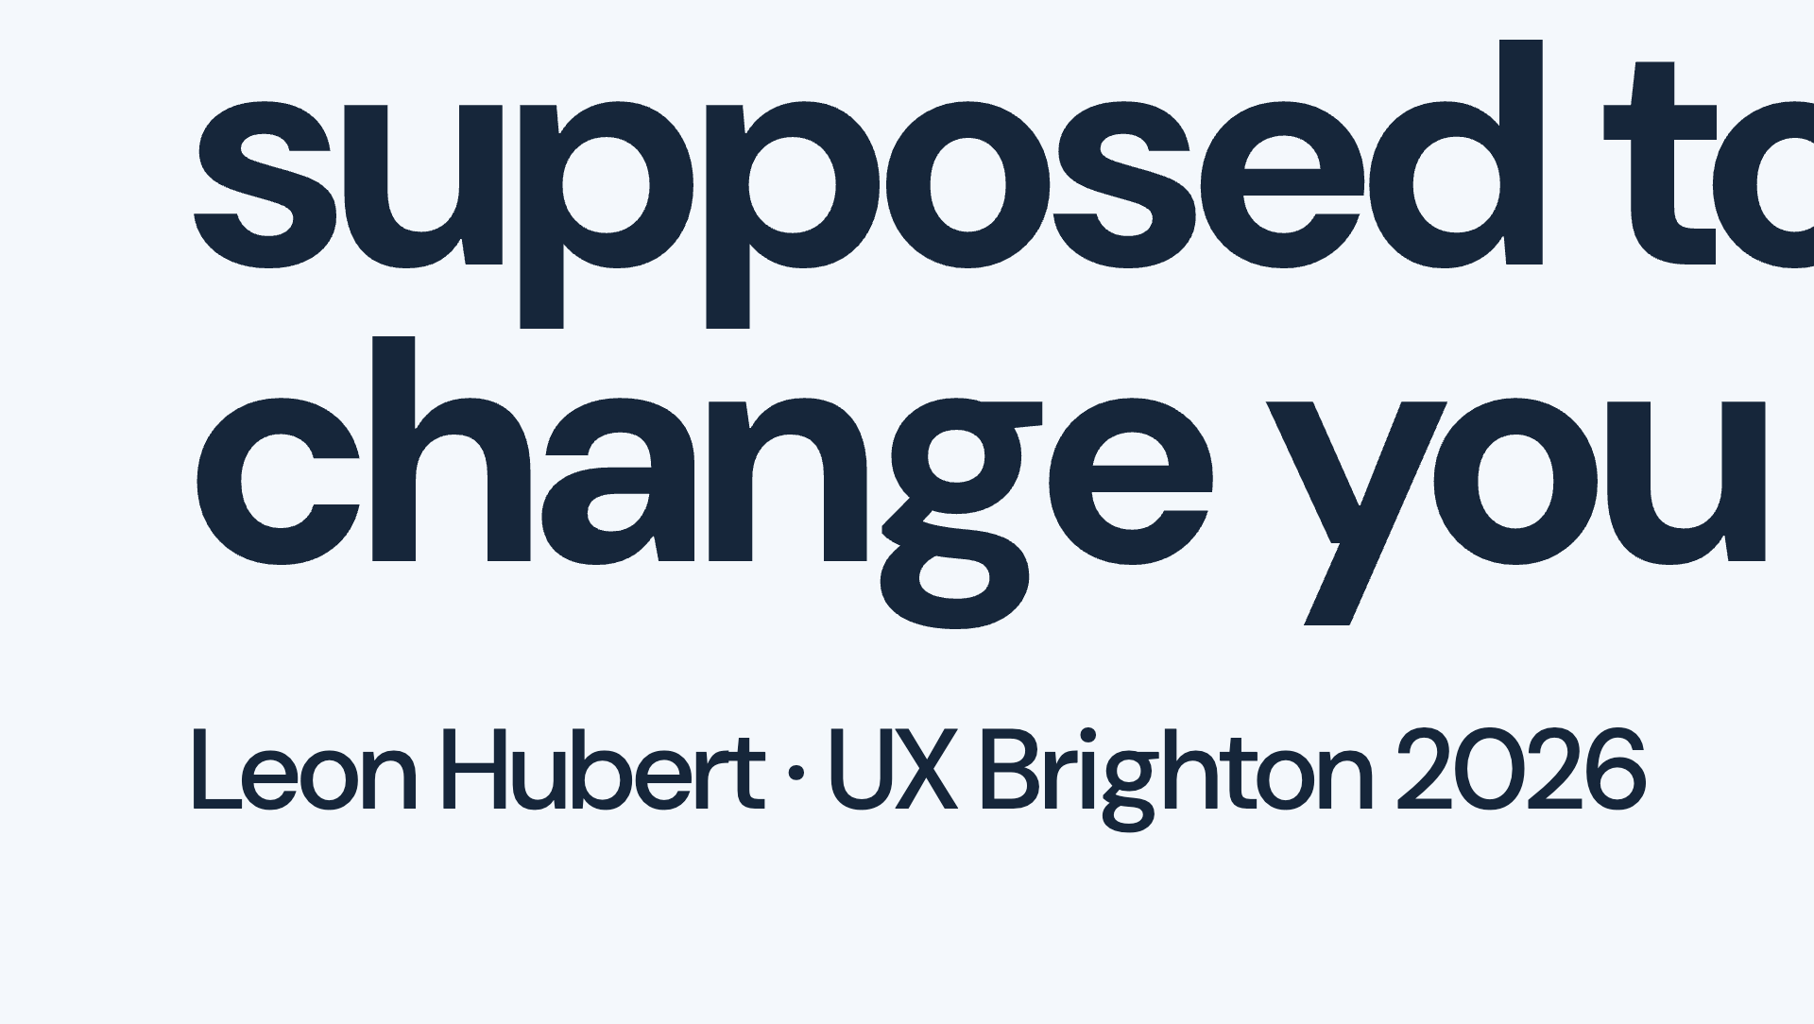

Notes:
Hi, thank you Danny. I'm a researcher so I'm going to talk to you about research, I wonder why?

Slide 2
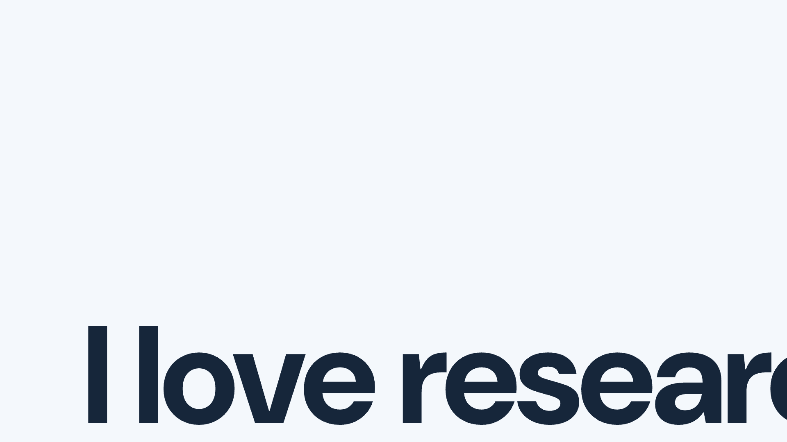

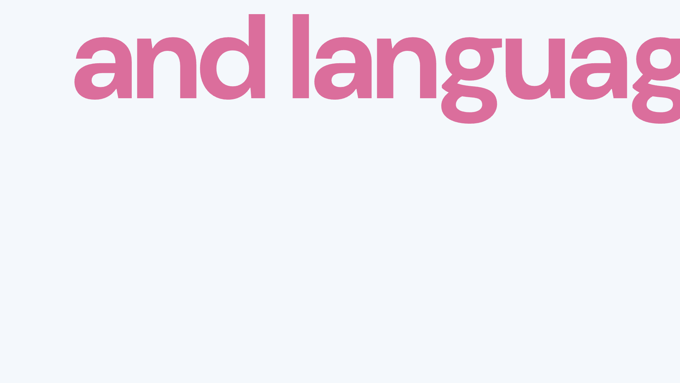

Notes:
Because I love research: learning and understanding is fun and it enables us to do really good things. I also love language. I think language is so important in the work we do as researchers and as designers. The words we use for our work shape what we think we are trying to achieve. They shape what we do achieve. And this is really a conversation about what research should achieve.

Slide 3
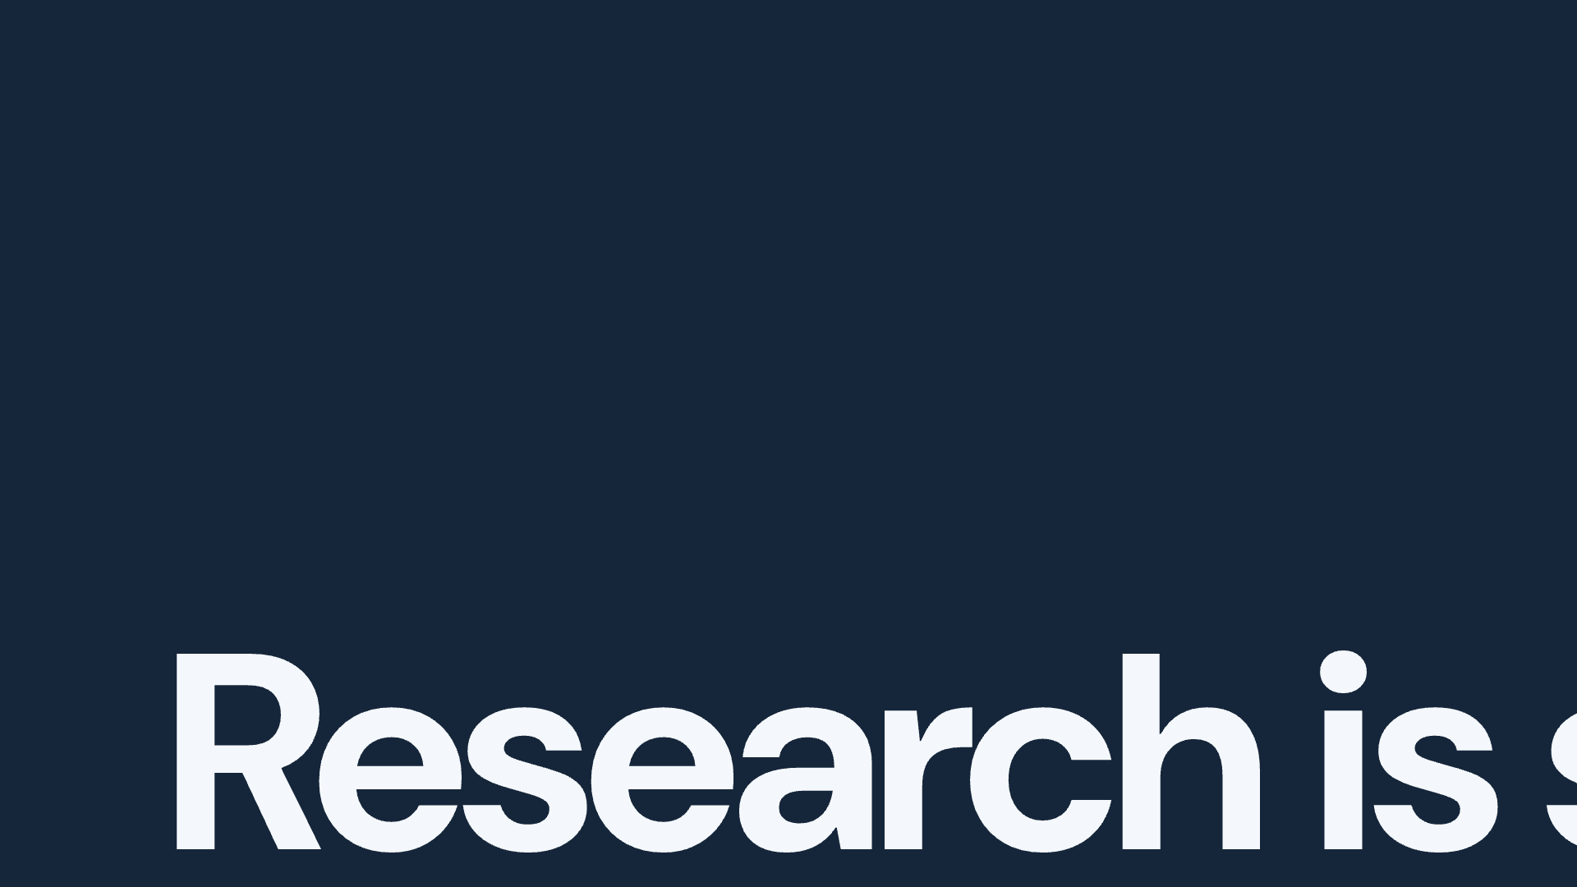

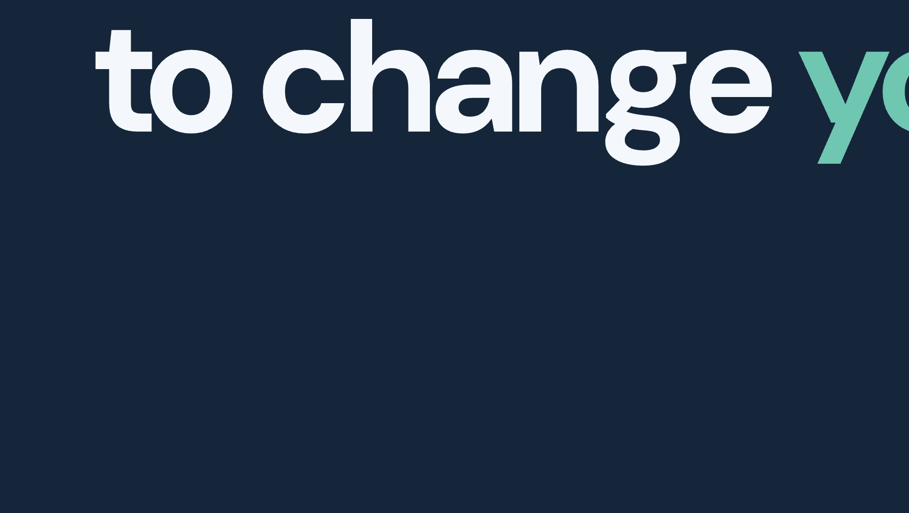

Notes:
So I know, this is a bit romantic. Whenever I've talked about this as a leader to less senior researchers I work with, to my team, to my stakeholders, I've always said something quite different. I've said research is ultimately about risk. We are a risk management function. We spot risks and we help organisations avoid risks. And all of that is still true but in recent years it's felt like quite an inadequate explanation. So here's a new explanation to complement it. Research is supposed to change you, because research is a learning process. It should change our understanding of things. It should make us wiser, which yes still means avoiding those risks. It might mean changing our explanation of a problem, or recognising something we had missed, or becoming more confident for better reasons. As the ways we do research change, I want to keep asking whether that change in our understanding, and in our teams and organisations, is actually happening.

Slide 4


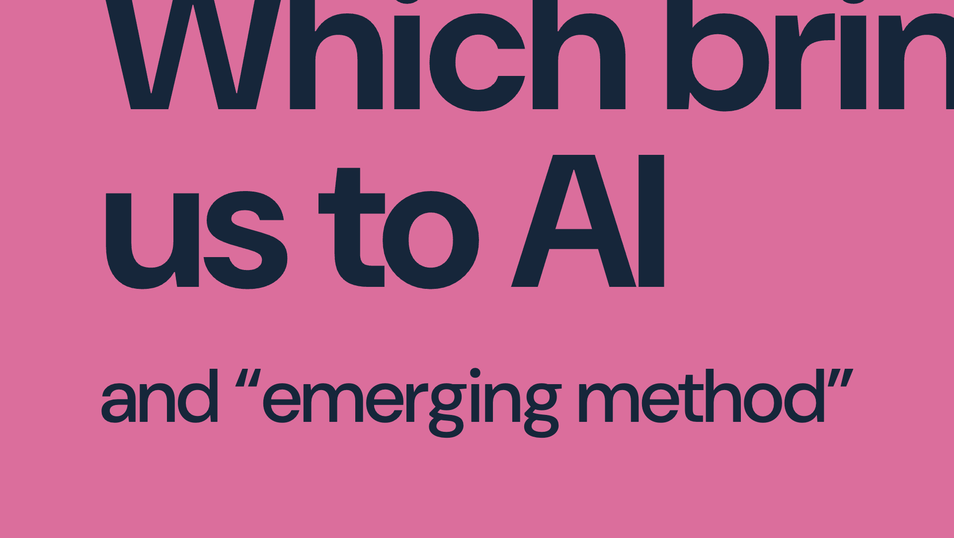

Notes:
Which of course, inevitably, brings us to AI. All roads lead to it, everyone is trying to think about it. And it is where so many of these emerging methods meet us. Now, there's a lot of noise out there…

Slide 5

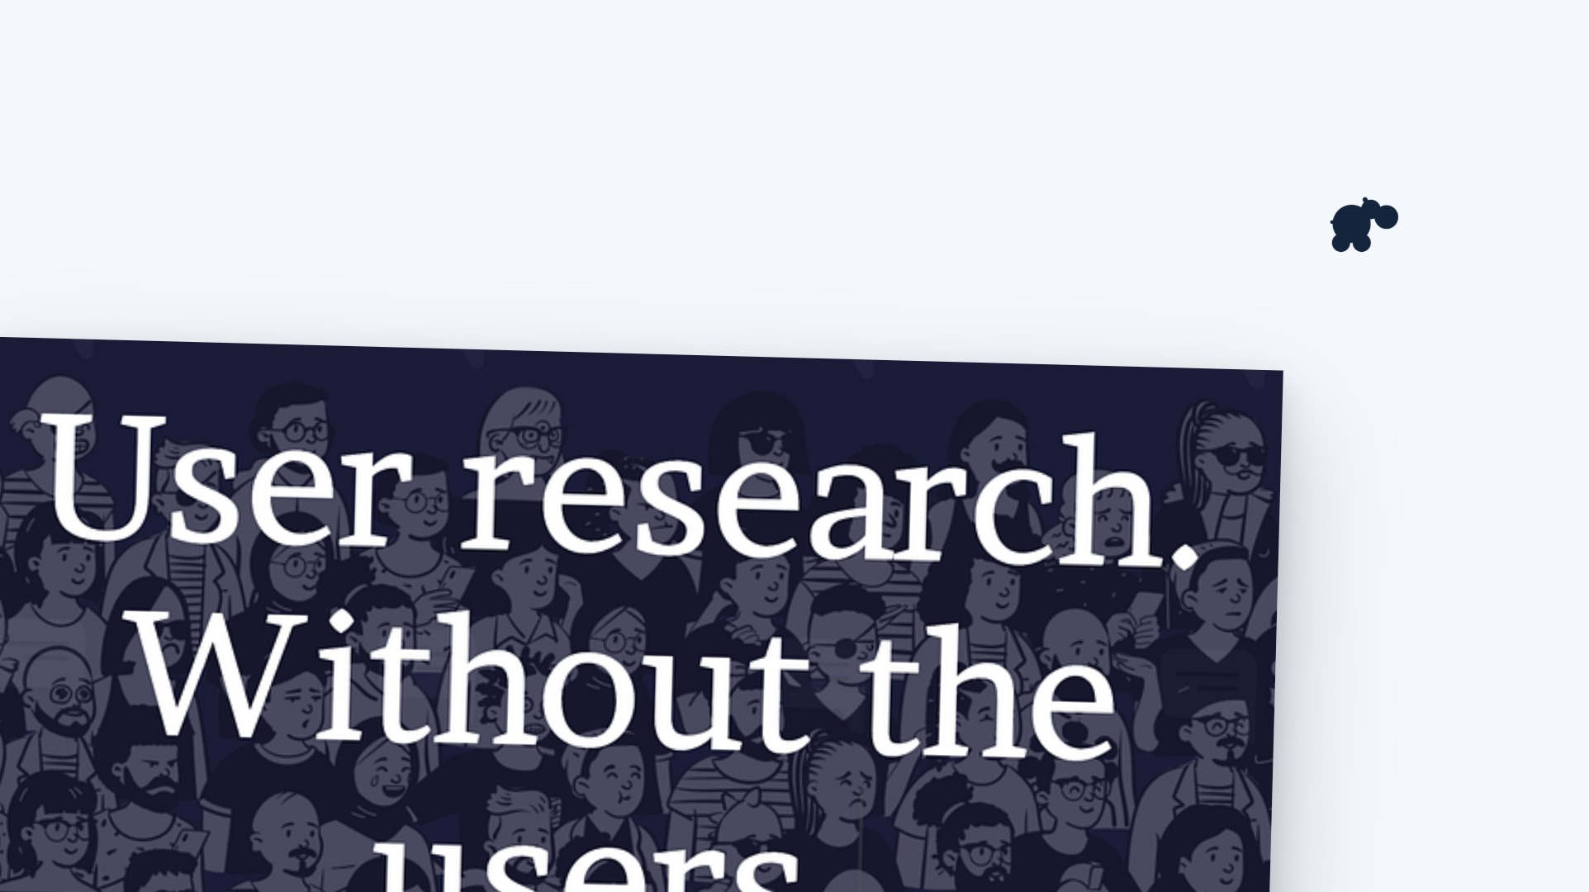
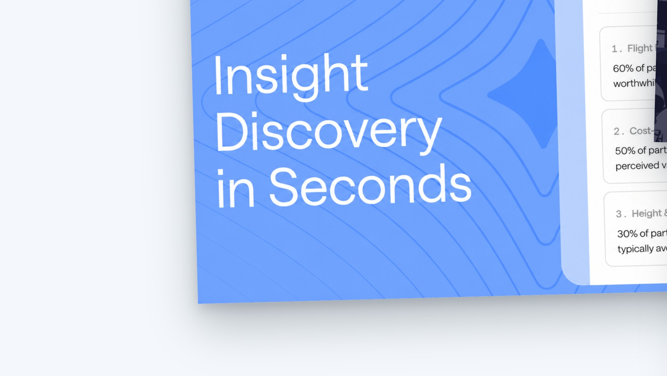
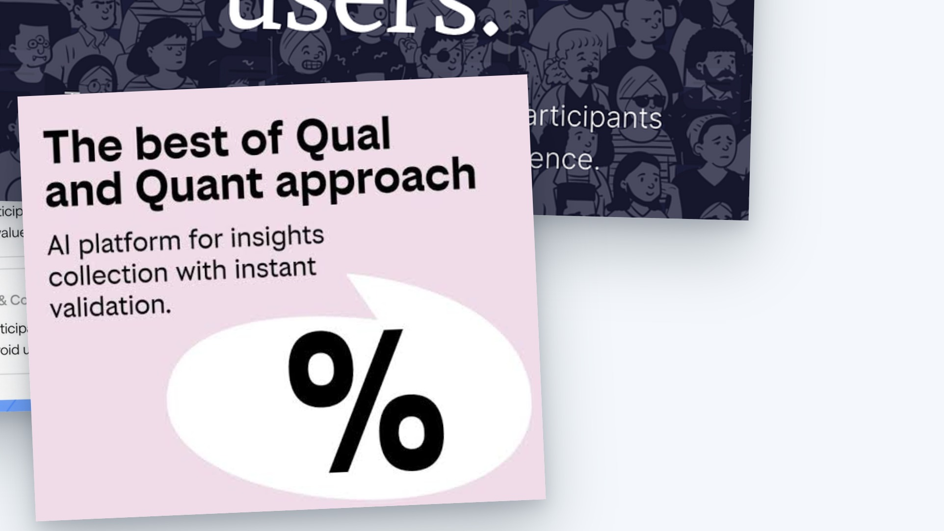
Notes:
and, without being too controversial, I'm not sure all the stuff is good stuff. There are some big, bold claims. We are told that we can discover insights in seconds, that we can do user research without those pesky users, and that we all should be doing Qual at the scale of Quant. I'm not going to stand here and tell you that these products are selling a bill of goods, that is what the slide is for, but I am going to say that they're not quite understanding the core value of doing research.

Slide 6
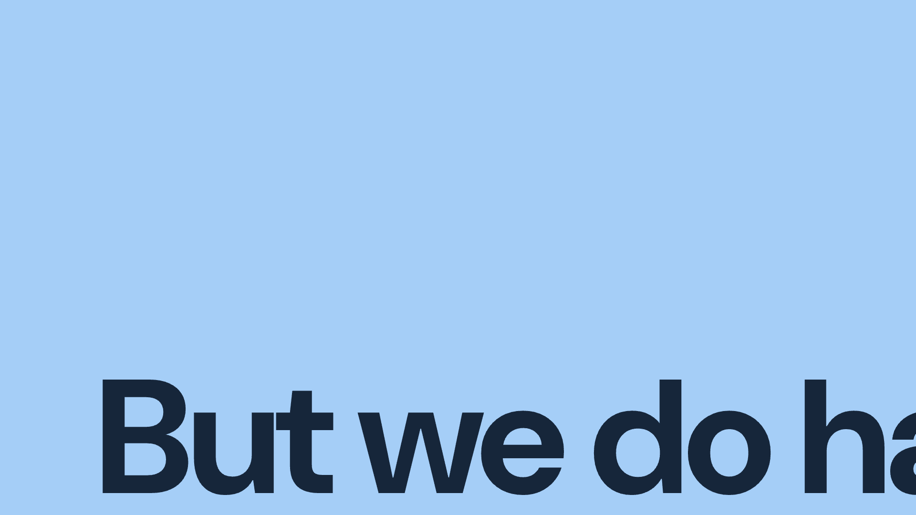

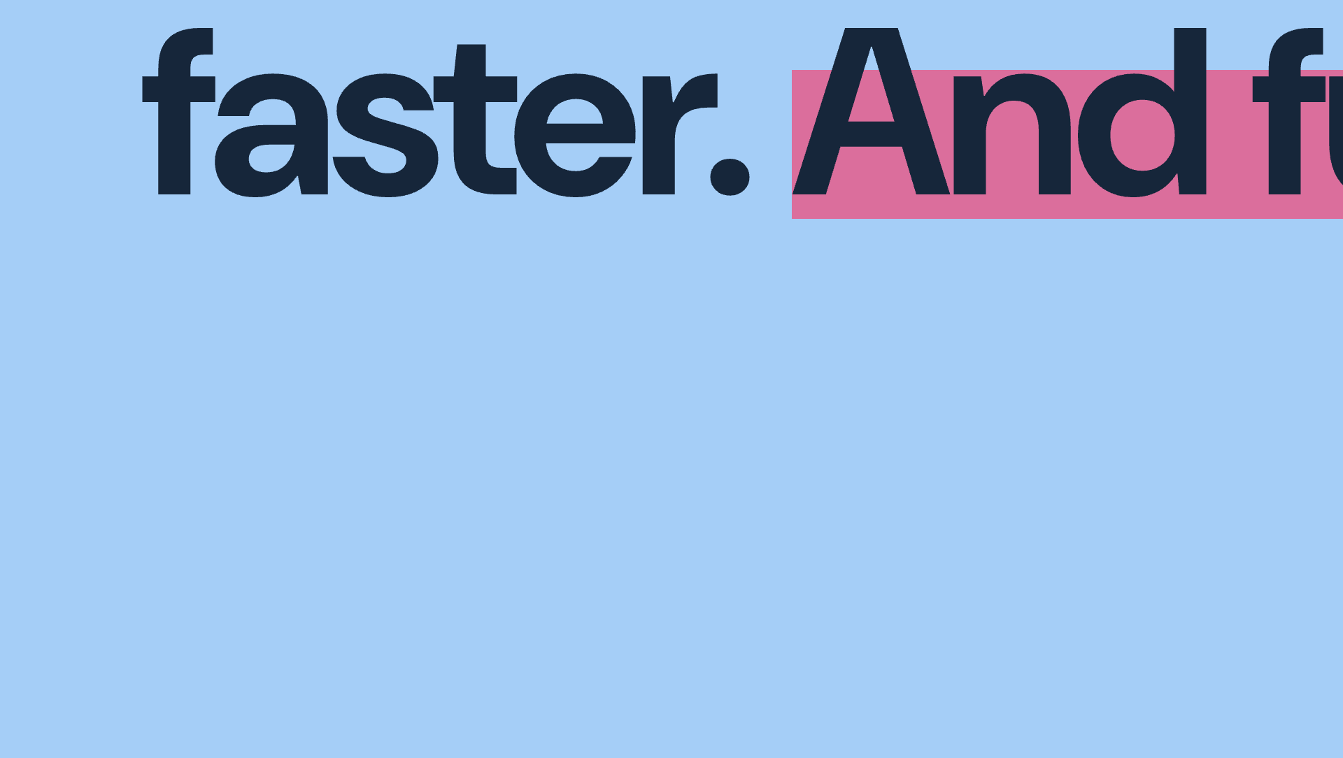

Notes:
And yet, alongside this, we are going to have to go faster. Our research has to work in the environment where decisions are being made. Faster delivery and engineering create a real challenge for how we contribute. I also want us to be more ambitious. I keep returning to the question, what could going faster make room for: work we currently rush, questions we leave unexplored, and better ways of telling research stories. How do we reach useful understanding sooner, and what can we now attempt that used to be out of reach?

Slide 7


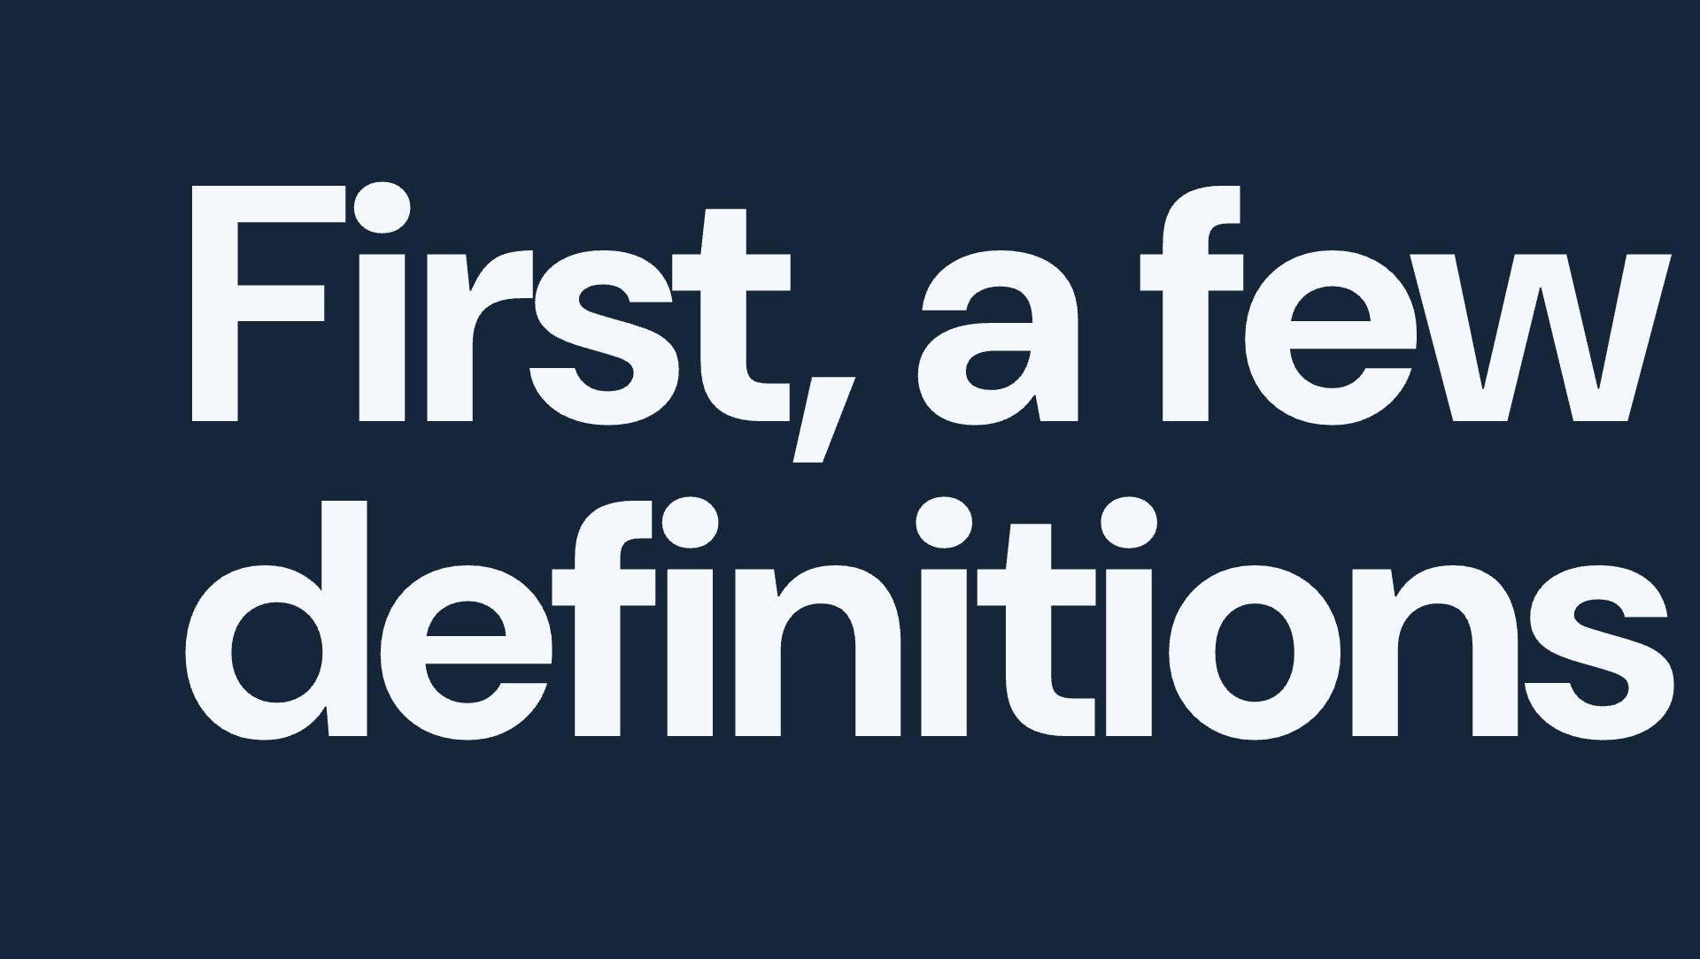

Notes:
Before we get to what AI can do for research, given I've @ed every research tech company, let’s actually talk a bit about what research is for. A few definitions to start.

Slide 8
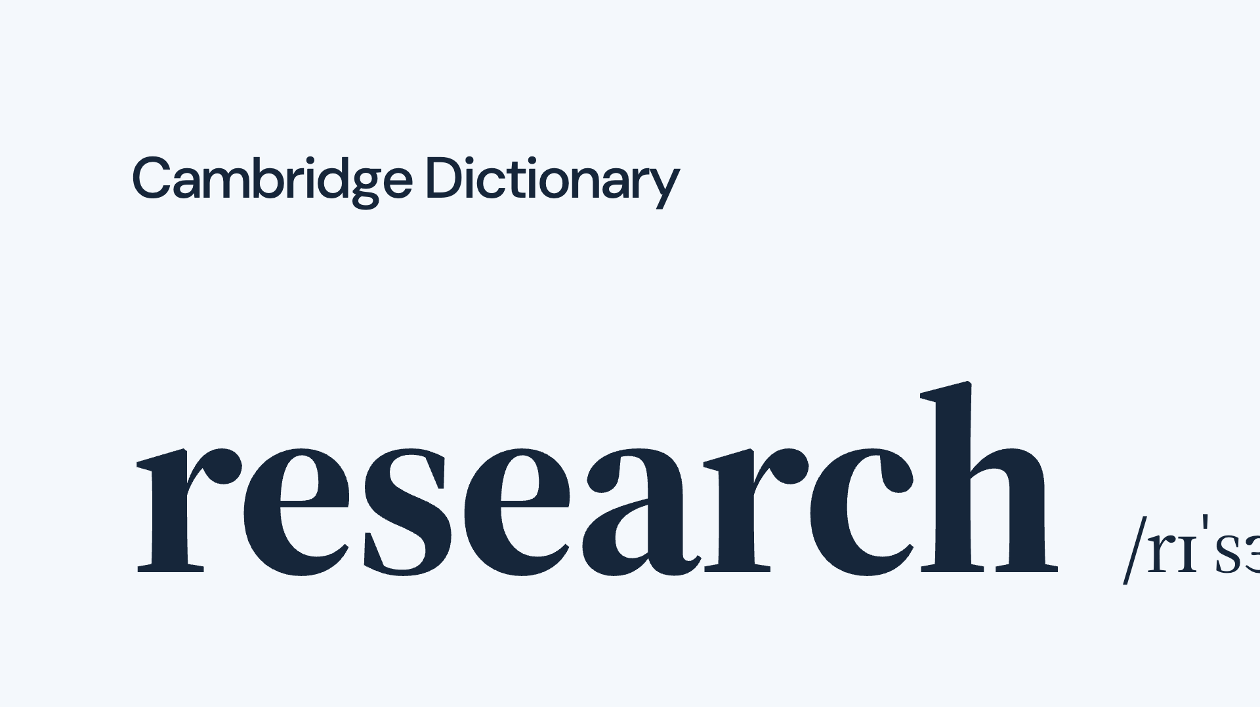
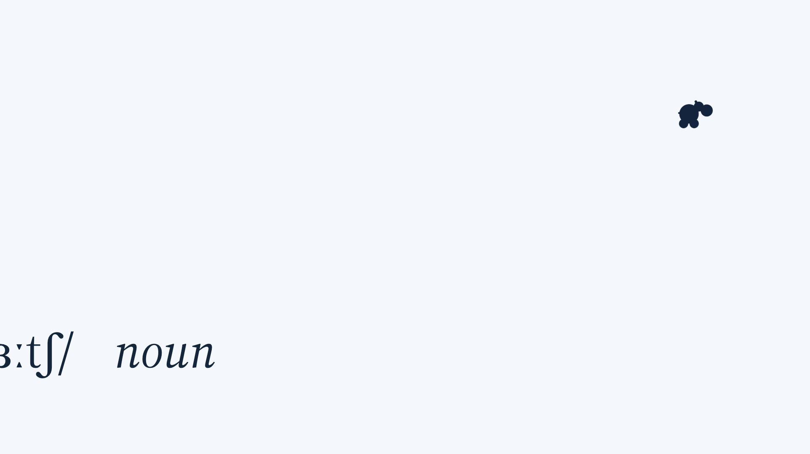
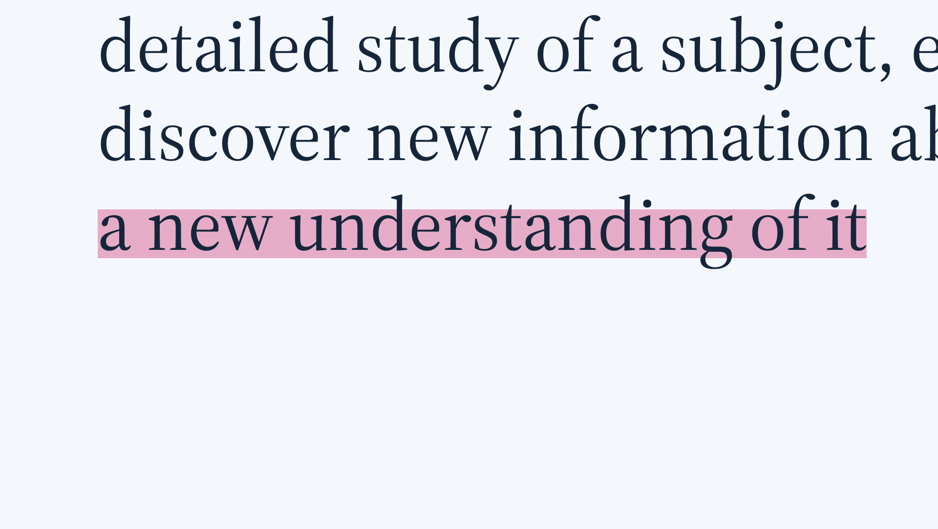
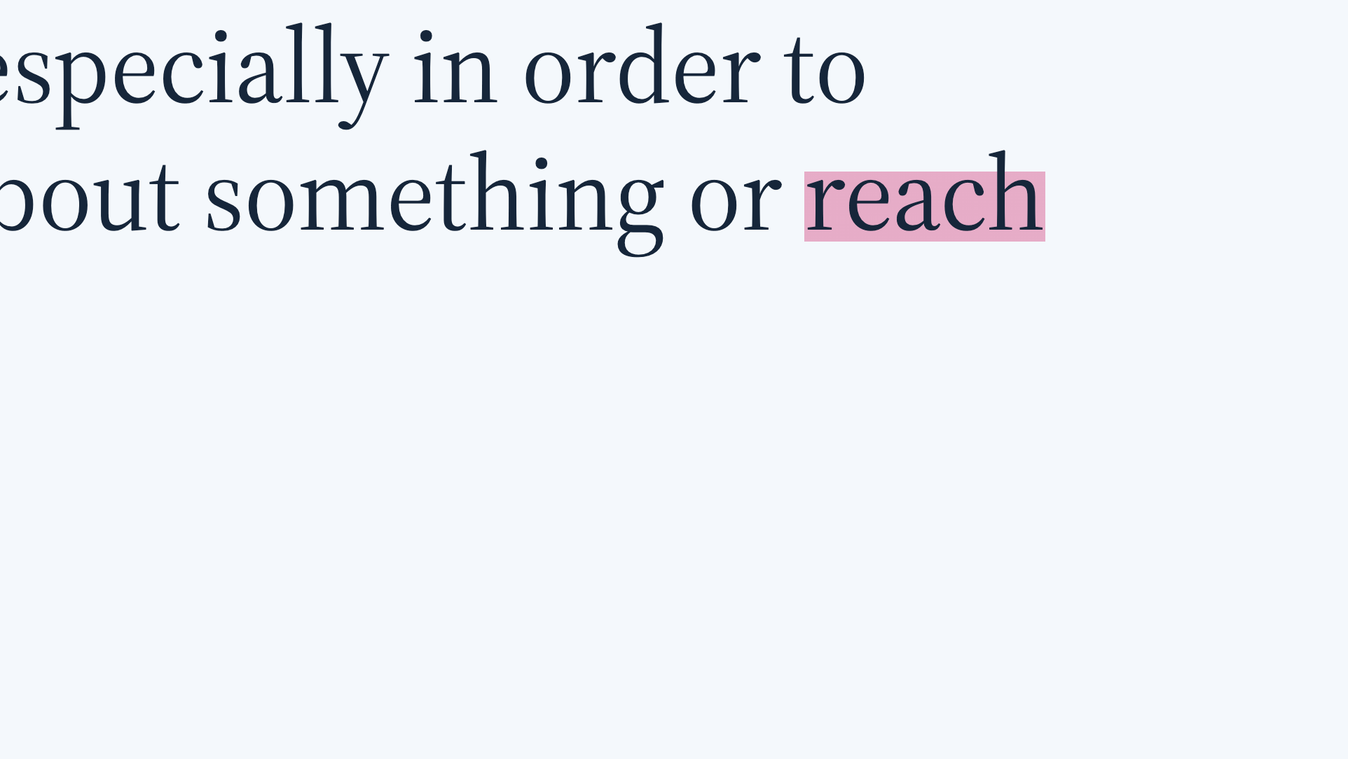
Notes:
So when we talk about research we're talking about detailed study of a subject, especially in order to discover new information or reach a new understanding of it. This is the purpose of enquiry. Easy.

Slide 9
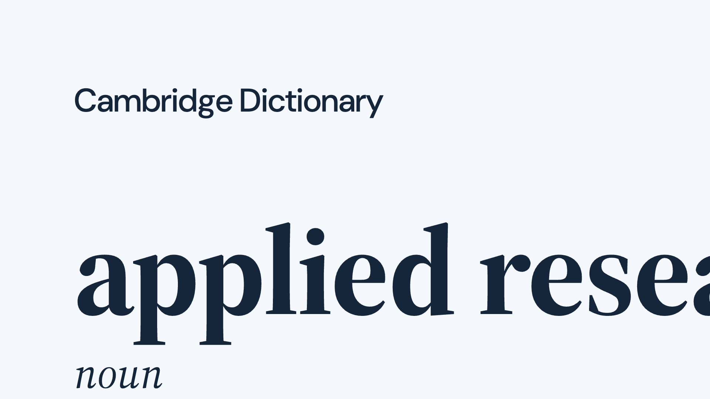
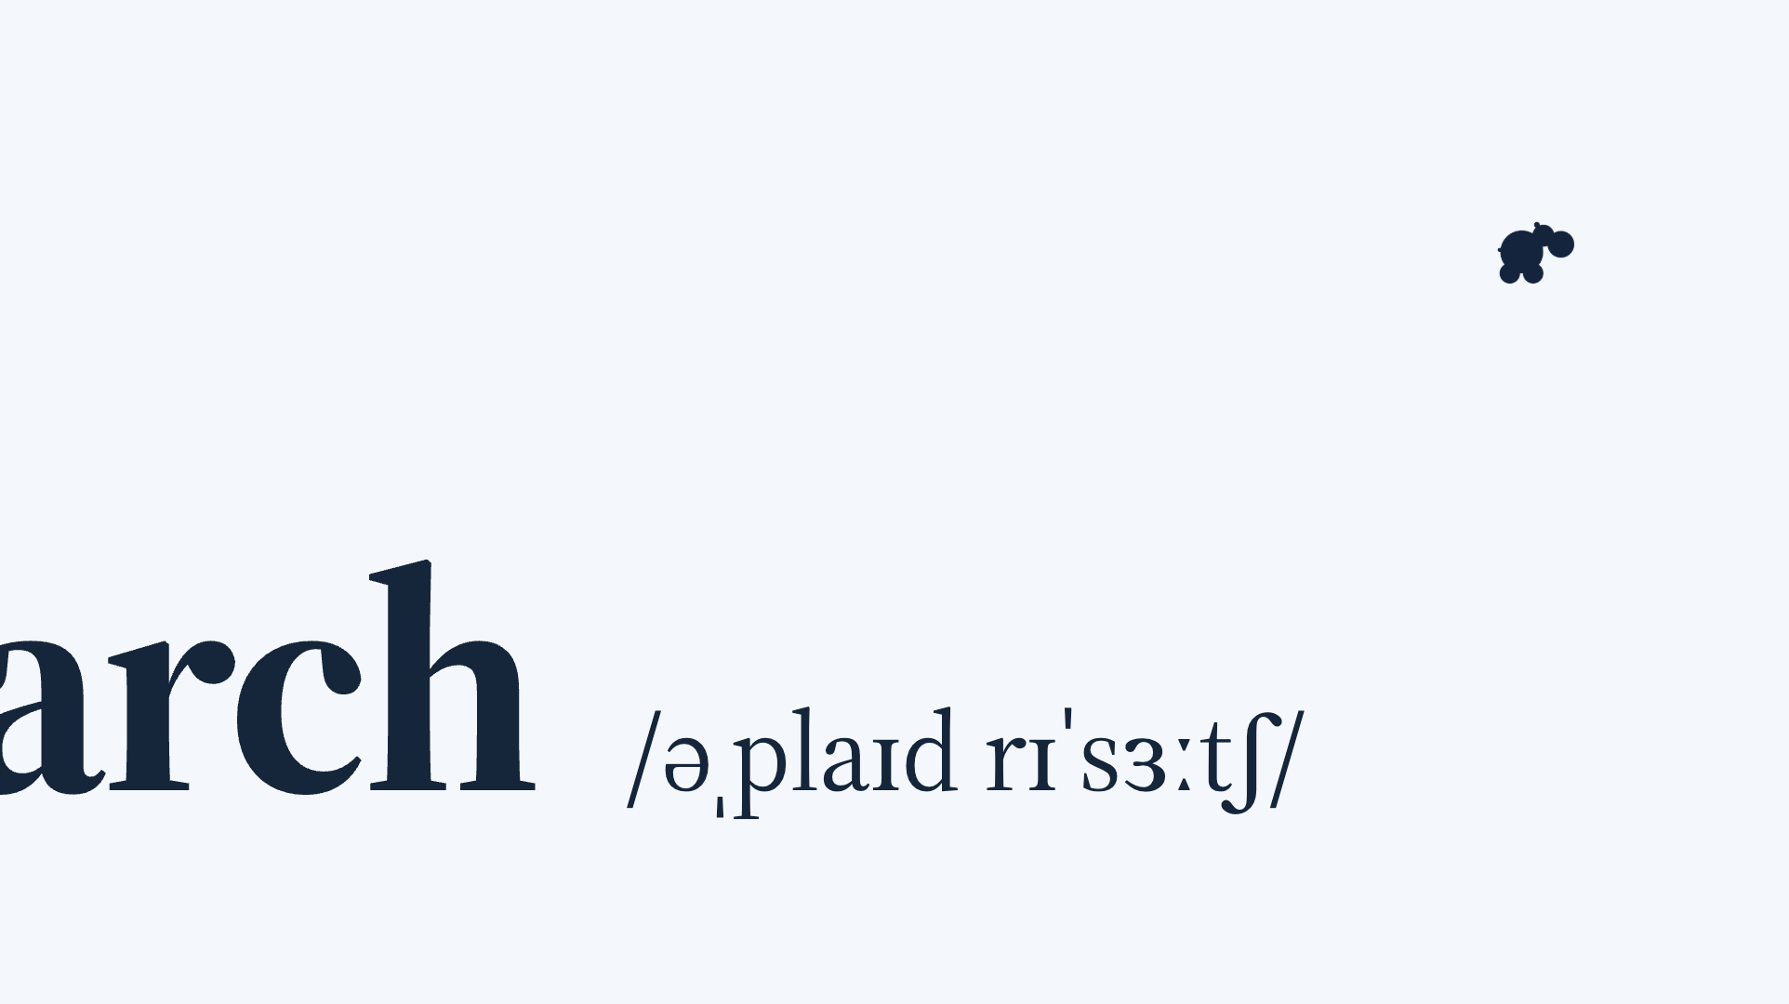
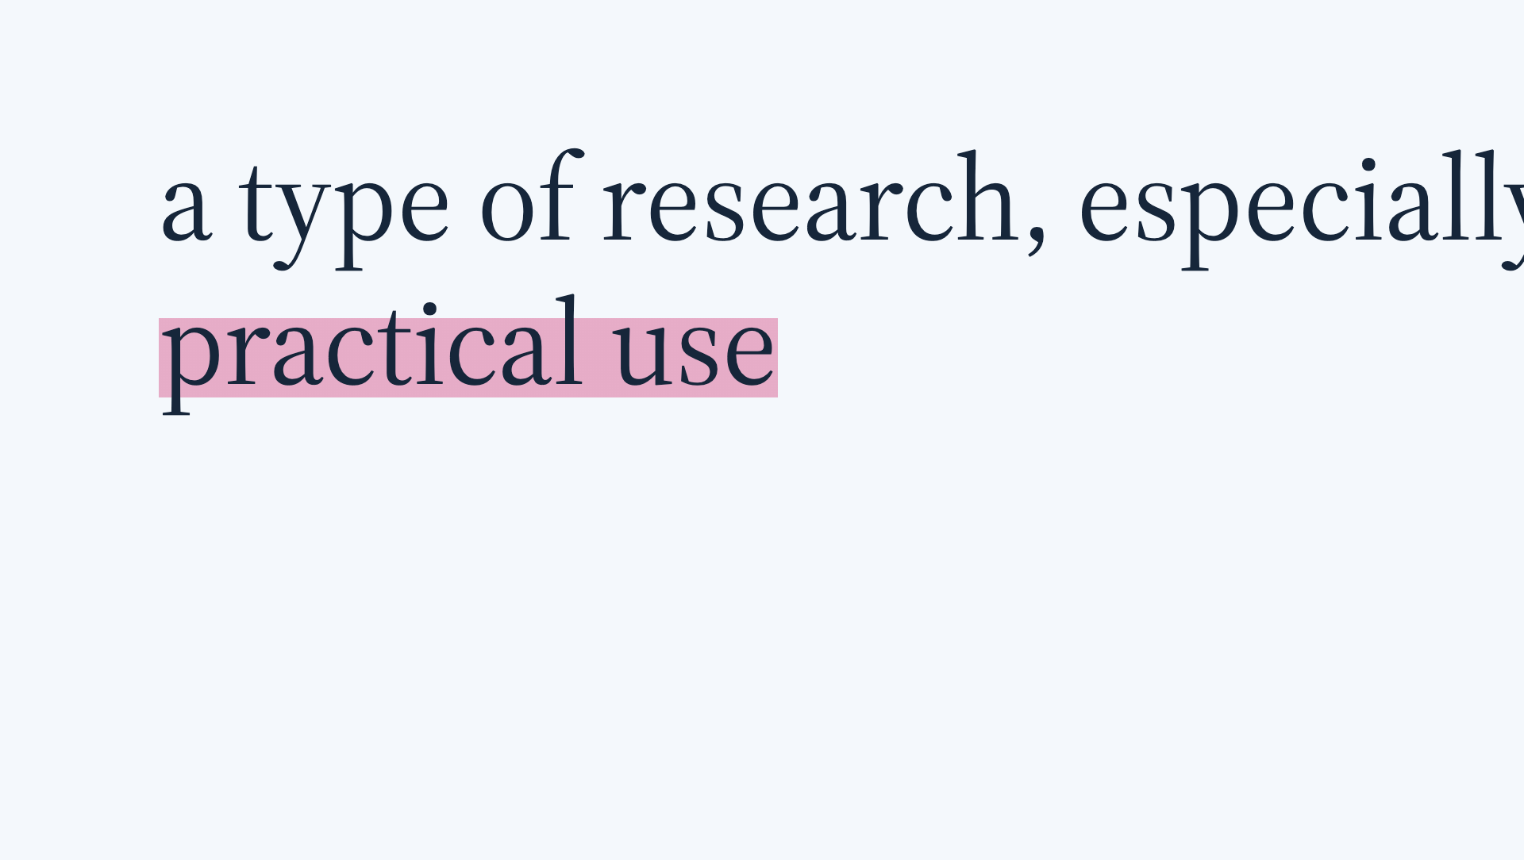
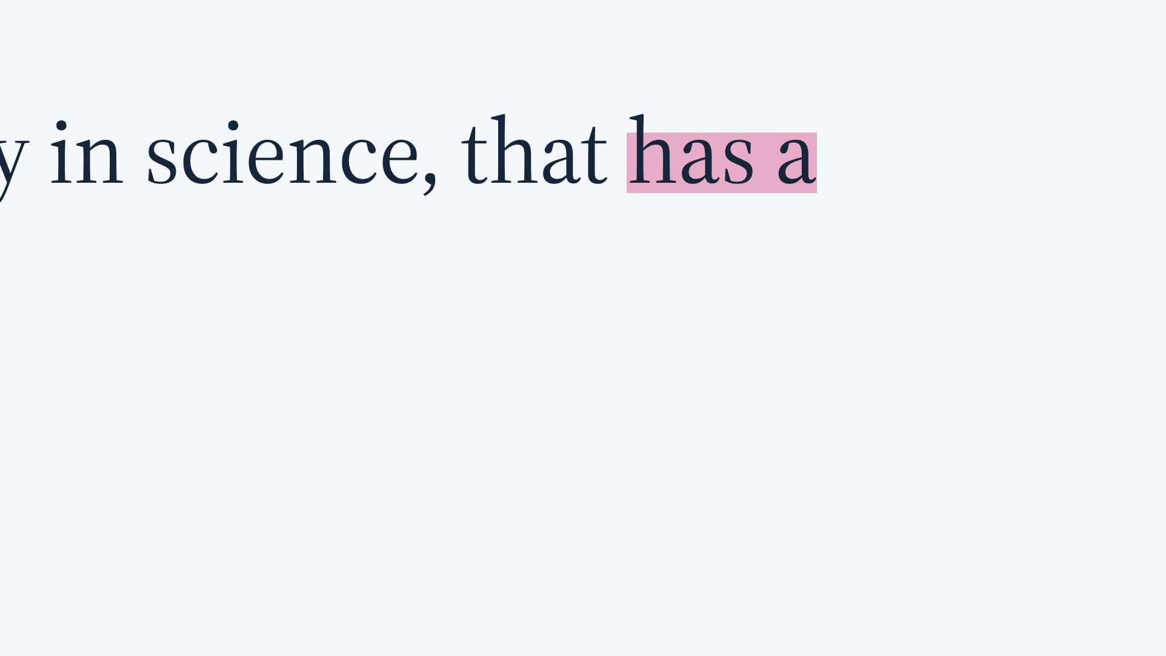
Notes:
And in our context, applied research, we're doing it with the objective of having practical use. It is not learning for its own sake. But then there's one other important word, which we bandy around constantly, which we really, REALLY need to talk about.

Slide 10
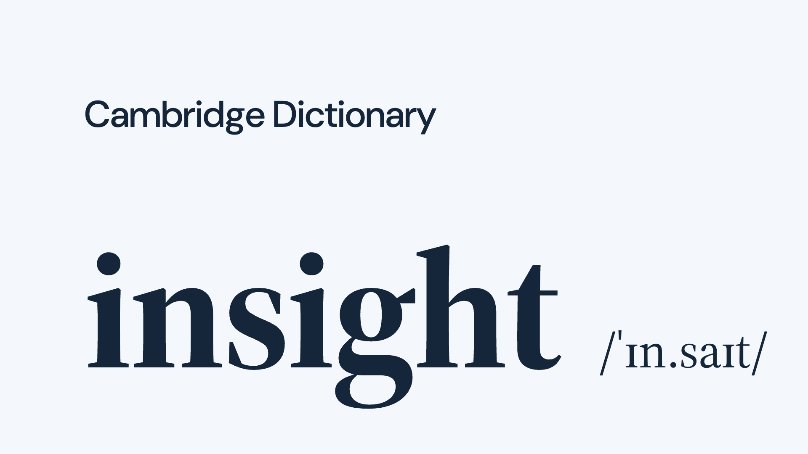
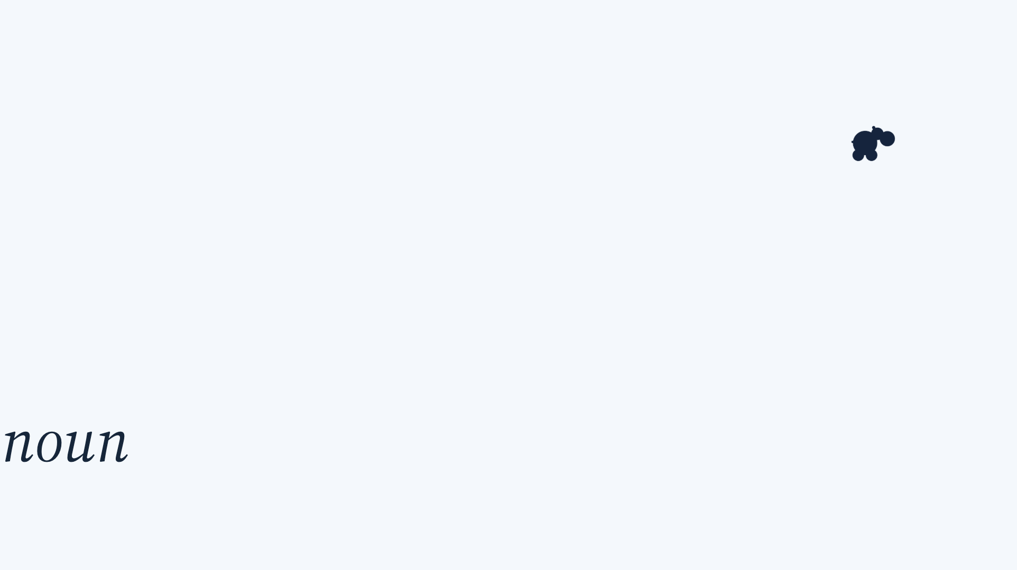
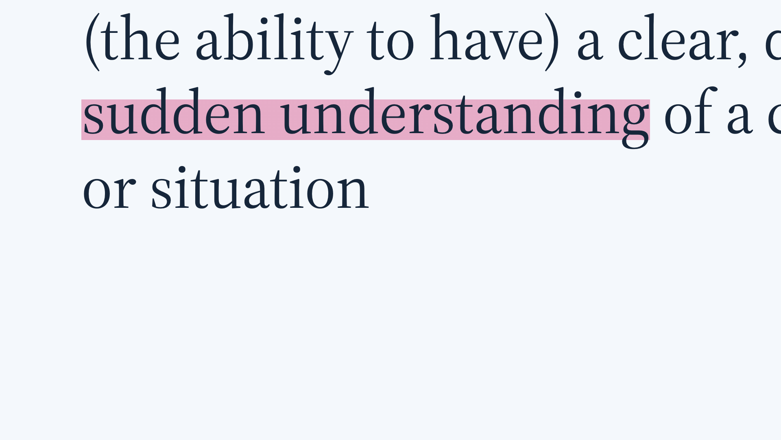
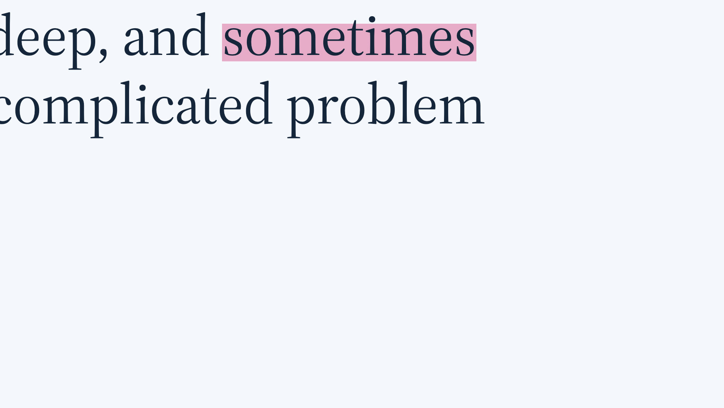
Notes:
A clear, deep, and sometimes sudden understanding of a complicated problem or situation. Which is interesting because we make insights the objective of a lot of research, but I am not always sure we internalise what this means.

Slide 11
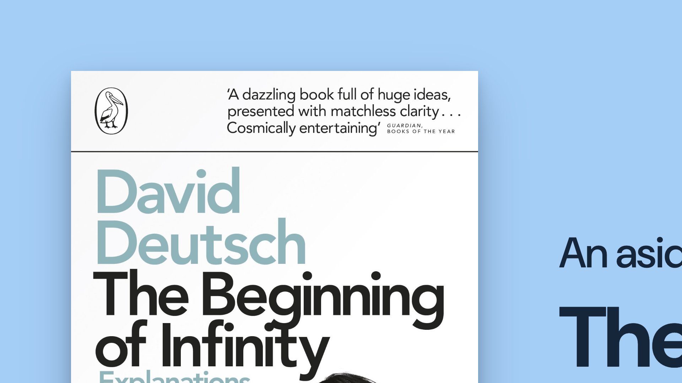
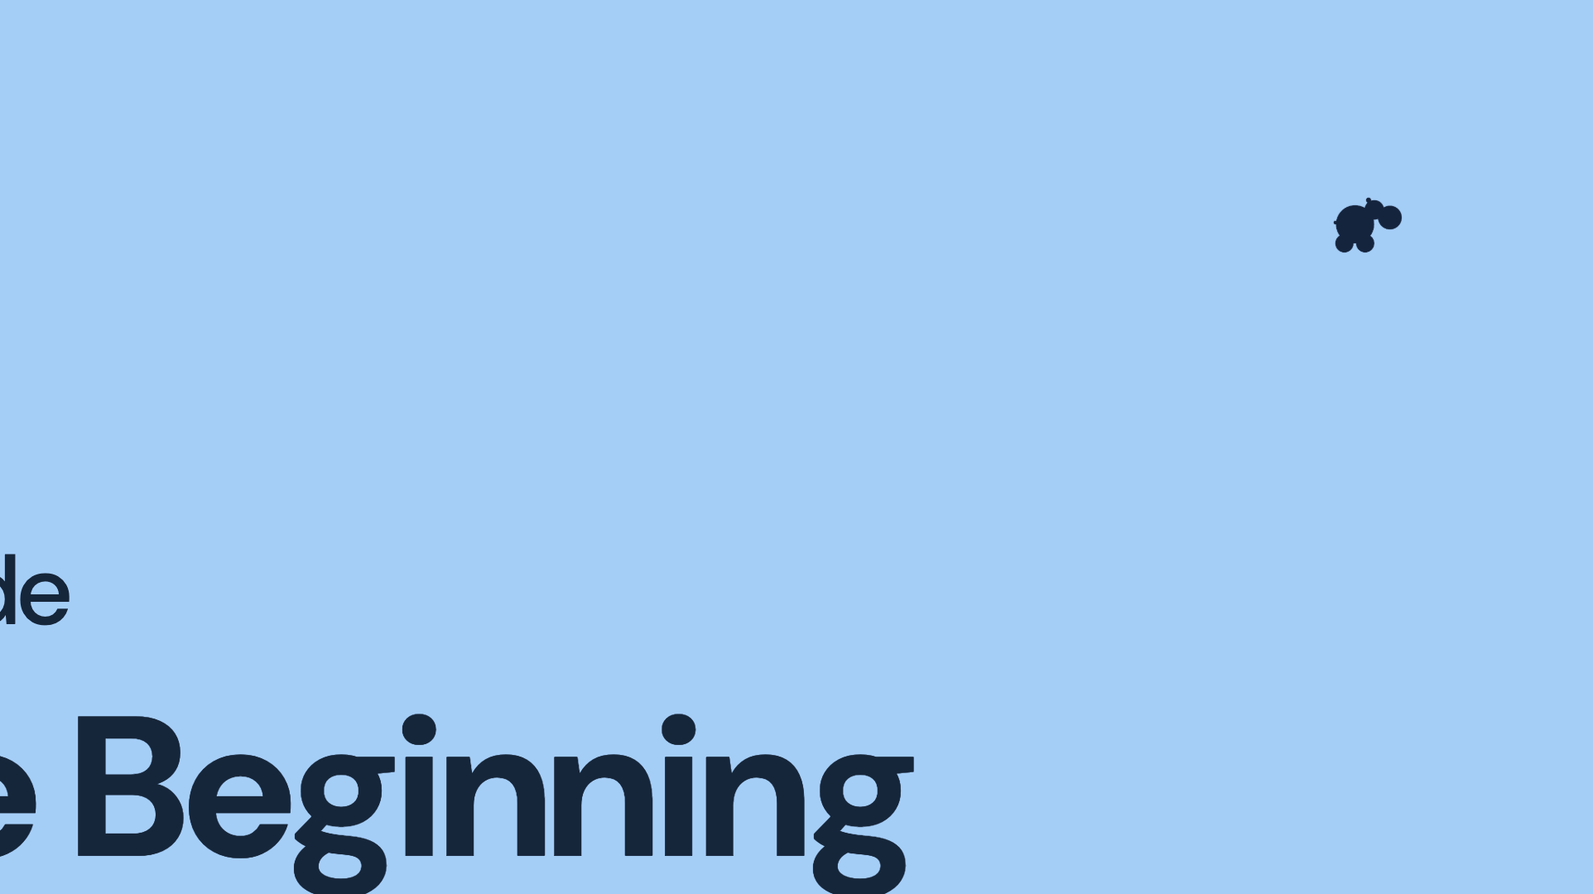
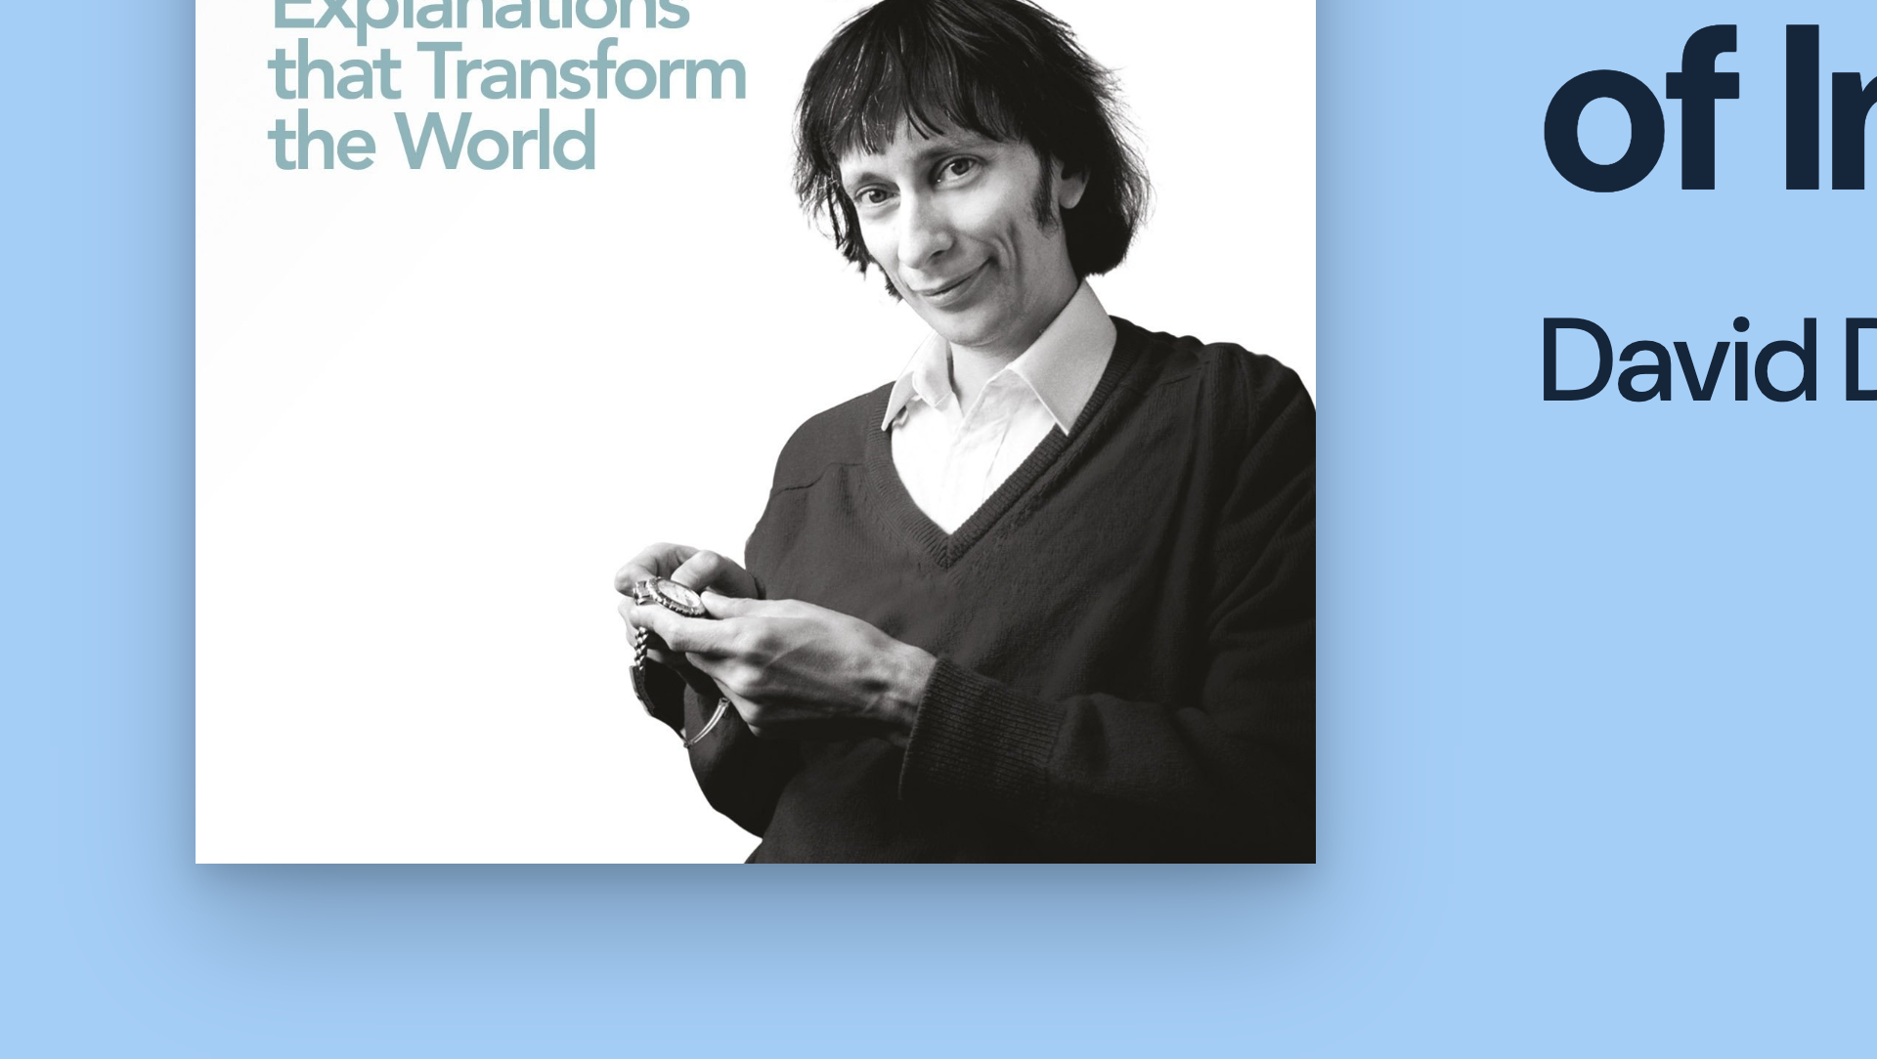

Notes:
Which forces me to be self-indulgent and stop for an aside about David Deutsch and The Beginning of Infinity. This book is hard to read, it's about science and human knowledge, and I'm only talking about it because the idea I’m taking from this book is that better explanations help us advance our knowledge. Knowing facts about something leaves us with different possibilities from understanding why it happens and being able to explain it. And importantly, that this is a creative step. You learn things and, on your own or with others, you develop explanations that you use to change things. Which brings us back to insights…

Slide 12

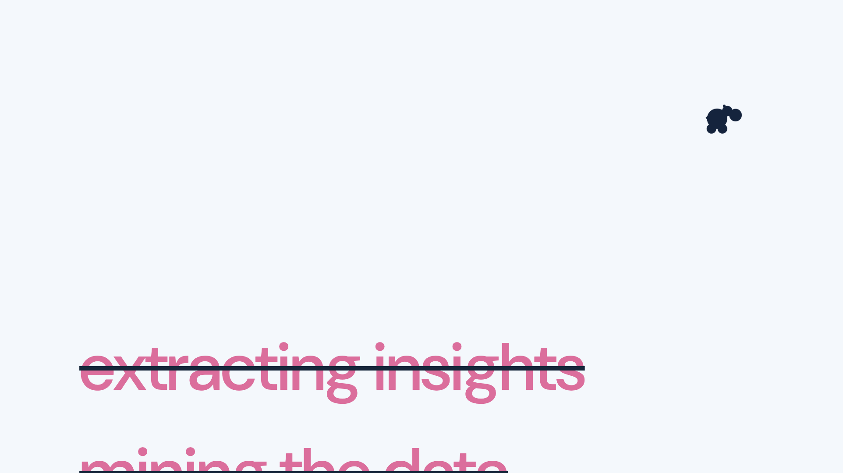
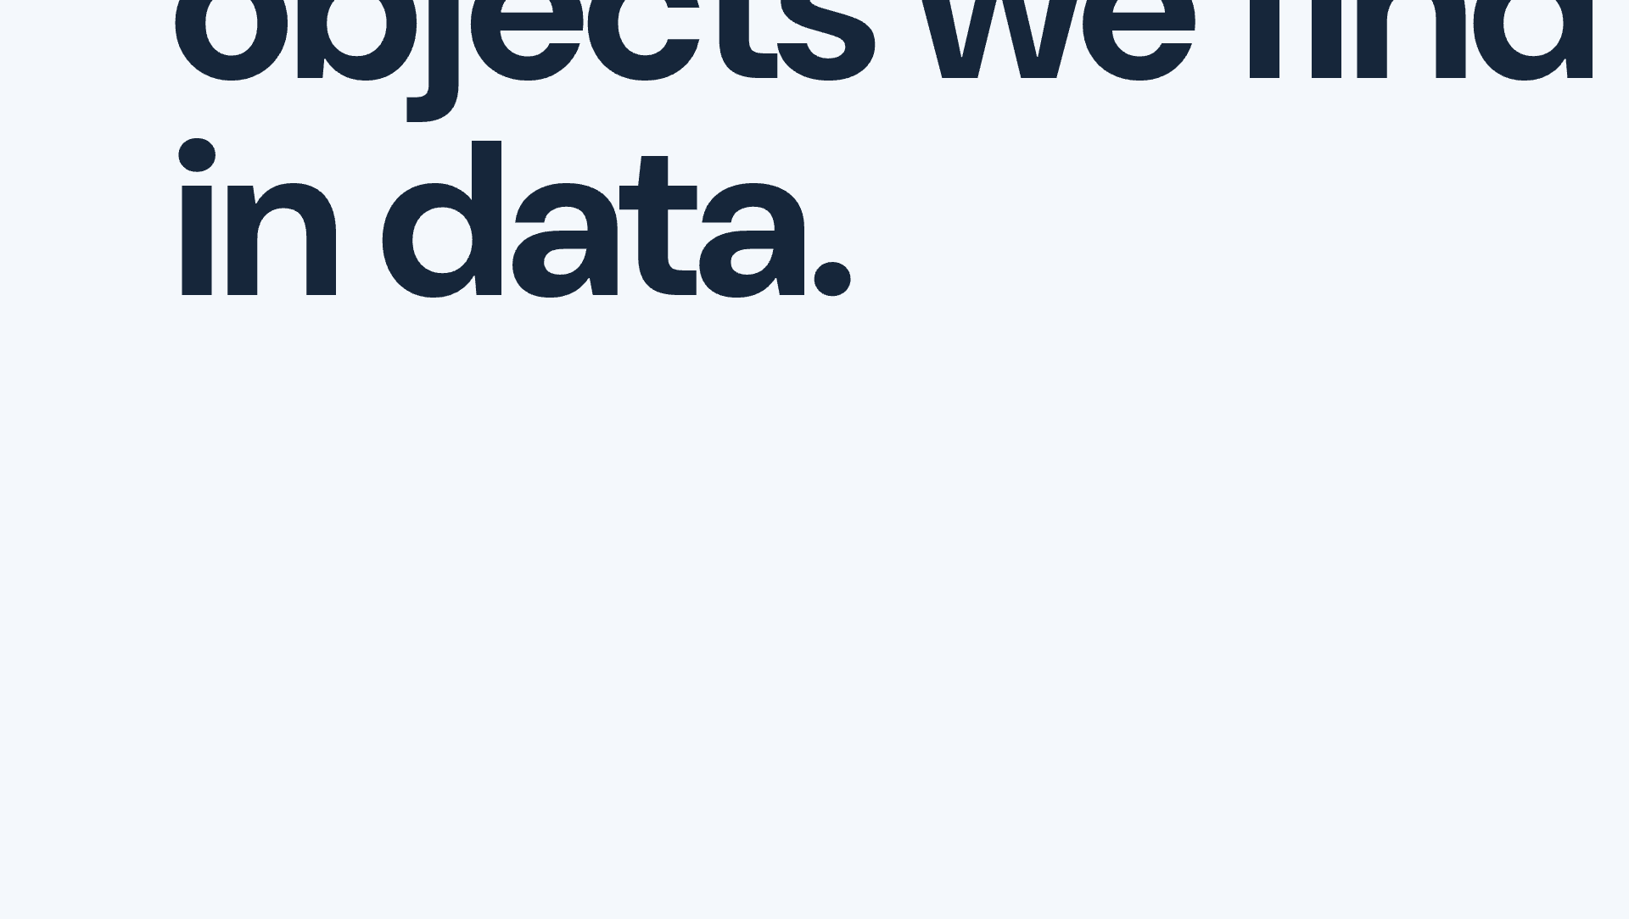
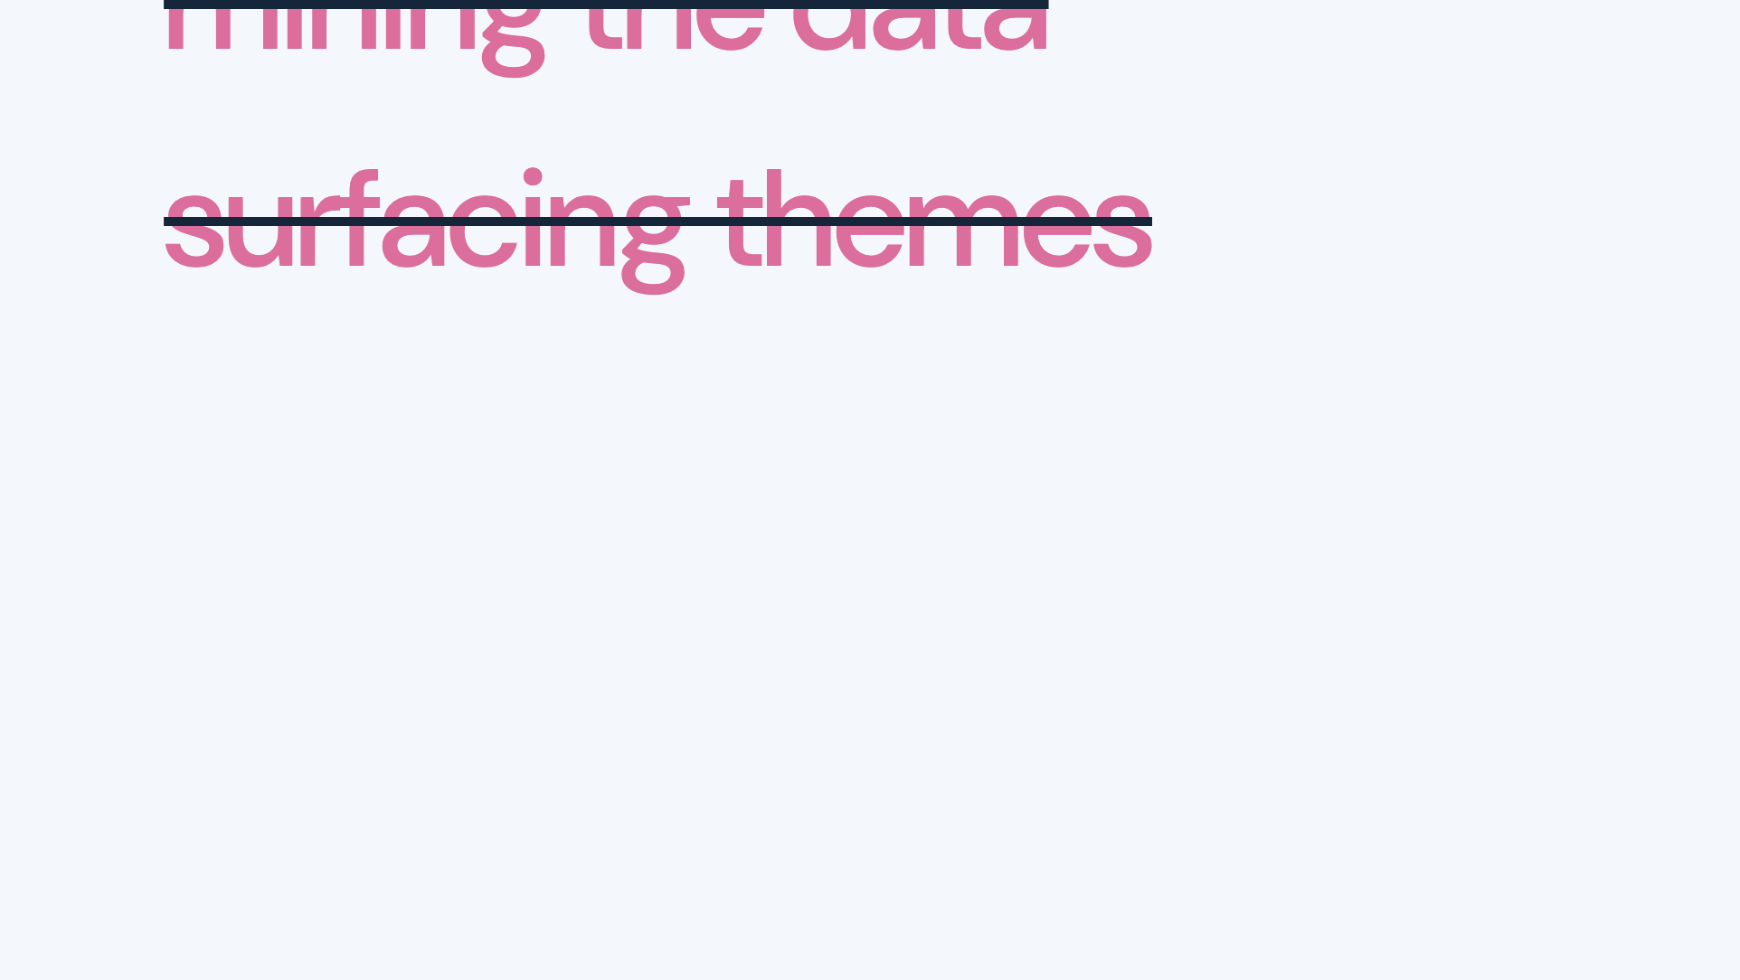
Notes:
We talk about insights like they're lying around, waiting to be found, we extract them or discover them or mine them or surface them. But understanding is not lying around in the world waiting to be found.

Slide 13
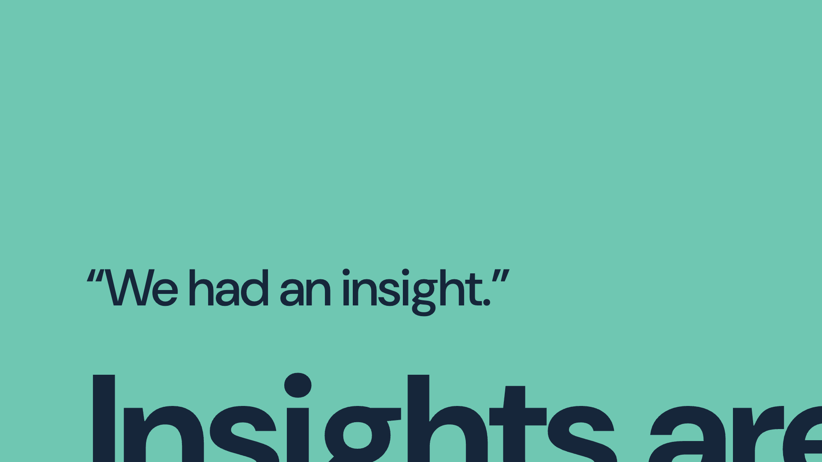



Notes:
We have insights, through processing information. We experience them and we communicate them and if we do it really well others experience them too. It happens in us. This sounds quite fluffy when I hear myself but it is really important because it is very different from knowing something.

Slide 14
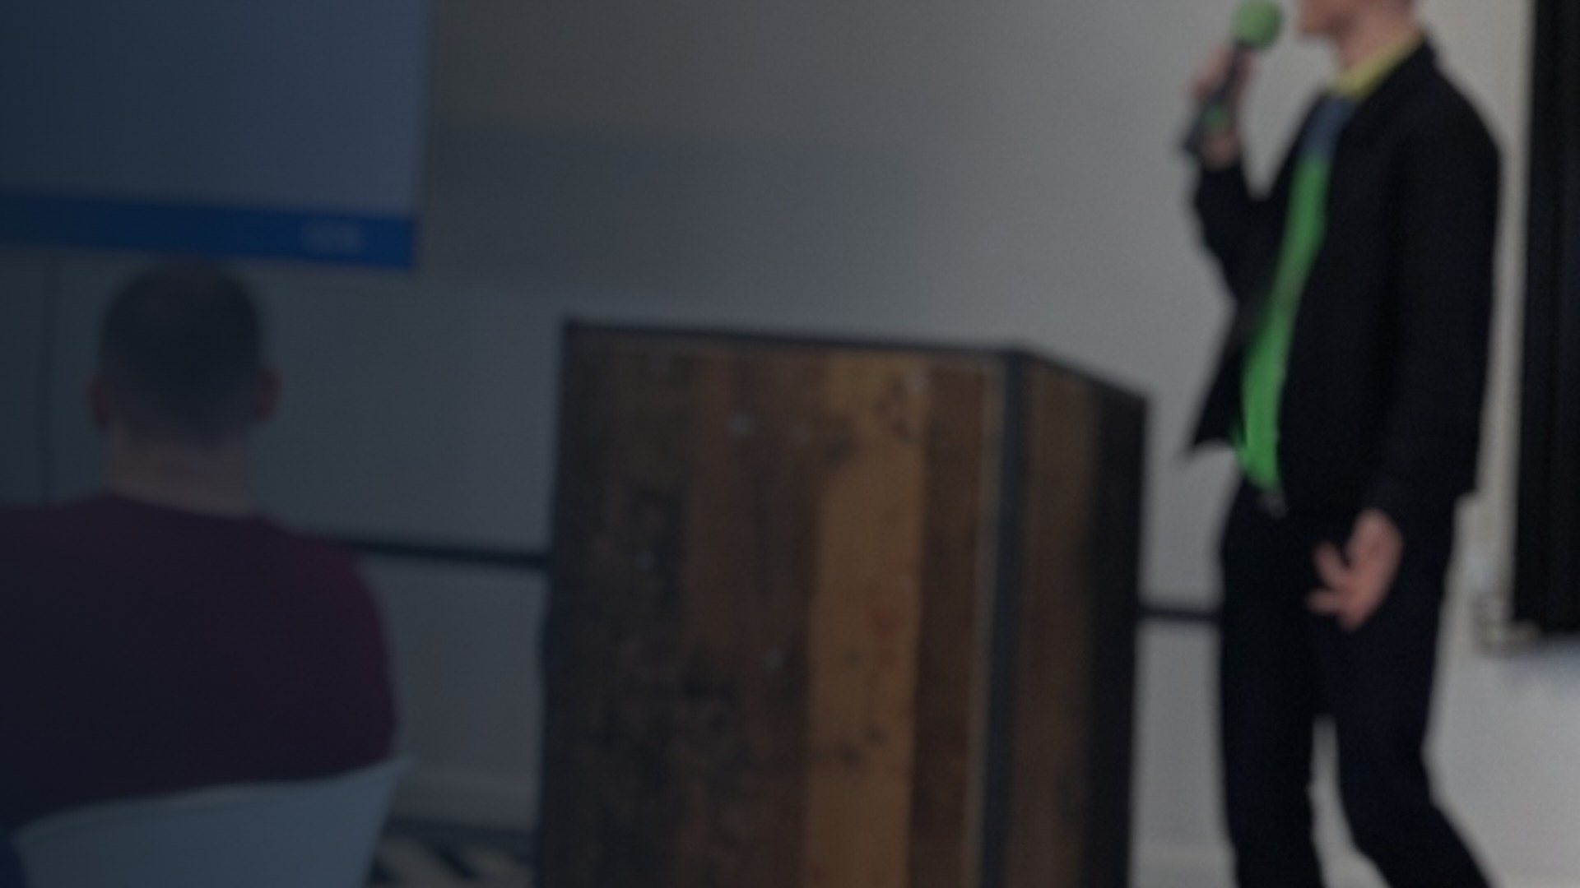
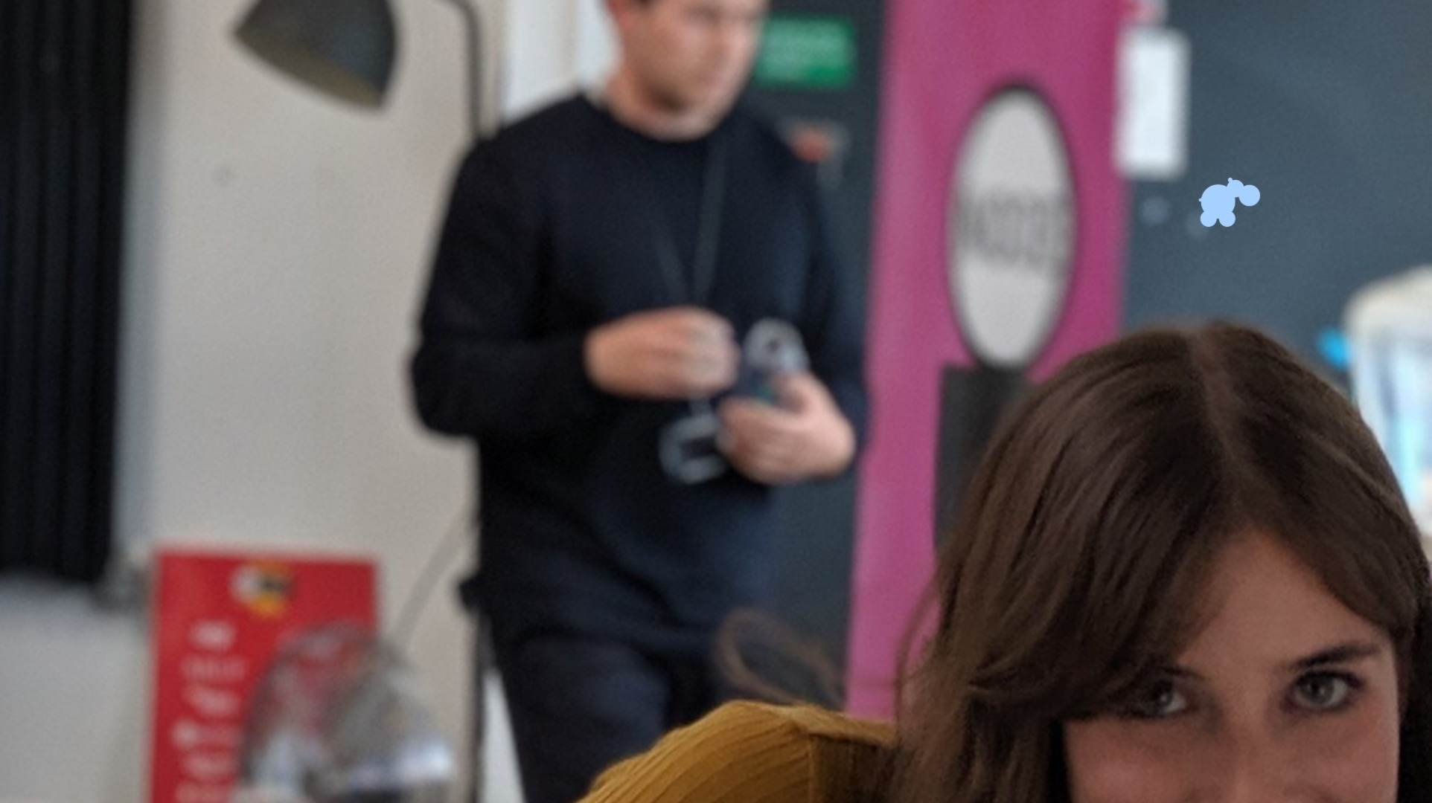

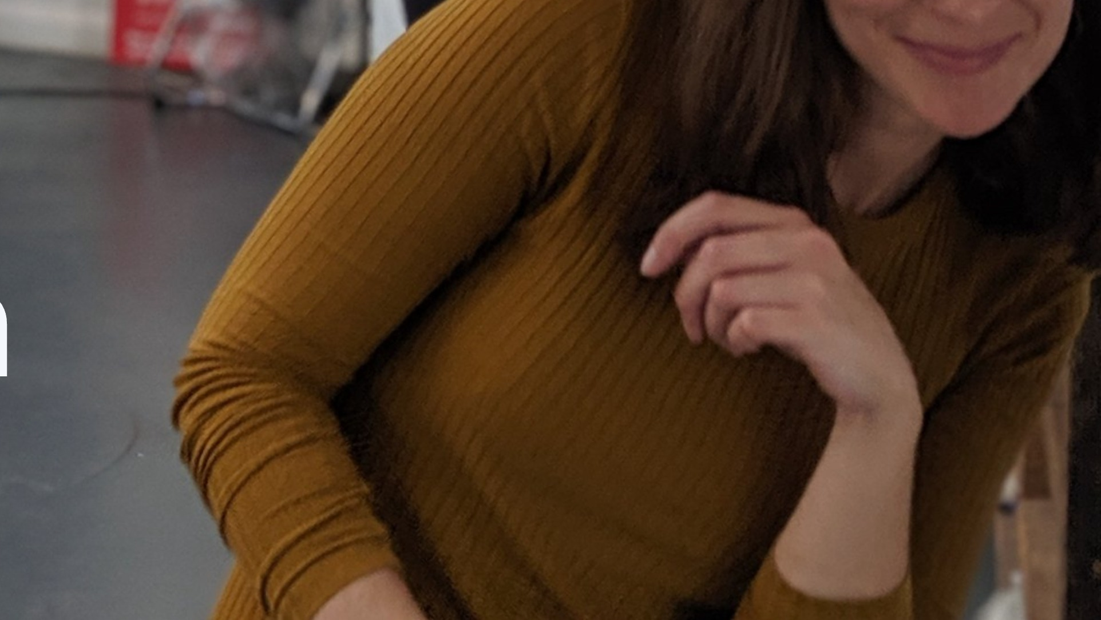
Notes:
So this is my mate Ignacia, she's a really ace service designer. We used to work together at the Government Digital Service.

Slide 15
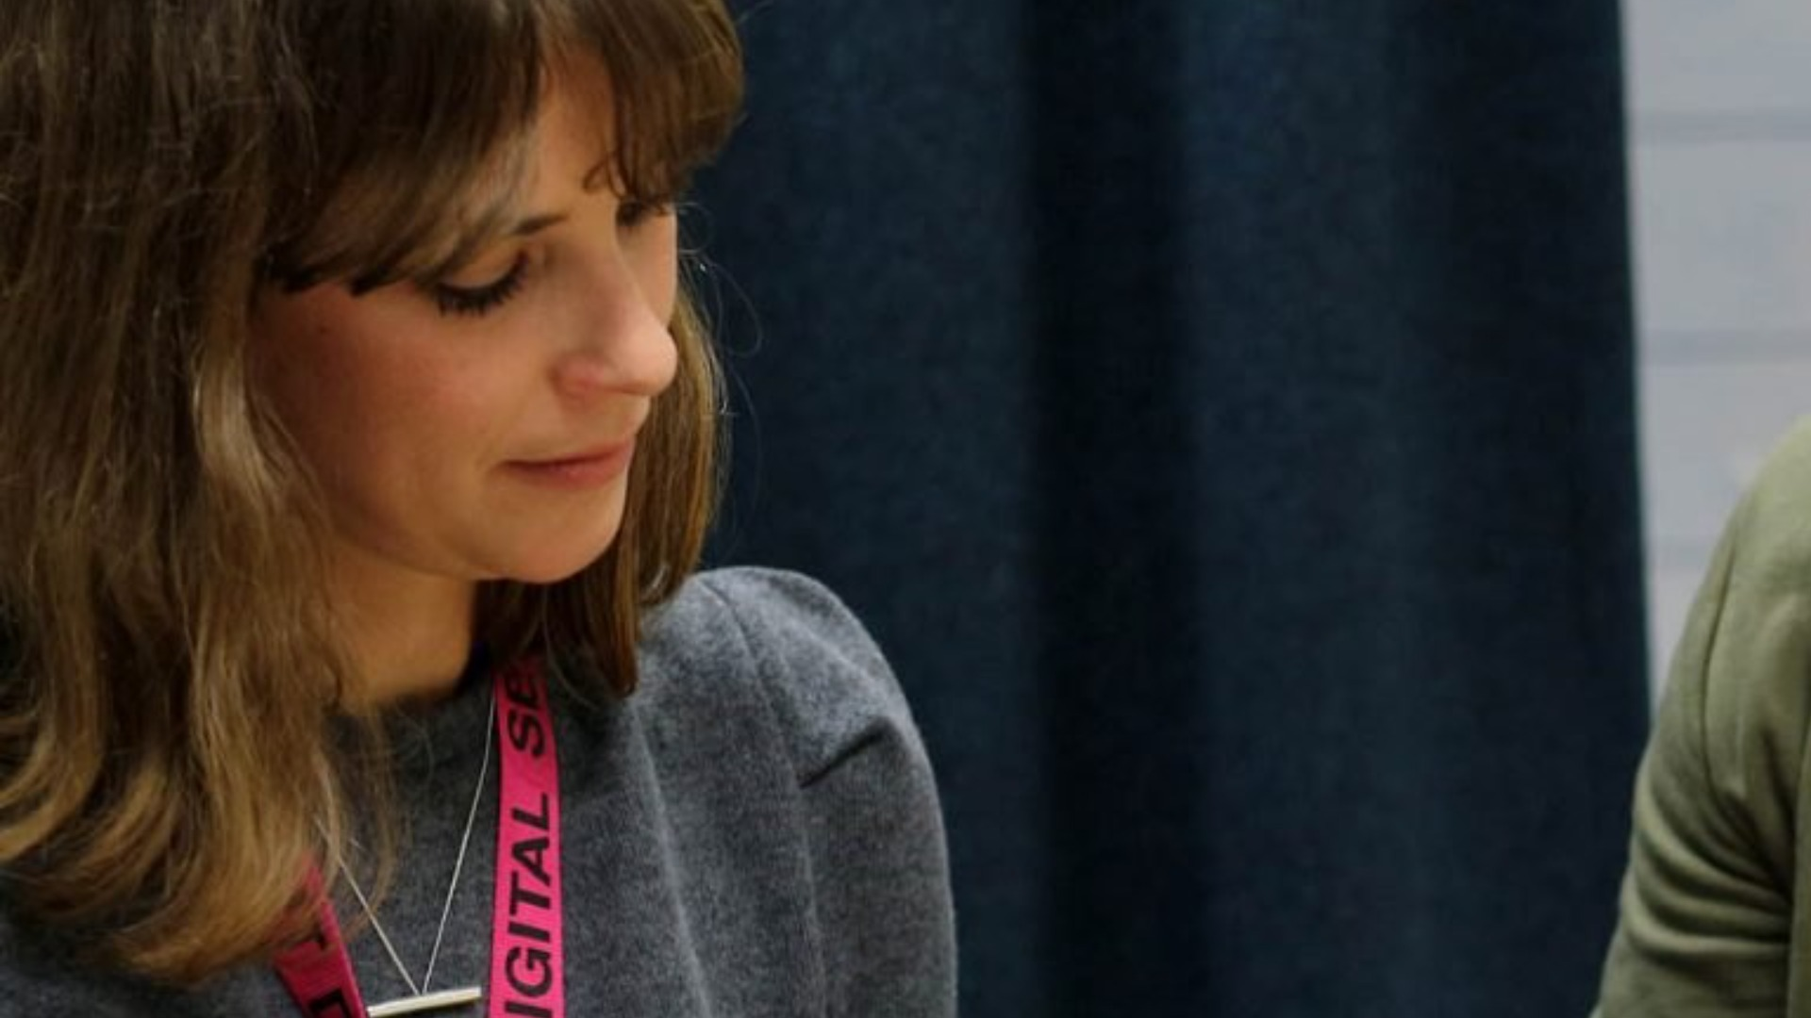
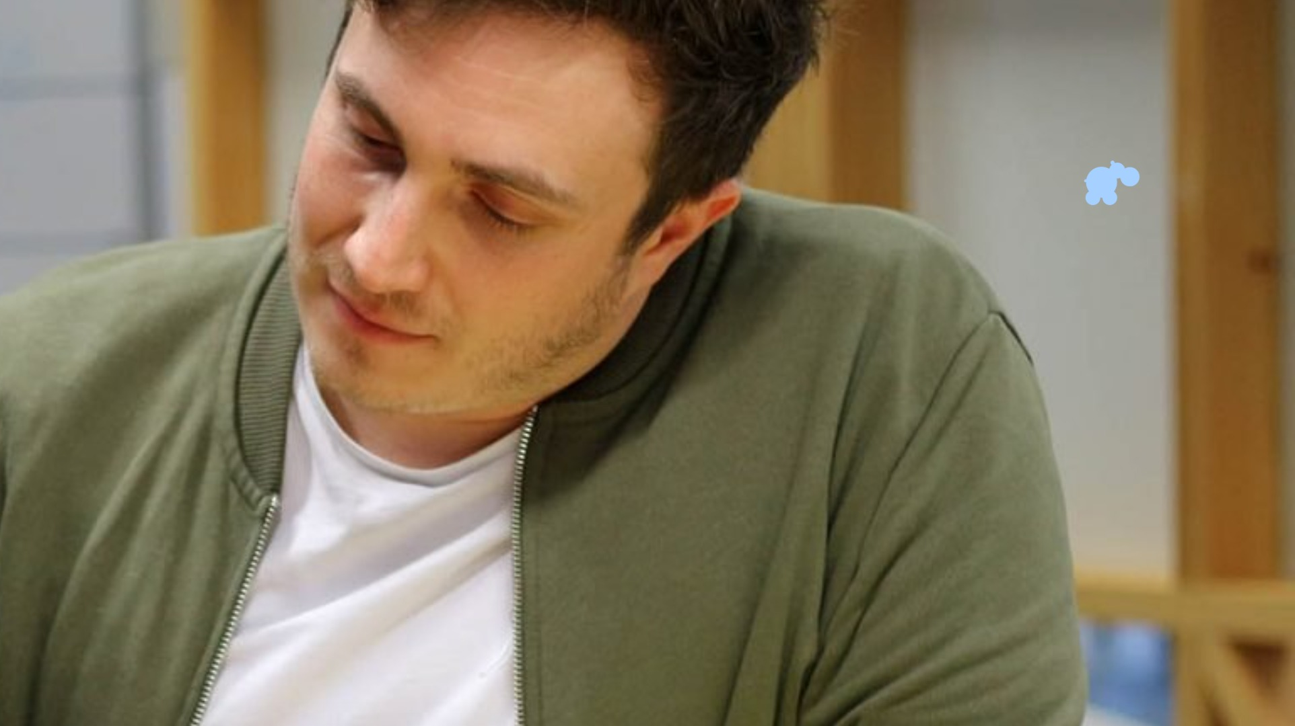
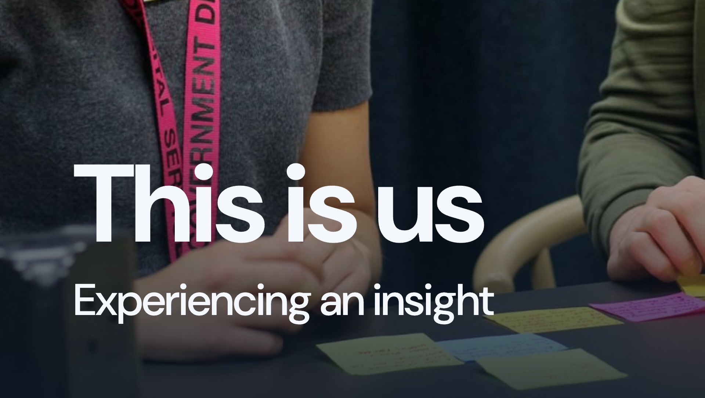
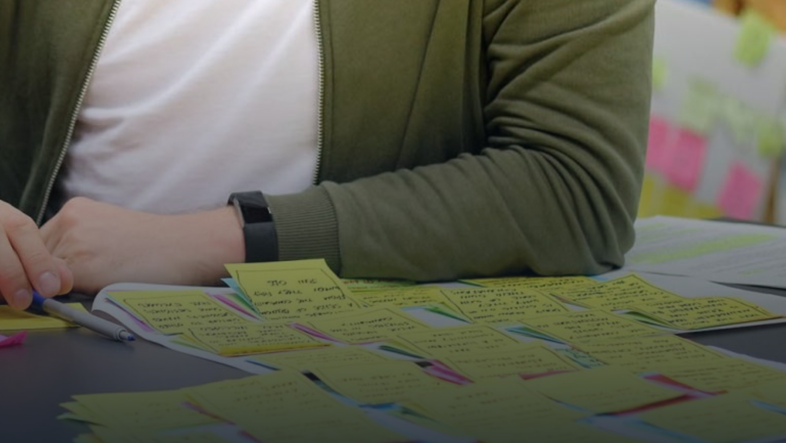
Notes:
This is us, experiencing insights. We were working on some research about inclusion in the design community at GDS. We did the interviews, and it was 2019 so we wrote it all up on post-its, and we looked at these findings for hours. And I can remember quite deeply the moment when I looked at three seemingly disparate findings, and constructed them into an explanation that changed everything about how we understood and communicated this research and what that team should do. A little later, one of us (Ignacia) put the paper notes away, and we never found them again. This should have been a disaster, but it really wasn't, because we both so completely understood the things we'd learned through that processing and through that insight, that we were able to sit down and write up those findings again.

Slide 16
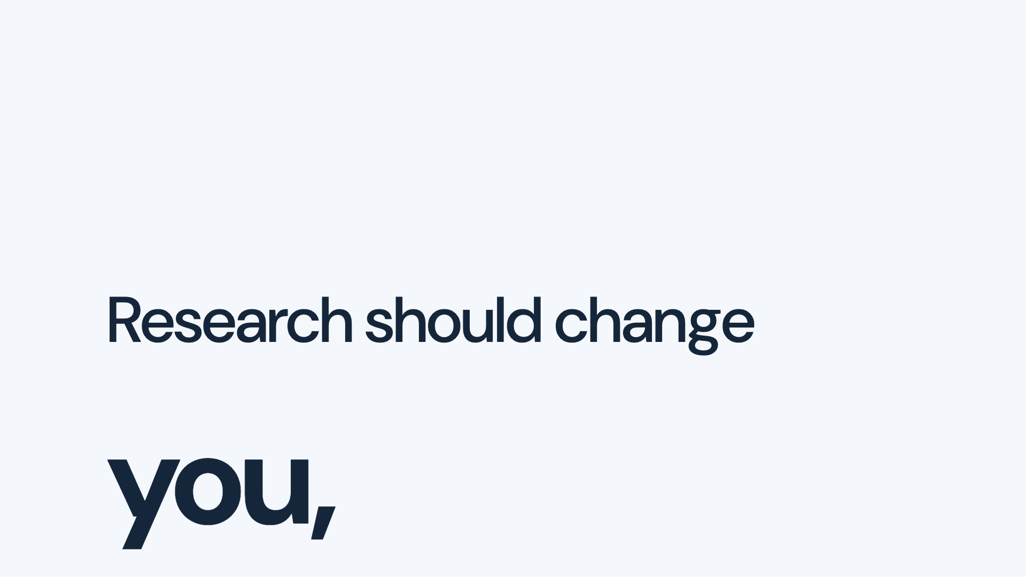

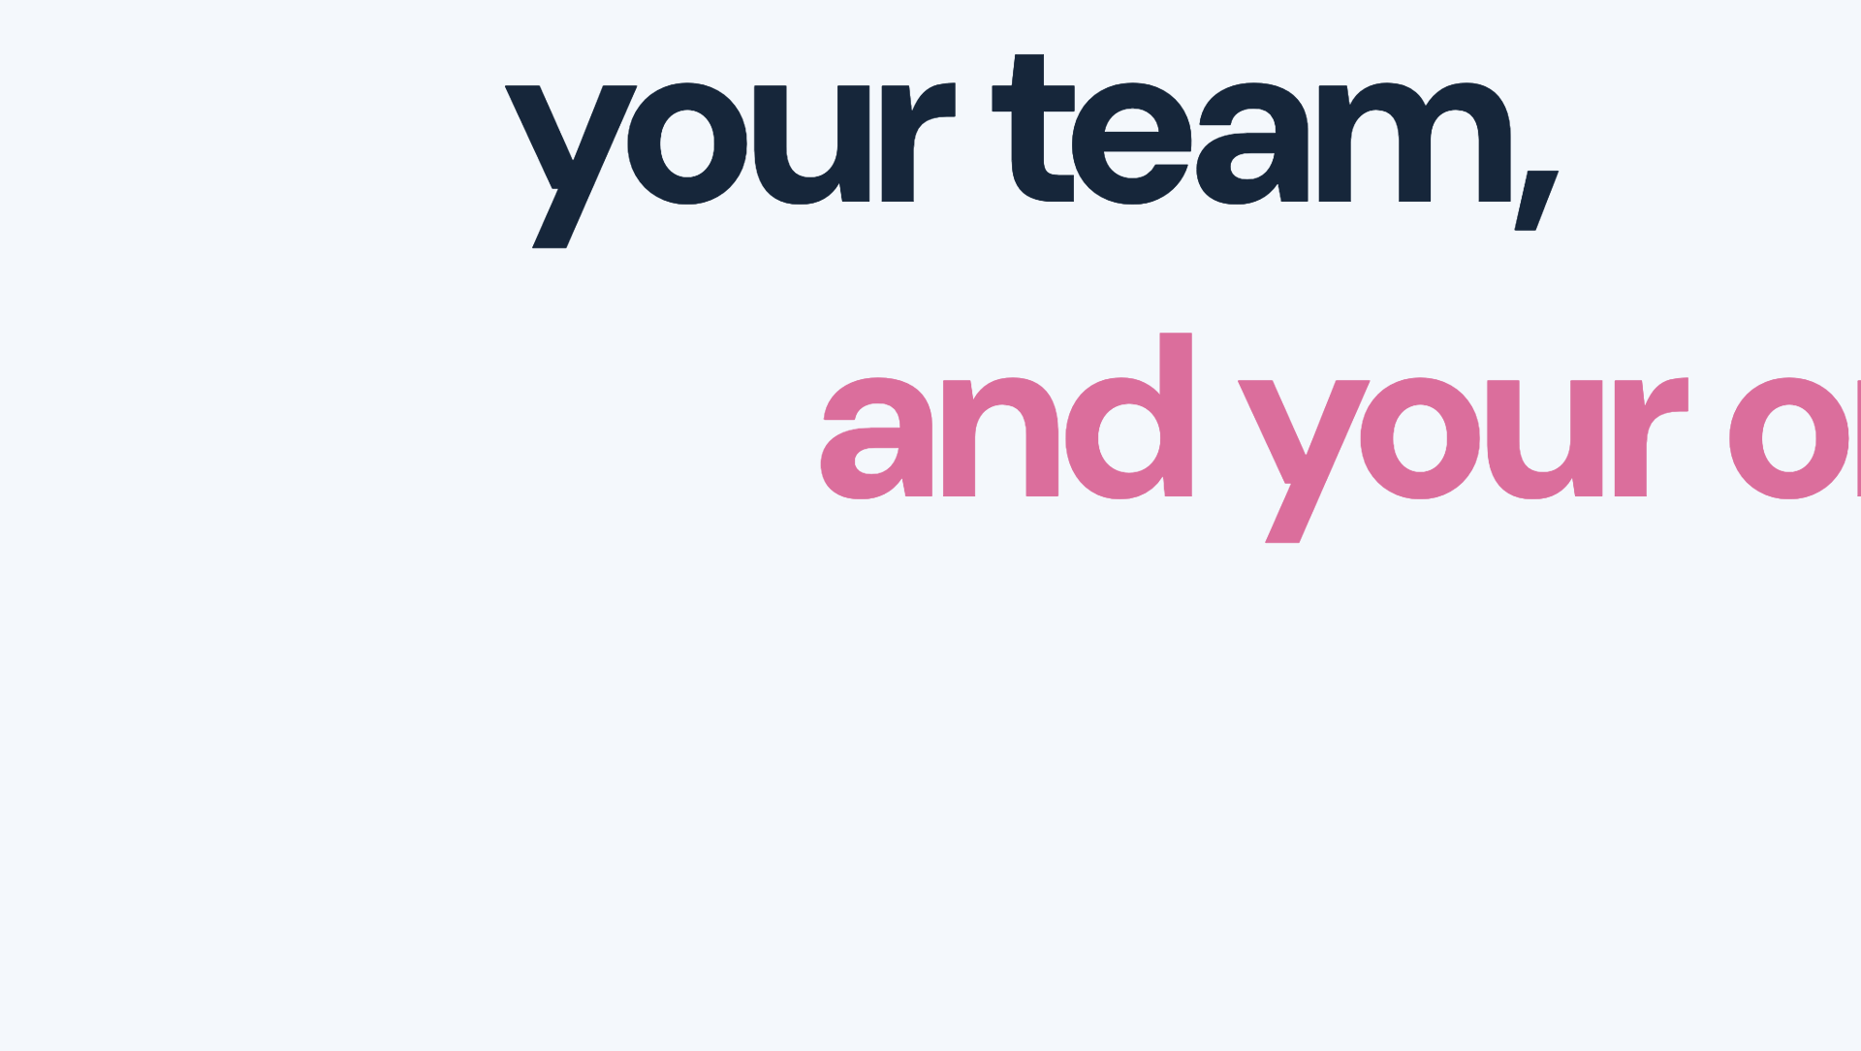

Notes:
And that's a really key point. As a researcher, my understanding is only part of the job. The people communicating, the people making decisions need to be able to use what we learn. They need to understand enough to question things, recognise their limits and act appropriately.

Slide 17

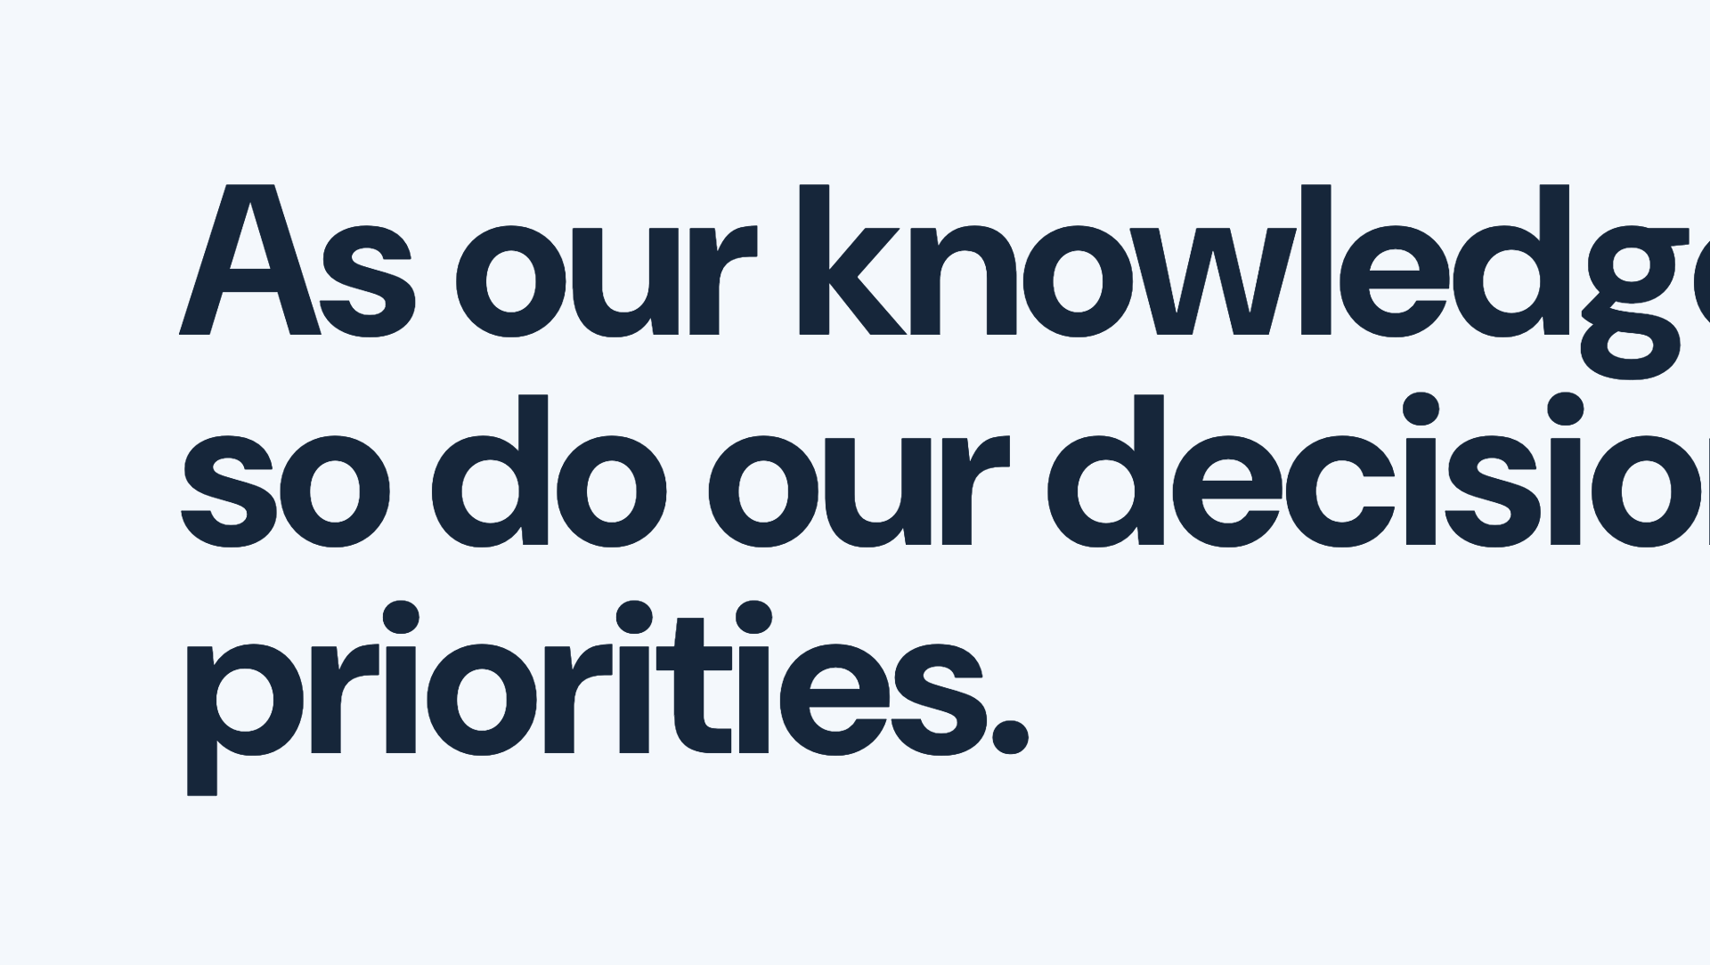
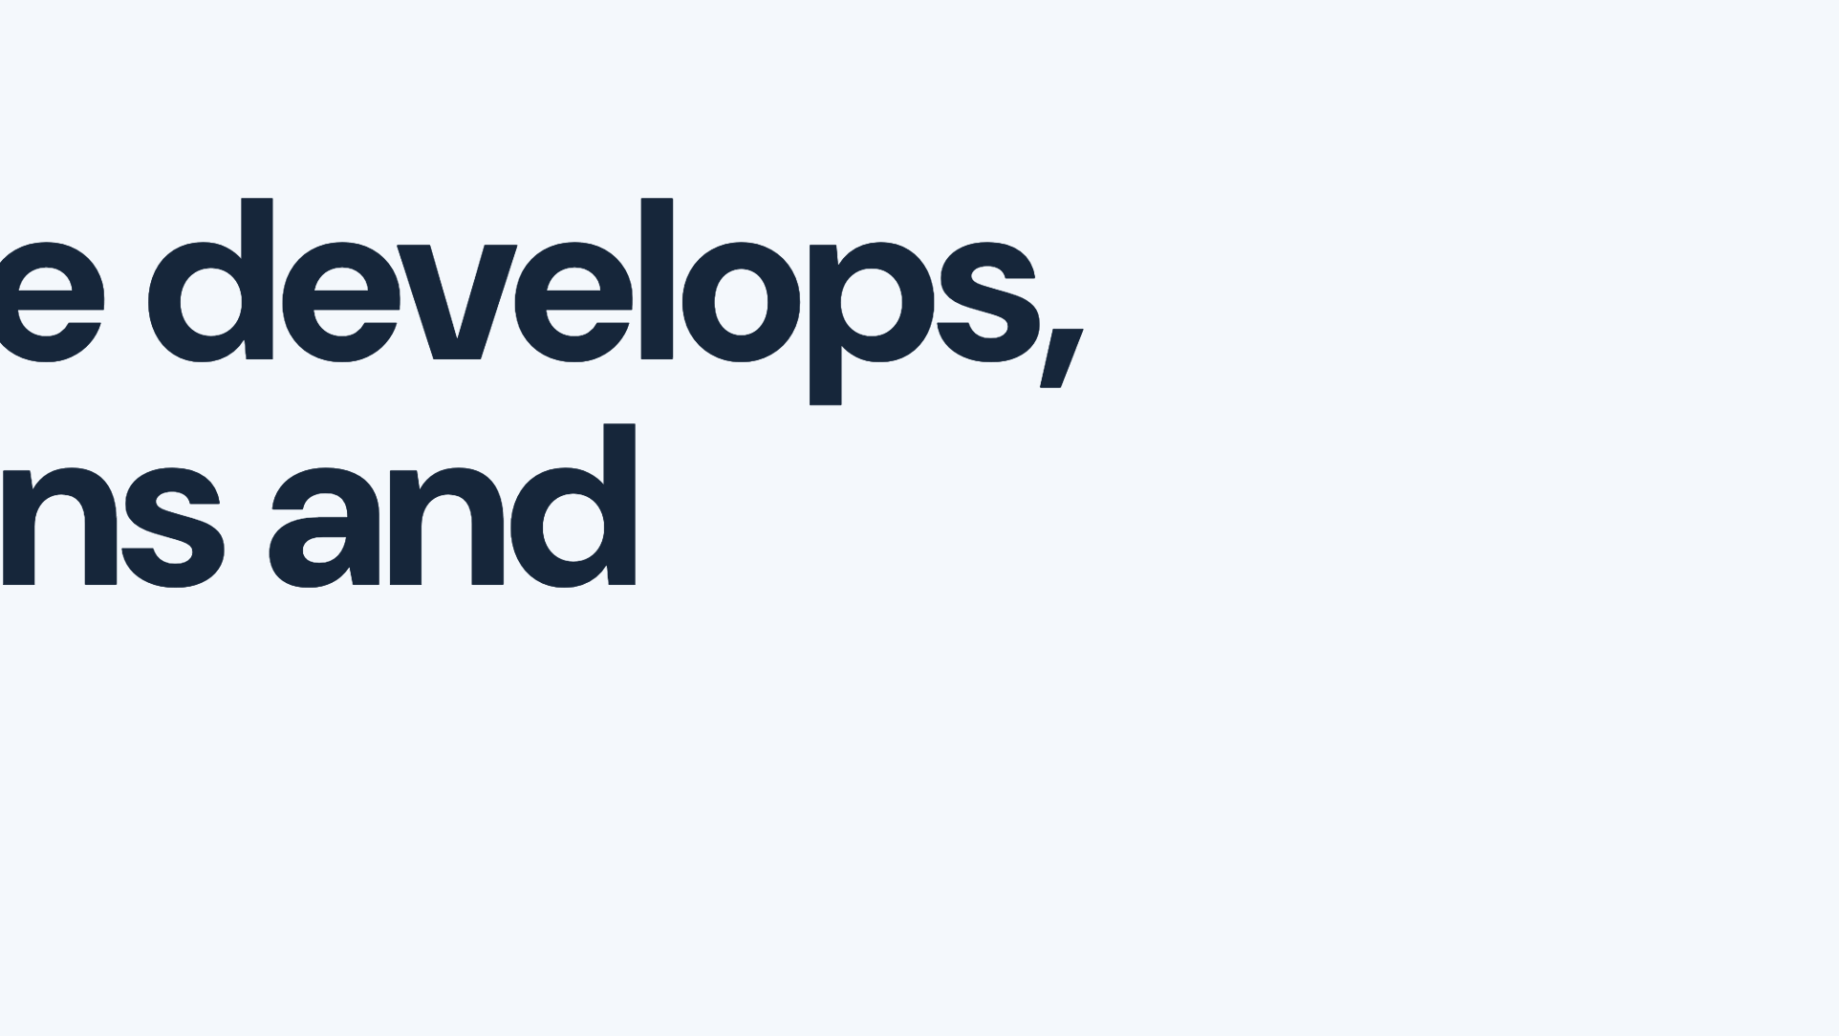
Notes:
And collectively, better explanation can change what we think the problem is, which options we consider, and what we prioritise. This is how all that change leads to better outcomes.

Slide 18
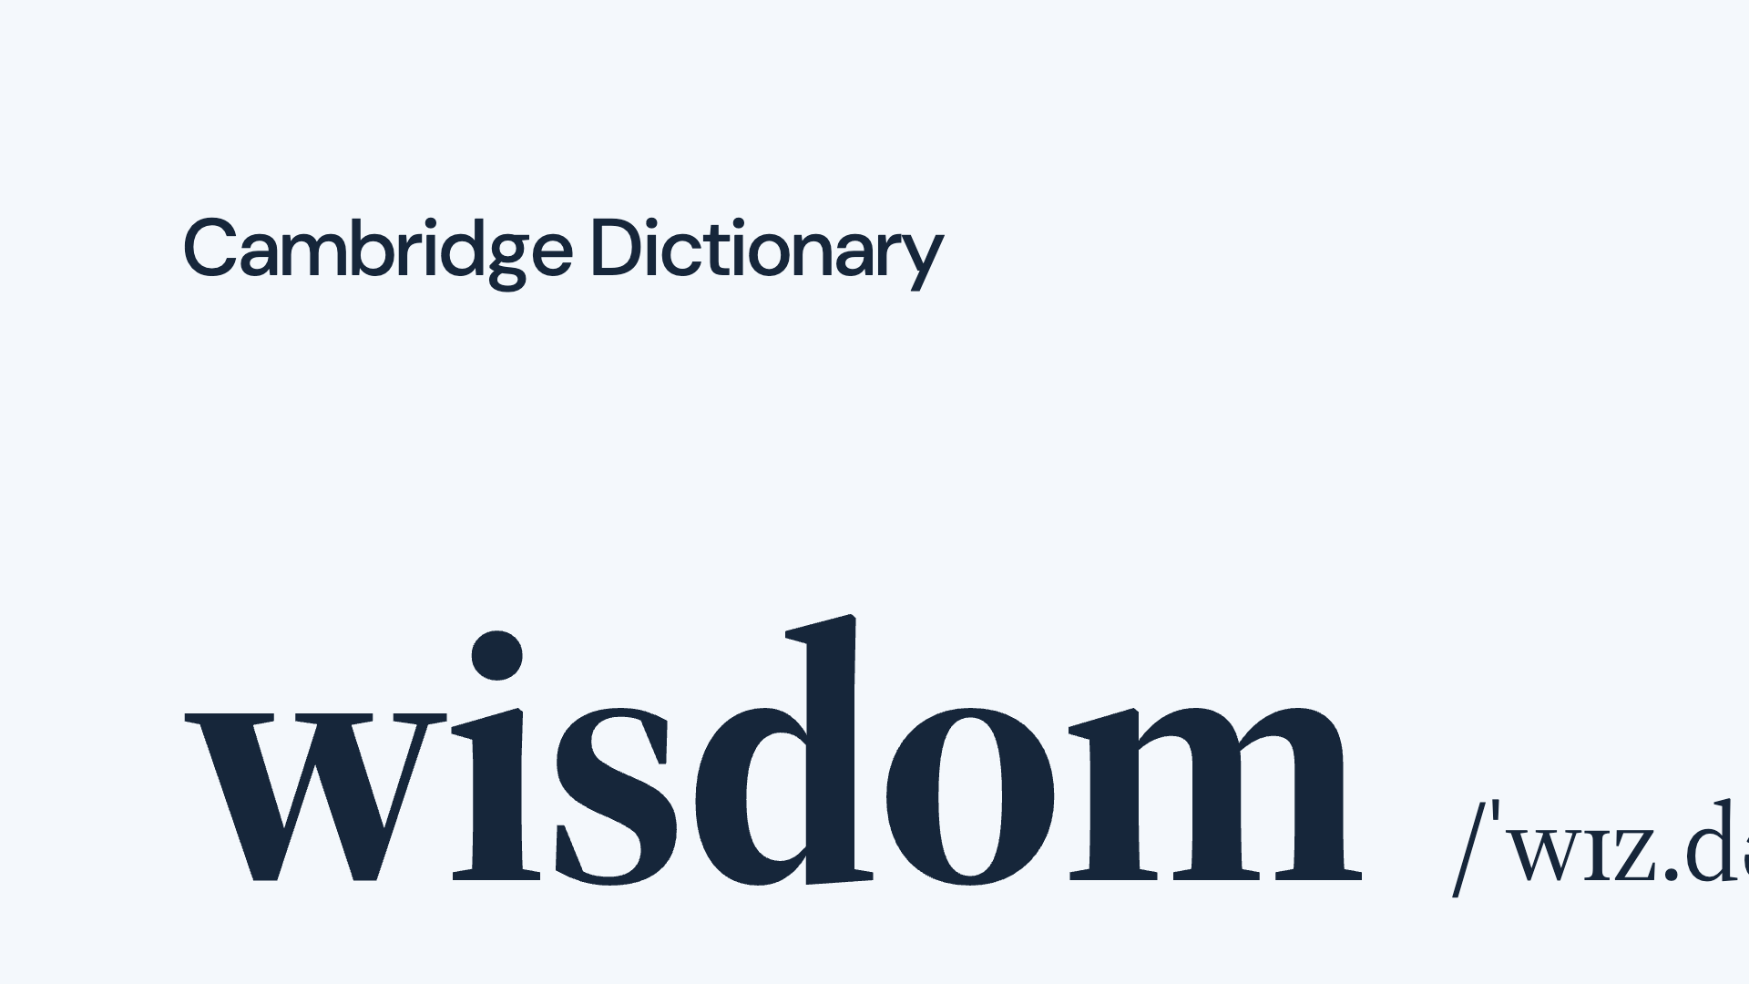
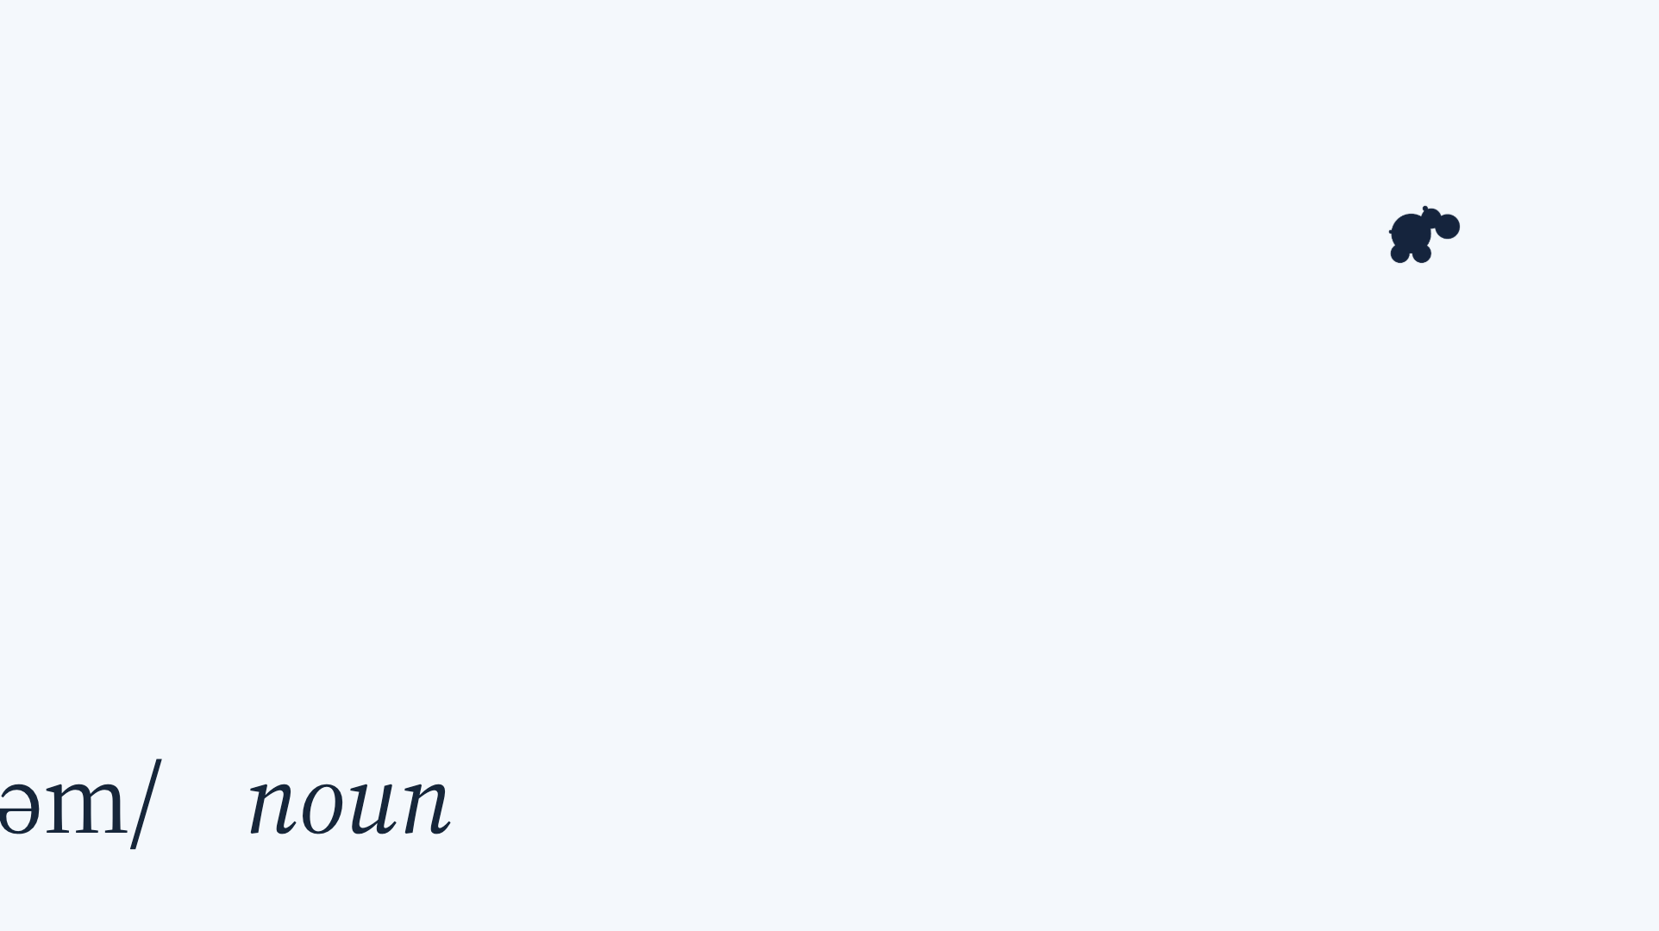
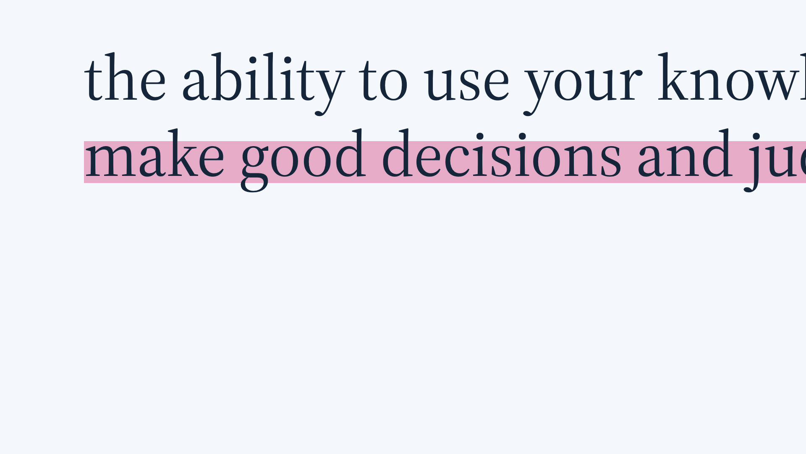
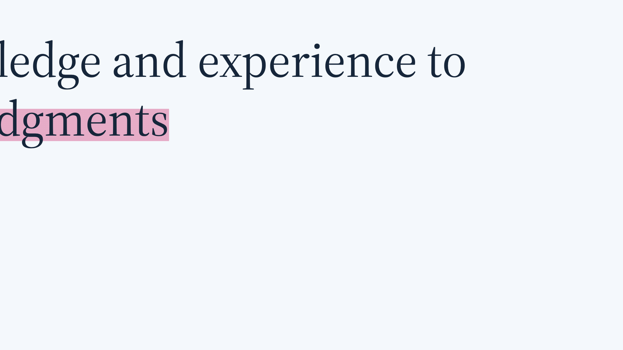
Notes:
If we wanted to put a word to this, maybe it's wisdom. I'm less convinced by this one but I was getting carried away with the dictionary template. But that learning is what helps us make good decisions and judgements.

Slide 19
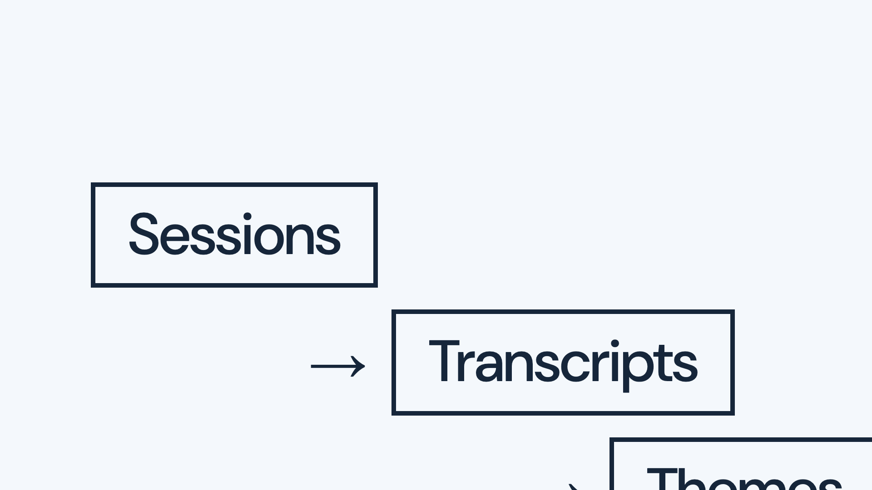

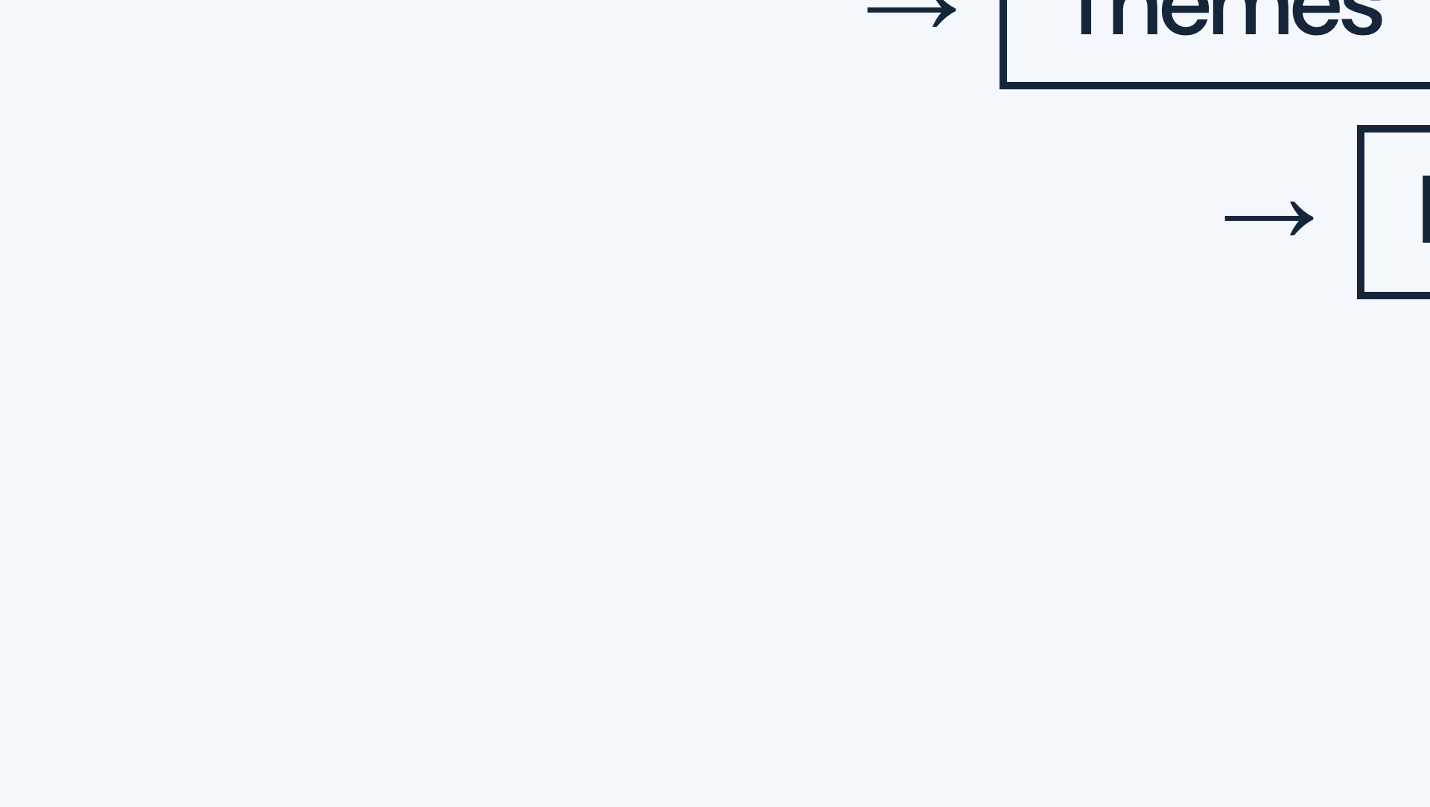
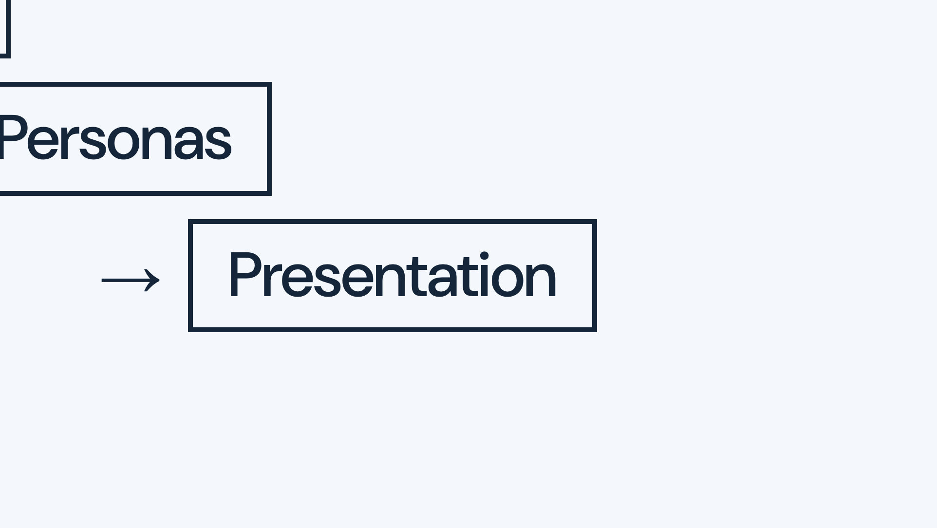
Notes:
And this means that when I think about where research might change and adapt with AI, I look at a process like this. We can do all this, run sessions, analyse transcripts, develop themes, create personas, present findings, and learn nothing at all if we want. It's increasingly easy to do.

Slide 20




Notes:
So when we take on the challenge of adopting emerging methods, we have to be asking: where does the learning happen, and who is doing it?

Slide 21




Notes:
So I promised Danny I would actually talk a bit about methods. There are four opportunities I want to give a glimpse of: deeper understanding, challenge, shared understanding, and speed. I'll go more in depth at the start then speed up a little. Before I do I want to acknowledge a lot of uncertainty. I'm adopting this stuff and exploring and these are things that have worked. I do not think great tools for thought and learning with AI are very common yet, so take these with that in mind and consider them possible starting points.

Slide 22
Notes:
So, deeper understanding. Can AI, for all we've just talked about, deepen what we learn?

Slide 23
Notes:
I think the answer is yes. I've spent a lot of time looking at how agentic AI can help us expand our analytical lenses. By that I mean quickly applying multiple analytical methods to research data, taking the best bits of those that work and constructing stories across them.

Slide 24
Notes:
To do this, I've been using agent skills. Here's a set I have, you can tell cos they have the annoying / command thing going on. Recently, having done a thematic analysis over a set of research data about perceptions of AI, I had the feeling there were unexplored angles. I didn't have a lot of time, but having created these skills it took me a couple of hours to work through a discourse analysis over the same data set. I did not learn as much as if I had sat down and undertaken that discourse analysis myself, but that was not an option I had, and the process completely changed how I presented that research, and who to, and the ways I tried to influence change with it. My understanding was different, and I did a better job as a result. This still requires you to know which methods might be appropriate and the limitations, but I think most of the time we barely scratch the surface of our analytical toolkit and I think this is a real opportunity to do that more.

Slide 25
Notes:
The next area I want to talk about is challenge. Can AI support and strengthen the reflexive method?

Slide 26
Notes:
This is Mike, he's an important product guy at Hippo. We work together quite closely, which means I get to hear his opinions on research…

Slide 27
Notes:
These are Mike's opinions on research. Now I wouldn't say exactly the same thing, but there is a real thing in here. Reflexive method, keeping our perspectives and biases in check, is hard work and is vulnerable to time pressure, delivery squeeze and inexperience.

Slide 28
Notes:
Using AI to pressure test my interpretations, to spot gaps, counter-examples, limitations in my explanations, and under-represented voices has proven really effective. It's helped me challenge my own opinions, pointed out times when my desire to tell a compelling story might be flattening counter-examples, and helped me think about which cultural and social perspectives I might be misunderstanding. This isn't a silver bullet, obviously AI is also biased and used poorly will do all the same things I'm talking about, but again it feels like a part of a toolkit that can allow us to bring more rigour into our work.

Slide 29
Notes:
Shared understanding. If research is supposed to change your team and your organisation, how people experience what we learned matters as much as what we found.

Slide 30
Notes:
When I started writing this talk, I'm not sure I'd have added this section in, especially cos of what I thought of AI video and audio; that says a bit about the pace of change. But AI tools increasingly let us take one set of research data and turn it into the thing a particular person needs: an explainer video for people who will never read a report, an infographic, a journey map someone can explore, or a playback tailored to the exact question one stakeholder is asking. The most common version people have experienced here is Gemini Notebook, but this is increasingly available via any coding agent. I think making research artefacts more transient and throwaway is a really good thing. It still takes a lot of guiding because you should be really confident you can stand behind what it says, but this creates real opportunities to scale the understanding and impact of research.

Slide 31
Notes:
Speed. There it is again, that funny feeling. Yes, we need to talk about speed.

Slide 32
Notes:
I'm going to caveat this chart, before anyone loses their mind: this is from some very small tests, and it shows a bit of what a single given round looks like. It's completely vulnerable to all kinds of bureaucracy and organisational dysfunction. But, when trying to use agents across the research cycle, with access to the right tools and especially operational foundations, there's a lot of potential to go faster, and to spend bigger chunks of our time doing the learning. I'll briefly touch on recruitment: this is using agents that keep track of screening, scheduling, follow-ups, cancellations and gaps, rather than leaving a researcher to chase every dependency. I won't dwell on this because it's immature and an area we are all still learning a lot about, but I think the core of spending larger proportions of time in the field and learning, and less operationalising, is really the direction of travel.

Slide 33
Notes:
It's also worth saying that some of what we need is just old stuff.

Slide 34
Notes:
You’re already hearing about this today so I’ll be brief. Making research and data long-lived has been an obsession of our industry for at least 10 years. AI helps a lot. Finding and resurfacing relevant material, connecting it to the current question, and making it easier to examine. I think there are huge risks and huge rewards here. With AI doing the connecting, it will be more important than ever to keep surfacing who we learned something from, under what circumstances, and how much of that understanding applies here. But the ambition for research to keep contributing after its original playback, and to recognise when existing evidence is insufficient and we need to learn something new, feels like one that has actually been met here.

Slide 35
Notes:
This ties back to the project-brain example: we need evidence that remains understandable and connected to the interpretations it informed. I don't know if atomic research is THE right thing, but we need to be doing something here to make sure that the traceability of research remains legible.

Slide 36
Notes:
If everything in design and development and delivery gets better, we are going to be confronted more than ever with the fact that we can't research everything. And we shouldn't. Prioritising our research efforts based on risk is a key part of how we address that. Wardley maps are a great way of looking at a service and deciding which bits of this service are new, cutting edge, untested, like sticking AI in your patient support journey, and which are well commoditised, clear patterns and best practice. That really helps decide what to test. I could stop and talk here for ages cos it's a whole talk on its own, but I won't.

Slide 37
Notes:
Lastly, we have to mention research as a team sport. This is hard, this is unsolved. Lots of things I've talked about are easy to do alone, and since the pandemic that's happened more and more in places. I think this is a good time to make sure that our teams are seeing their users in the field, are in on the analysis and learning. That's what changes them and their understanding. That's what worked in my example with Ignacia.

Slide 38
Notes:
So back to the final idea. There is a lot of talk about AI transforming research. Research is itself supposed to be transformative. I hope these emerging methods help us develop better explanations, question them more effectively, help others understand them, and get to useful understanding sooner.

Slide 39
Notes:
So when you're next weighing up a new tool or a new method, ask yourself: what do we understand differently, and what will we do differently because of it? Thank you.

