Slide 1
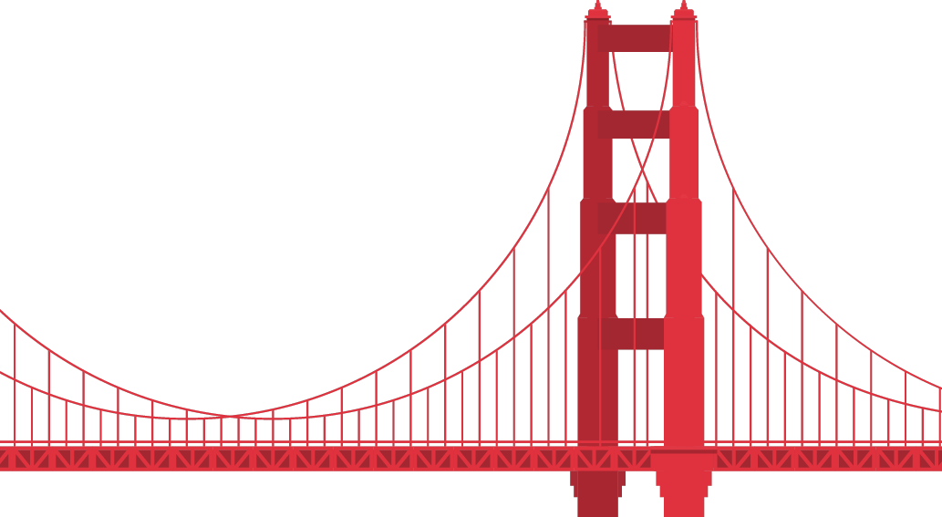

A WHOLE approach to bridging the integrity gap
Kathy Neuss
Head of Research
How good teams drift into bad outcomes, and how to stay whole​
Notes:
I’ve been a researcher in digital services since the late 90s. Perhaps even before some of you were born!
Methods and technologies have changed, but one thing I’ve always valued throughout is integrity, because our designs can affect millions of people.
My talk is about integrity and draws on my own experiences and frustrations of working on delivery teams, alongside some sociological, psychological and anthropological thinking.
I’m going to start with a story about bridges, hence the title “A whole approach to bridging the integrity gap” as I think bridges are a good analogy for UX. Essentially we’re moving someone from point A to point B – we bridge that gap with solutions guided by our methods. So it’s really important that our methods and the decisions we make around our methods are underpinned by integrity.

Slide 2

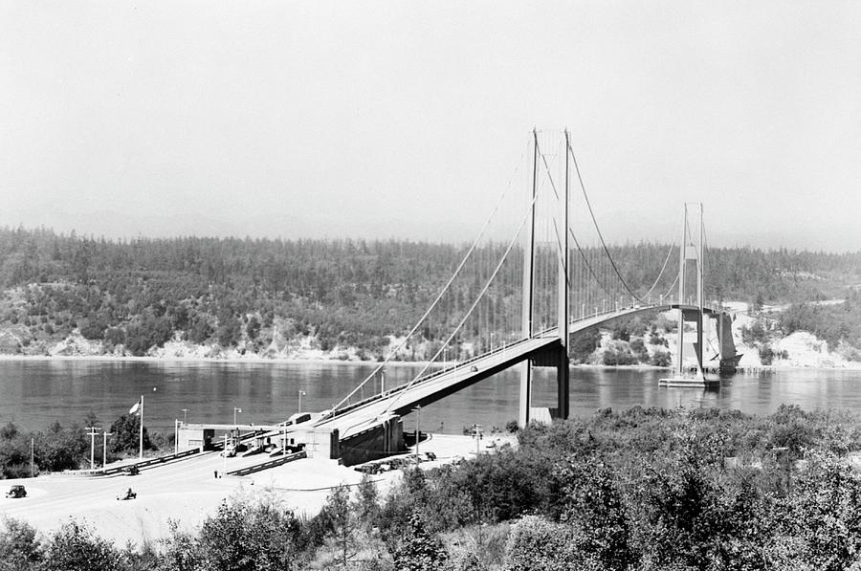
Notes:
This is the iconic Golden Gate Bridge. Who has been here?
Built during the Great Depression, it opened in 1937.
Joseph Strauss was the chief engineer, and amongst his team was Leon Moisseiff. Moisseiff was known for his work on “deflection theory.” Which is basically a mathematical formula that explains how and how much a structure bends or shifts when forces act on it.

Slide 3
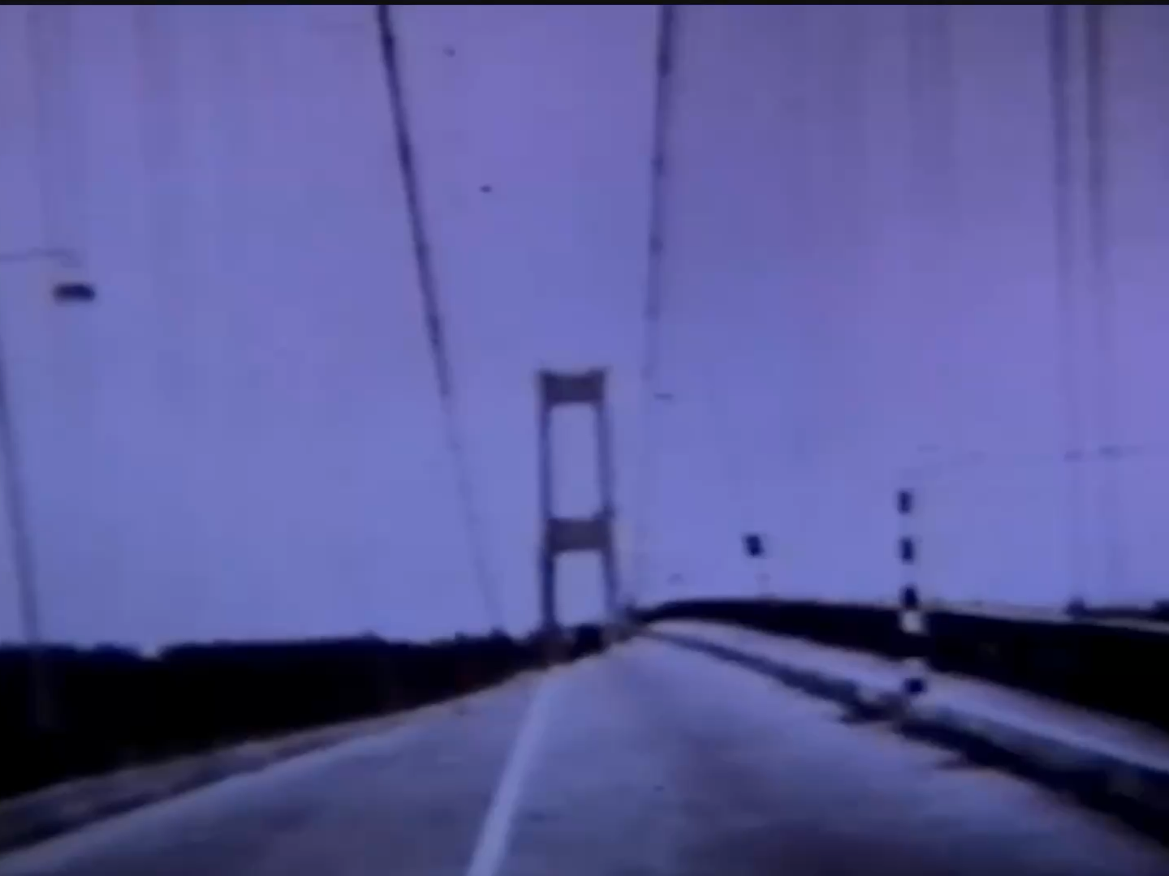
Same engineer, different outcomes
Golden Gate Bridge,
1937
Tacoma Narrows Bridge, 1940
Notes:
Following the success of the Golden Gate Bridge, Moisseiff went on to lead the design of the Tacoma Narrows Bridge, which opened in 1940.
He designed a highly flexible and ultra-slender concept that was to be the largest suspension bridge built in the US.
But, success can breed confidence, and confidence can hide forces that are not well understood.
Moisseiff called it ‘the most beautiful bridge in the world.” And yet, just 4 months after completion, the bridge collapsed.

Slide 4
Notes:
This is actual footage on the morning of the collapse.
No longer being held together under pressure, the integrity of the bridge broke, literally.

Slide 5
integritas
Latin: Wholeness
The Etymology of Integrity
1400s: Physical
Entered Middle English referring to physical soundness and purity.
3. 1540s: Moral
Shifted to define moral uprightness and an undivided character.
The Root
From integer - meaning untouched, complete, or whole.
Notes:
"When you hear the word 'integrity', what comes to mind?" Most people will say "honesty", doing the right thing or good morals. Which it is, but it’s also more.
The word originates from the Latin integritas, which means “wholeness.”
In our work, integrity means all the parts that make good research, design and delivery, the whole of it. And wholeness is what we need to bring to successfully move someone from point A to point B in our digital services.
Integrity failures are rarely as dramatic as the Tacoma narrows bridge, nor are they malicious.
More often, they’re a pattern of small compromises that compound and pull us away from what we set out to achieve. They pull apart the whole.

Slide 6
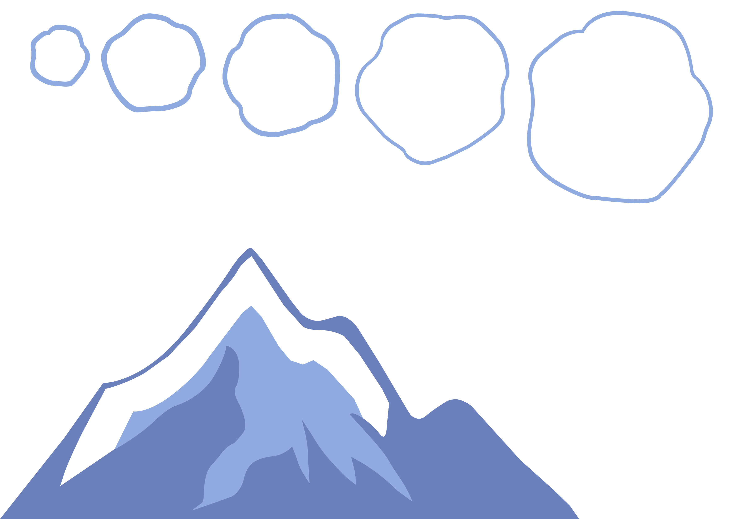
It starts with pressure
  deadlines, policy, competition
Notes:
It starts with pressure, then comes adjustment, then normalisation, then amplification, then consequence. Perhaps, sudden, but actually long in the making.

Slide 7
Then comes adjustment
  “We’ll accept this for now”
  “We’ll revisit later”

Slide 8
Then normalisation
  the compromise becomes the baseline

Slide 9
Then amplification
  repeated across sprints, features, releases

Slide 10
Then consequence
  sudden… but actually long in the making
Notes:
For Moiseiff, every bridge that didn't fall made the next one feel safer.
It wasn’t common practice to model bridges at the time. In his defence you could argue that he was unaware of all the forces that challenged his theories.
We don’t have that excuse. Prototyping is part of our practice. Yet we still launch services despite known problems.

Slide 11
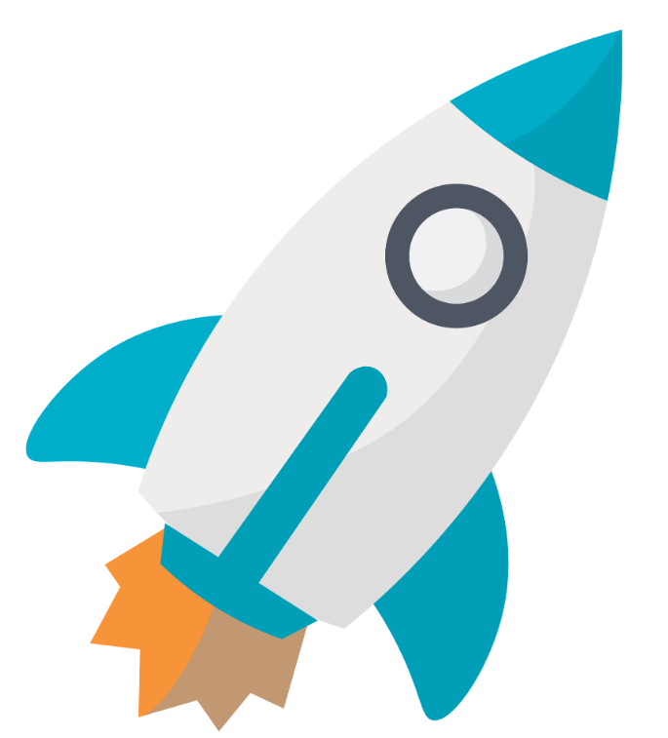
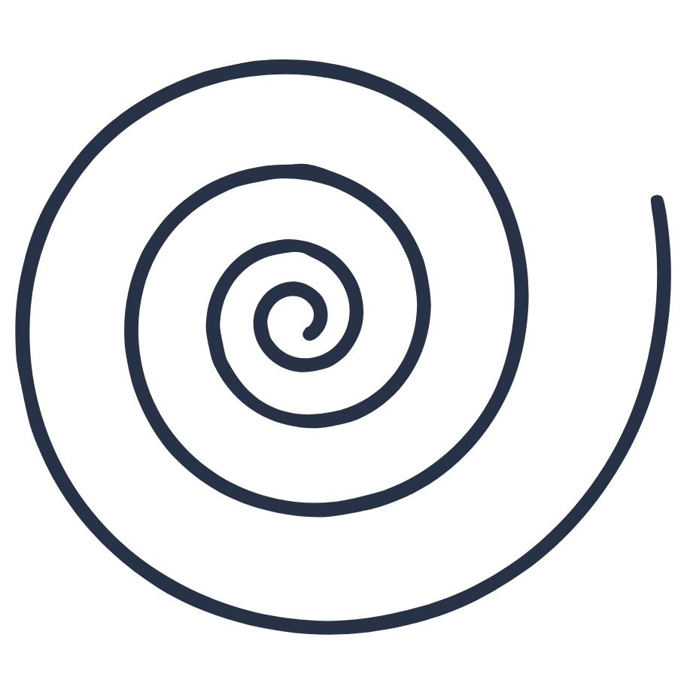


Normalisation of deviance
  Live
  Diane Vaughan
  Beta
  Alpha
  Discovery
  How competent, ethical people produce bad outcomes together.
  Deviance
  Deviance
  Deviance
Notes:
That’s what Diane Vaughan in her study of why NASA launched the Space Shuttle Challenger in 1986, despite known problems, calls normalisation of deviance.
Normalisation of deviance is the gradual process by which something that should be unacceptable becomes acceptable.
For example, In government digital delivery (where I mostly work), the deviance is a gradual drift from the original problem statement. In discovery, user research is deferred because deadlines are tight. In alpha, the scope narrows to fit the budget. In Beta, a workaround is accepted because it gets the service live. And completion is reported against delivery milestones rather than user outcomes.
You might feel like you’ve experienced this spiral, or are experiencing this. I know I have.
Some of this isn’t in your control. Speaking up when you see a project drift from its vision is. But speaking up can be hard and comes with risks.
To help you, I’ve created a memory aid for approaching the task of digital service design with integrity and wholeness.

Slide 12
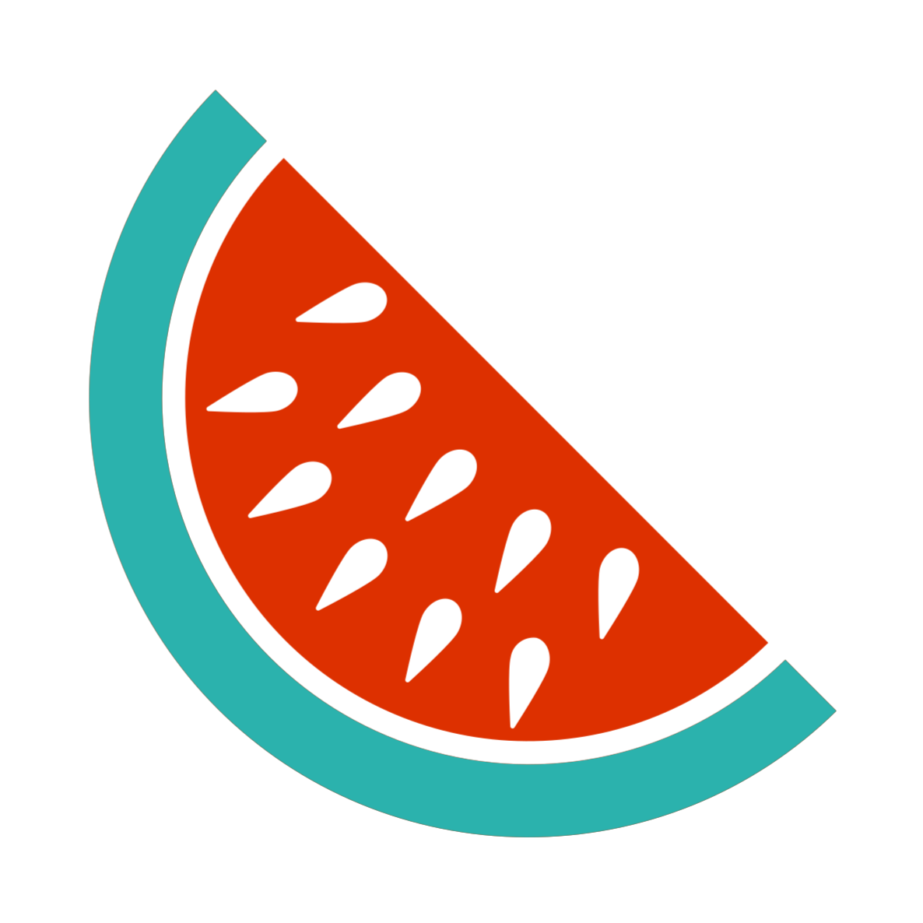

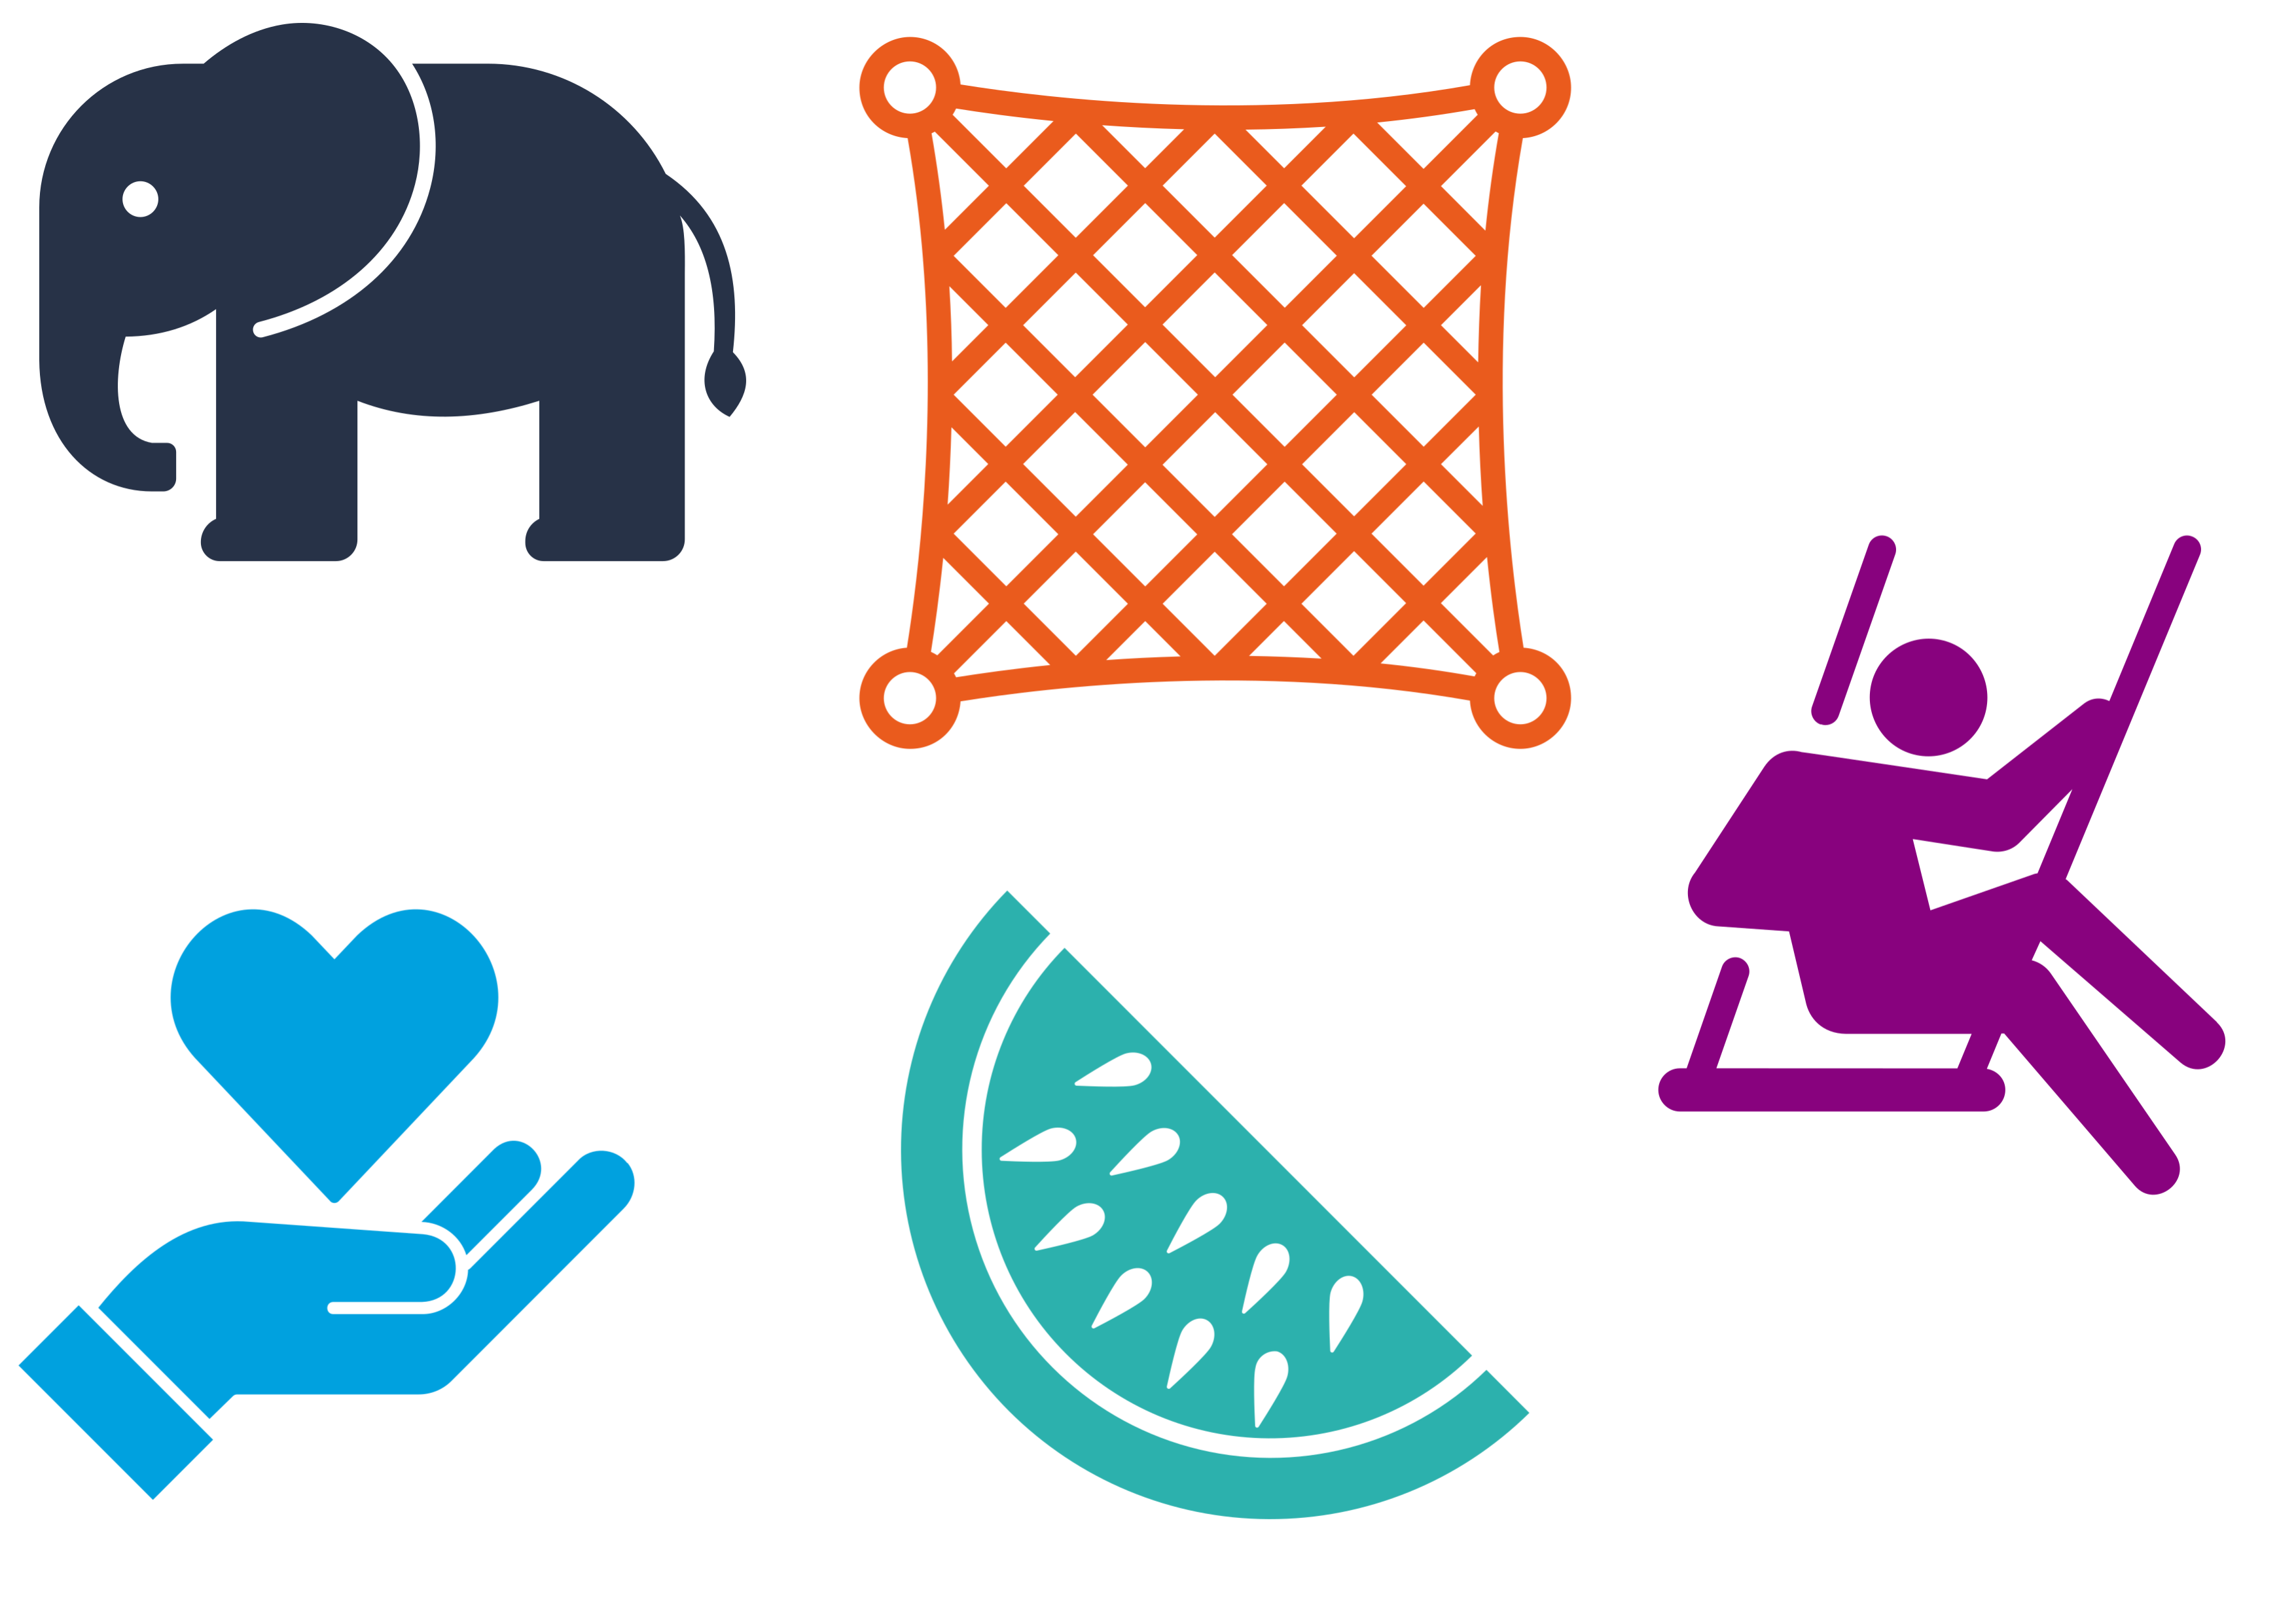
W
Outcomes
over *outputs*
Humility
and knowing what we don’t
Liminality
awareness
Who
are you not considering?
Elephant
and rider
H
O
L
E
Notes:
WHOLE is an acrostic you can take with you when you leave the Dome today.
WHOLE is a way of bridging the integrity gap and addressing the compounding compromises and deviance.
Each letter protects a different part of the whole and relates to: a question, a virtue, a principle, a concept and a metaphor. but they are all connected.

Slide 13
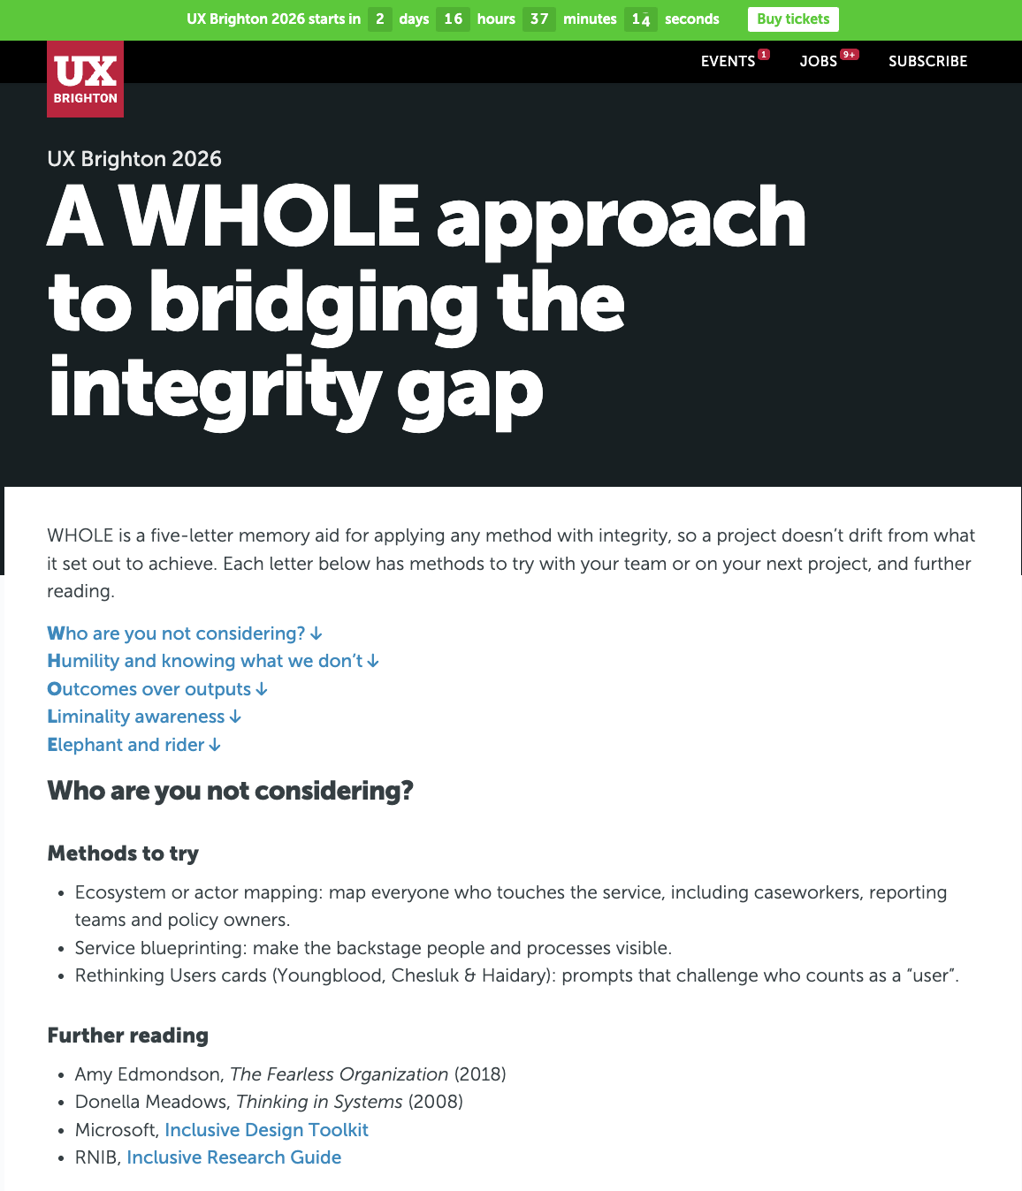
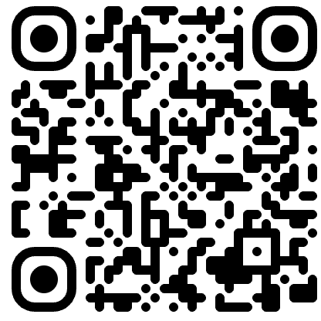
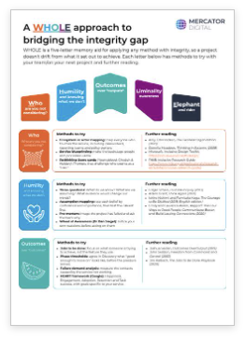
Notes:
There’s a handout with suggested methods and further reading if something resonates with you.
Let’s start with the question: Who are you not considering?

Slide 14
Who are we not considering?
Research participants are mostly:
  Digitally confident
  Already familiar with services
  Comfortable speaking up in interviews
= recruitment bias
Notes:
We all know it’s hard to recruit an unbiased sample.
Research participants are mostly digitally confident, familiar with the service, and comfortable speaking up.
This doesn’t happen intentionally. Vulnerable participants are harder to recruit, timelines are tight, and “good enough” gets accepted.
So, recruitment bias is an obvious place to start (and frustratingly user researchers often carry the brunt of the blame) but it’s not just participants that we need to consider.
It’s also the people behind the scenes: the ones who use, report on and support the service. And it’s also your own team.

Slide 15
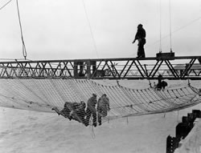
Notes:
At the time of the Golden Gate bridge construction, the expectation was one worker’s life lost for every million dollars spent.
The chief engineer, Joseph Strauss, refused to accept that blood price and installed a huge safety net under the construction site. It saved 19 men, who called themselves the “Halfway to Hell Club.”
The net wasn’t foolproof. But I wonder whether it mattered that people felt considered, thought of, worthy of being there and valued.
Do you feel that same kind of consideration has been invested in you? Do people want to stay in your team?

Slide 16
Humility and knowing what we don’t
When given the choice between being right or being kind, choose kind.
- Dr. Wayne W.Dyer
Notes:
H is a virtue: humility.
Humility helps build the safety net that supports your team.
The international standard for human-centred design says teams should be multidisciplinary, because diverse expertise makes better design. But it isn’t always easy. Conflicting personalities, values and priorities can lead to distrust, resentment and, at worst, confrontations, and yes, even physical punch-ups.
I love this quote which appears in the film Wonder: ‘ when given the choice between being right or being kind, choose kind.”
But humility is more than kindness. It’s knowing what you don’t know.

Slide 17
Humility in practice
What do we know to be true?
What are we assuming?
What evidence would change our minds?
Notes:
Humility goes hand in hand with curiosity, reflection and openness to opposing views, which are exactly what we need between team members and stakeholders.
In practice, we can move away from our egos and blame by asking three simple questions when conflicts arise:
What do we know to be true? What are we assuming? What evidence would change our minds?

Slide 18
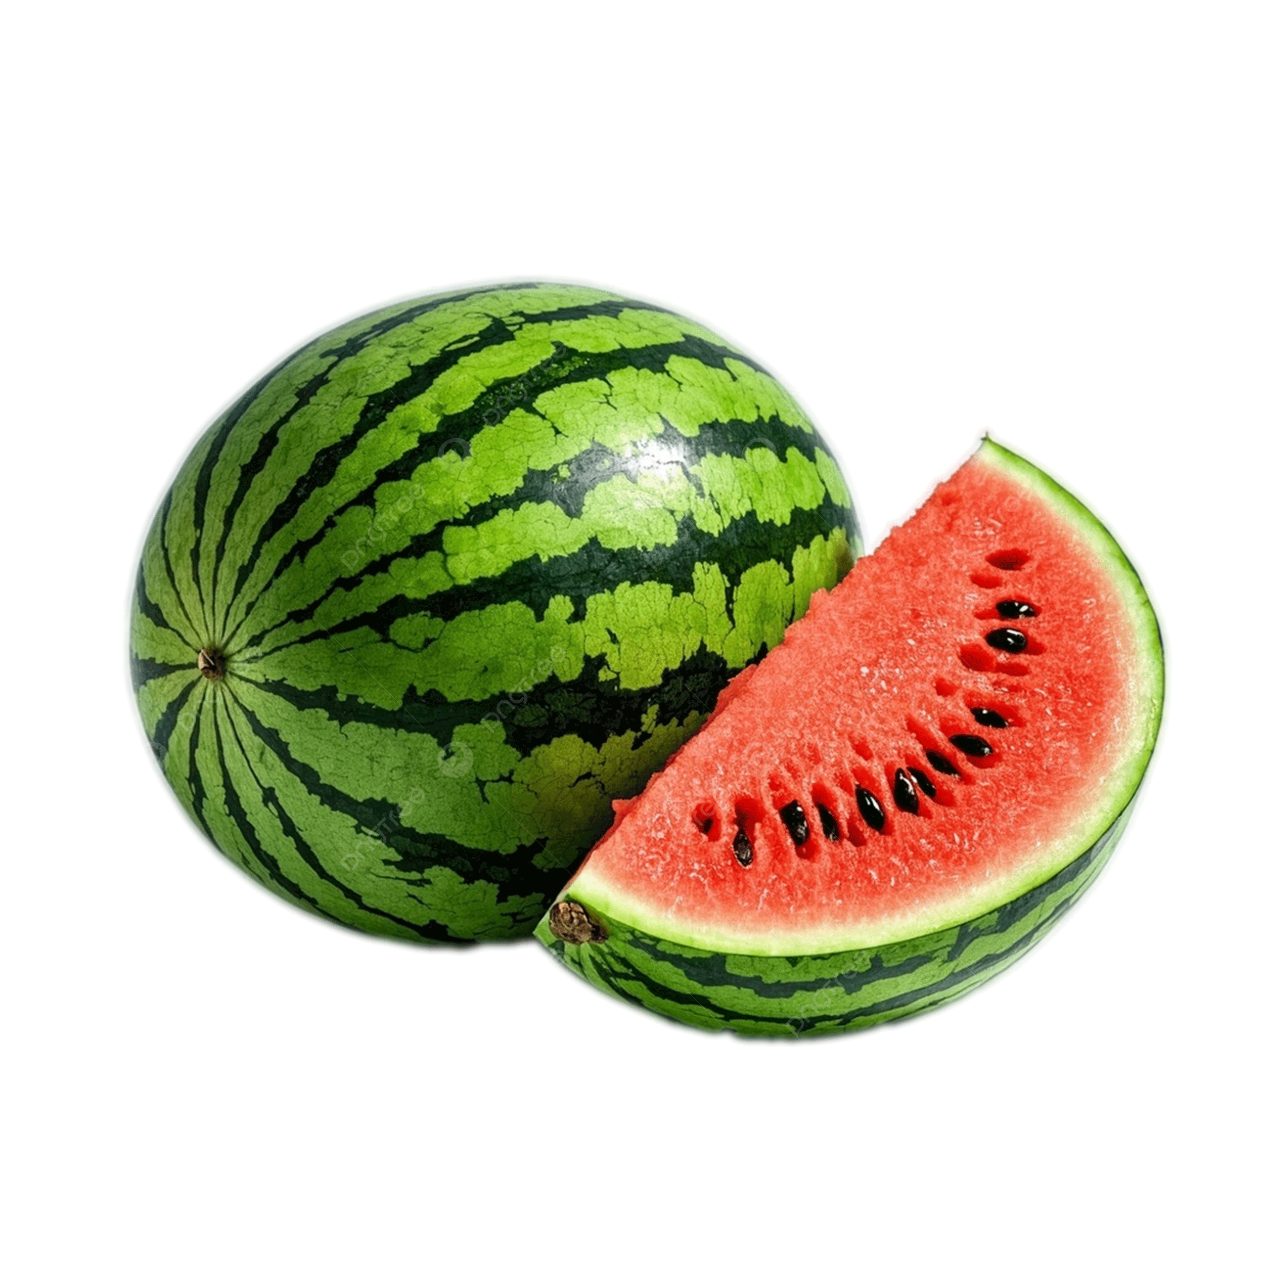
Outcomes over outputs; but the right outcomes
  Reported as success
  Delivered on time
  Within budget
  Key performance indicators met
  What users experience
  Call volumes remain high
  Assisted support costs remain high
  Vulnerable users still struggle
Notes:
O is a principle: outcomes over outputs. We often get to a shared problem statement, but not a shared vision of success.
You may know the watermelon effect: metrics that look green on the outside, but there’s a whole lot of red mush on the inside. It happens when performance measures don’t match what people actually experience. And often those measures are boilerplate, one-size-fits-all. Like eating every meal with a spoon: good for soup, not so great for steak.

Slide 19
From delivering outputs to solving human problems
A clear vision of the outcomes, based on a shared understanding of the problem you’re trying to solve
What does success look like?
What does good enough to move on look like?
Notes:
We often get caught in these 'delivery machines.' Success is often measured by whether we hit a sprint deadline or carried out a round of research. That’s output.
An outcome is the actual change in someone’s experience. If a service passes assessment but failure demand, the contact caused by the service not working, stays high, we’ve produced a high-quality output and a zero-value outcome.
So how do you move from delivering outputs to solving human problems?
Anchor your project in a clear vision of the outcomes, based on a shared understanding of the problem you’re trying to solve. Ask what success looks like for users and for stakeholders. They may conflict, and you can report against both.
Agree in Discovery what “good enough to move on” looks like, for example no more than 2 in 10 people needing help by the end of Alpha.
And don’t ever make it only about the numbers. We all know empathy is important. Behind every number is a person.

Slide 20
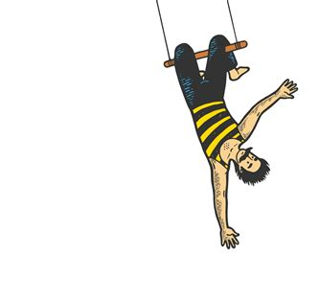
Liminality
The in-between, after the old way and before the new
Notes:
L is a concept: liminality and something that I’ve been going through in the process of creating this talk!
It’s the in-between, a state of transition and disorientation. It’s the moment you’ve let go of one trapeze bar and the uncertainty you feel before catching the next. It’s ambiguous and uncomfortable, because our brains crave predictability.
Digital transformation isn’t a straight line. It’s a journey through constant liminality, for individuals, teams, organisations, and right now for all of us with AI.
Teams and stakeholders often live through the same uncertainty very differently. Teams can feel accountable without the control. Whereas, stakeholders can see changing plans as unreliability. Each side reads the other’s stress as bad faith, and when uncertainty feels threatening, blame & scapegoating offer a quick, satisfying explanation or resolution.

Slide 21
How can you become a better guide for others in liminal spaces?
Name it
Separate “we don’t know yet” from “we got it wrong”
Show what’s stable: The user need
Notes:
So how can you become a better guide for yourself and others in liminal spaces?
Well firstly, liminality should not be seen as a phase that needs to be endured. Rather, it can be seen as an ongoing process that holds significant potential for personal and professional growth. So name the situation. Naming the situation can create a little psychological distance from the intensity of the feeling.
Second, separate “we don’t know yet” from “we got it wrong.” Not knowing is not failing. Build time into the plan for the unknowns and cultivate a growth mindset.
Third, show what’s stable. The user need. High-level, agnostic and stable over time. When everything is changing, people need to know what isn’t.
A liminal perspective doesn’t excuse harmful behaviour. But, it does help explain what’s driving it and where to intervene.
And the best remedy? Humility.

Slide 22
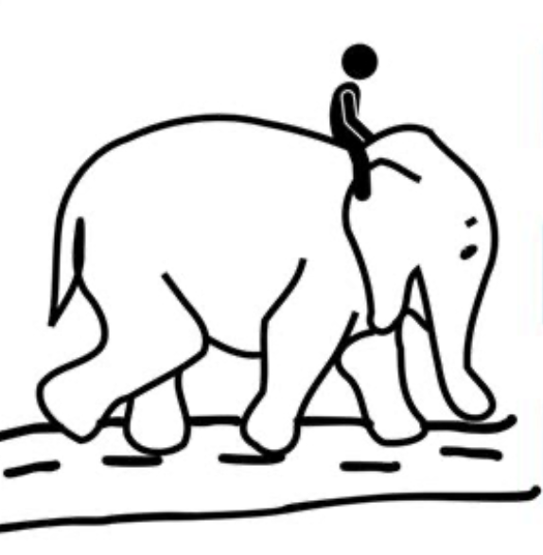
Elephant and the rider
“The mind is divided, like a rider on an elephant, and the rider’s job is to serve the elephant.”
- Jonathan Haidt
Notes:
Our final letter, E, is a metaphor: the elephant and the rider, from psychologist Jonathan Haidt: “The mind is divided, like a rider on an elephant, and the rider’s job is to serve the elephant.”
The rider is our conscious, rational mind: it plans and analyses. The elephant is our automatic, emotional side, and it’s far more powerful. Hence the metaphor of a small rider on top of a huge elephant. If the elephant wants to go somewhere, logic alone rarely stops it.
What does this look like in everyday examples, You get a takeaway instead of going to the gym. You buy yourself a pair of shoes in the sale that you never wear. You message your ex at midnight. We’ve all been there!
In work, it may mean not speaking up when you see a problem with your project.
The Tacoma Narrows Bridge didn’t just start moving on the day it collapsed. It moved from the start, enough to earn the nickname Galloping Gertie. The point is, when it first started to move, no one spoke up.

Slide 23
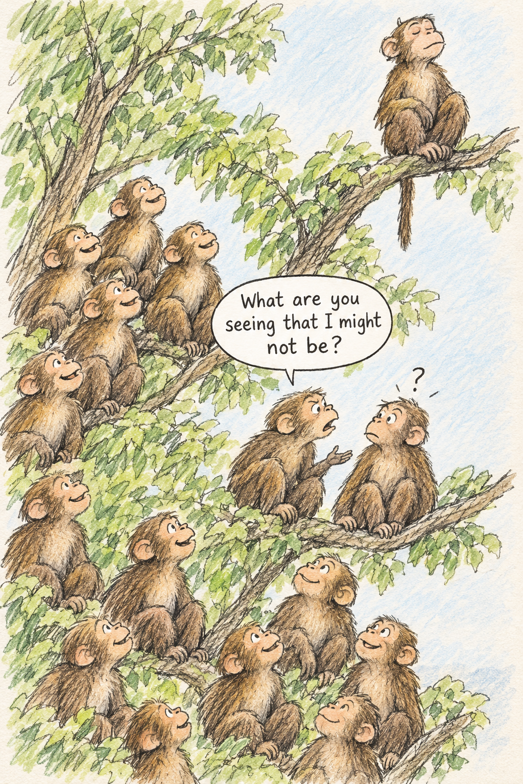
Notes:
Years ago an email did the rounds showing company hierarchy as monkeys in a tree. The one at the top looks down and sees smiling faces. The ones at the bottom look up and see a bunch of arseholes… well, a certainly less flattering view.
When a team member stays quiet in a meeting, it’s often because they’re in this tree. Their rational rider knows the project is failing. But their emotional elephant believes the person in the position of authority only values smiles, and that speaking up gets you thrown out of the tree.
So what gets someone to speak up, and someone else to listen is psychological safety and again humility. To help build that a great question to ask when there are differences of opinion is
“What are you seeing that I might not be?” Recognise your feelings and then make room to listen before bringing your own evidence.

Slide 24
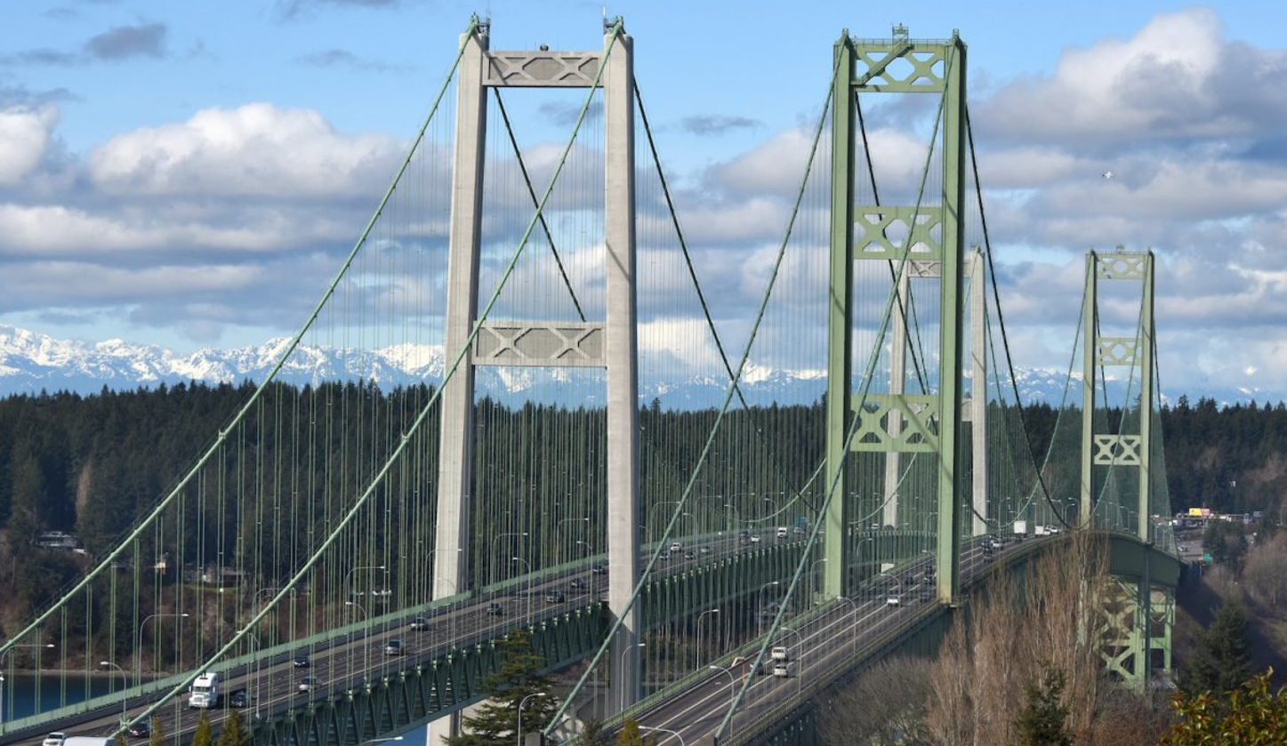
Notes:
Bringing everything to a close.
A new Tacoma Narrows Bridge opened in 1950, and a second alongside it in 2007. Both still stand, designed with an understanding of the whole set of forces.
Sometimes integrity means rebuilding. Sometimes it might mean stopping. And most of the time, it means getting it right.

Slide 25
W
Outcomes
over *outputs*
Humility
and knowing what we don’t
Liminality
awareness
Who
are you not considering?
Elephant
and rider
H
O
L
E
Notes:
Your next project will have its own set of forces. So remember WHOLE.
Ask;
Who are you not considering and grow a complete and holistic understanding of all people that have a stake.
Practice humility and build a psychological safe environment where people are kind, curious and open-minded.
Create a shared vision of outcomes that matter.
Have an awareness for stressful situations and liminal spaces.
And level your decision making by serving your elephant.
Because the people we build services for don’t experience our intent. They experience our decisions. Let’s bring integrity and make our decisions whole.

Slide 26
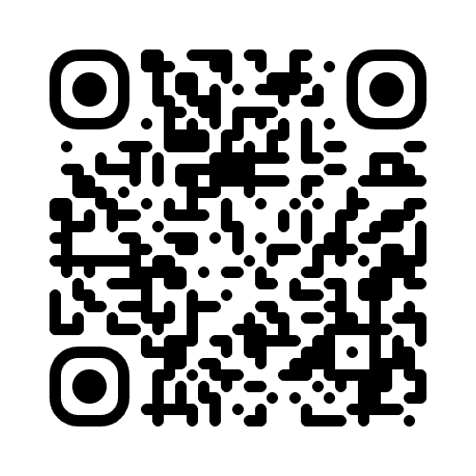
Thank you!
Kathren Neuss
Head of Research – Mercator Digital
kathren.neuss@mercator.group
Notes:
I hope I’ve got you thinking. This is a subject that I can talk a lot more on. And it’s been hard to scale it down into a 20 minute talk.
I’m here and around later into the evening to answer questions. Thank you!

