Slide 1

Experience debt
UX BRIGHTON 2026 · EMERGING METHODS
A method to turn scattered knowledge
into strategic action
CHIARA SCARABOTTI

Slide 2
Today: three aspects of the experience debt
Concept
What experience debt is and why it matters
Method
Three practices to manage it
Implementation
What it looks like in practice

Slide 3
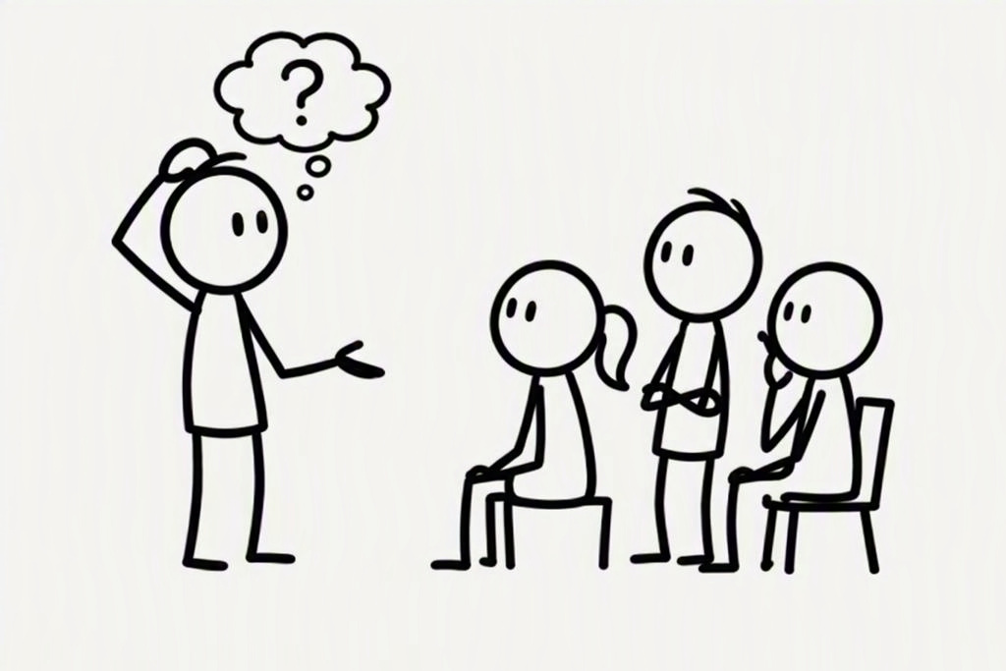
Teams and leadership keep asking the same questions
Where is the evidence for this issue?
Why does this problem matter?
What pattern are we missing?
Where should we invest next?
Why does this issue keep resurfacing?
Why did we design it in this way? Does it still make sense?

Slide 4

Problem space understanding and work is invisible

Slide 5

Knowledge is scattered and recorded in isolation
→ Discovery repeated
→ Connection missing
→ Impact not tracked

Slide 6
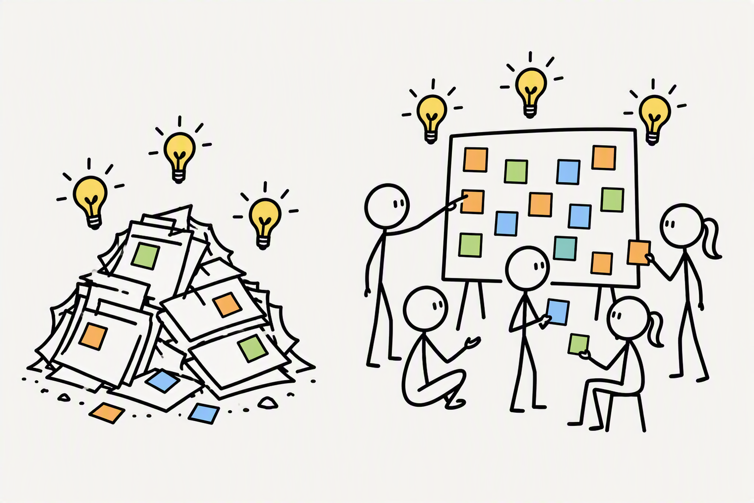
Problems are forgotten when priorities move on

Slide 7
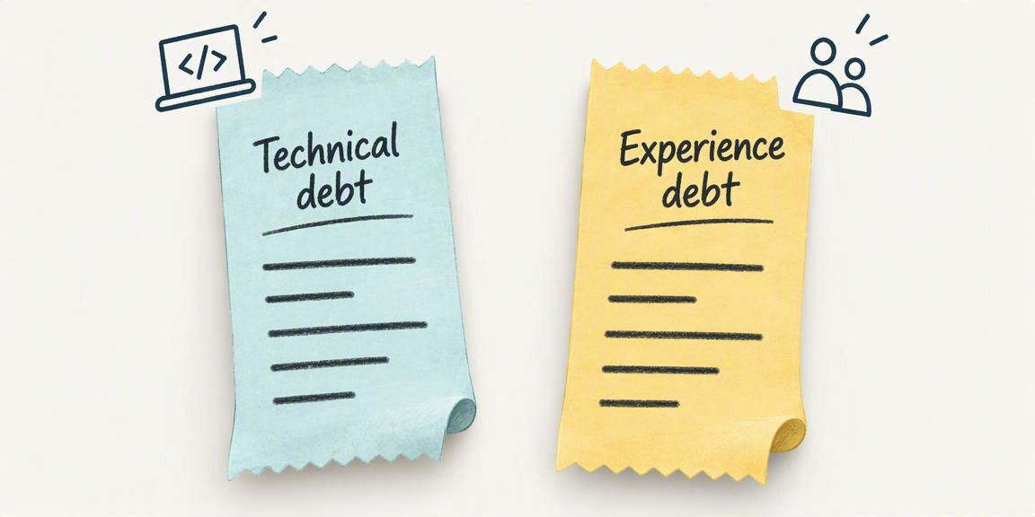
Known problems need the persistence of technical debt

Slide 8


Experience debt: gap between users’ needs and our offering
Design compromises
Unmet needs
Usability/accessibility issues
Lost problems
Partially resolved problems
Problems with unknown outcomes

Slide 9
Capture, connect, resolve to manage the debt condition
Invisible
Scattered
Forgotten
→
→
→
1. CAPTURE
2. CONNECT
3. RESOLVE
gives a home
gives a context
gives a history and a future
UX-275
UX-444
Discovery
UX-301
Backlog
In progress
UX-122
Prioritised

Slide 10
1. Capture gives problems a clear and persistent identity
UX-301
→ How to identify it
Guests cannot tell if their hotel reservation was successful
→ What’s the issue
JTBD (Job To Be Done)
Complete booking with confidence
→ Why it matters
SOURCE
Customer Support | Stakeholders | Research
→ How do we know about it

Slide 11
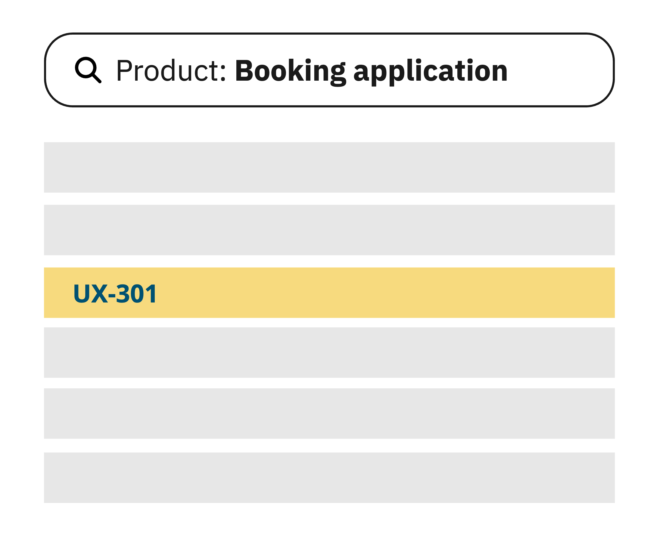
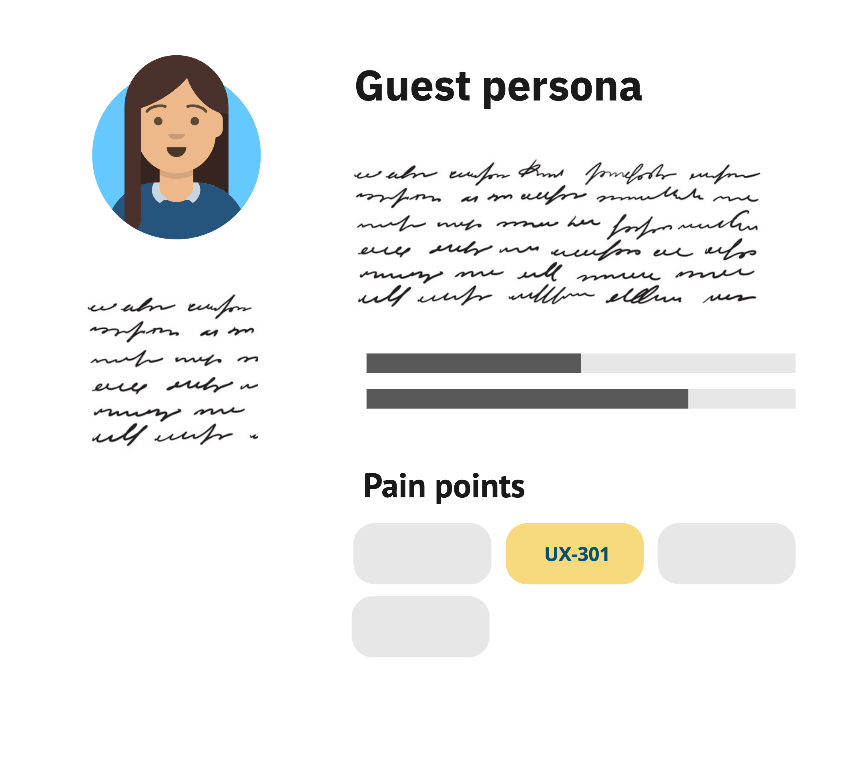
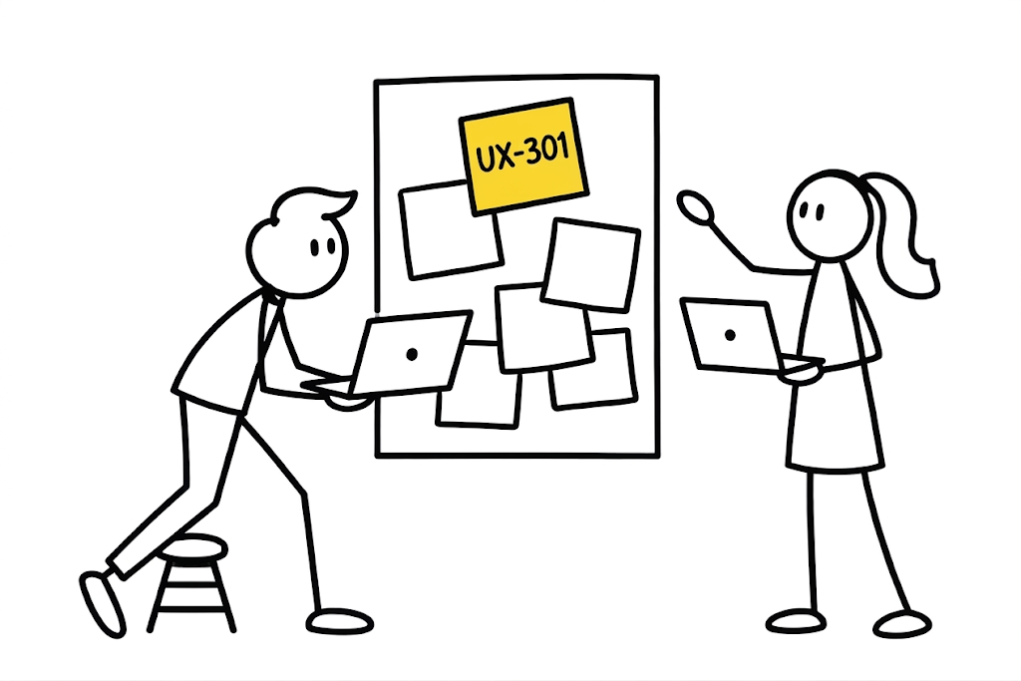
Accessible problem knowledge as result of Capture
Interrogate
Cite
Use

Slide 12
2. Connect reveals problem causes and impacts
UX-301
Guests cannot tell if their
reservation was successful.
UX-444
Hotel staff struggle to keep up with the volume of email requests
blocks
causes
UX-122
Fellow guests struggle to complete their check-in online

Slide 13
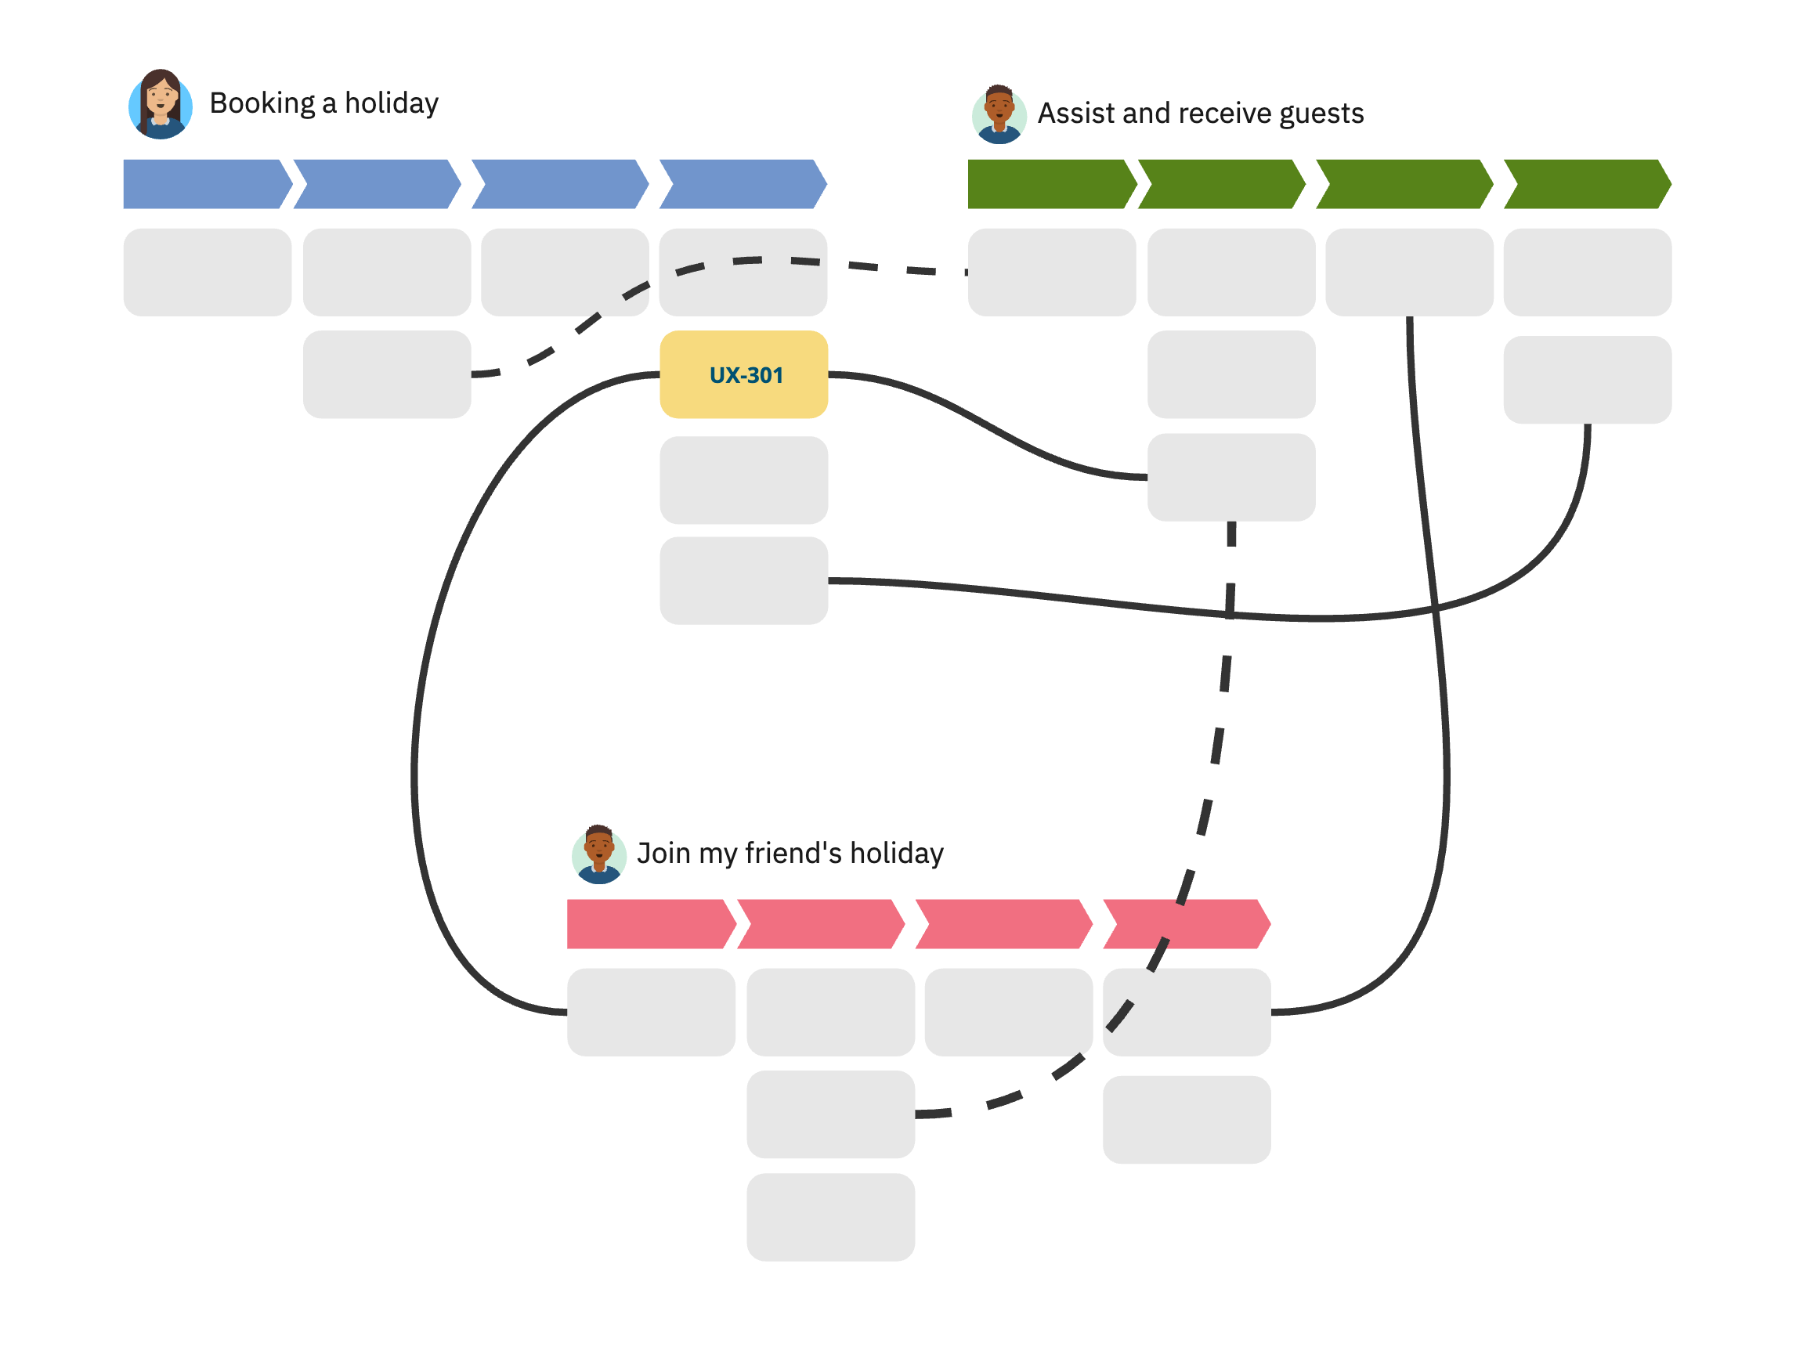
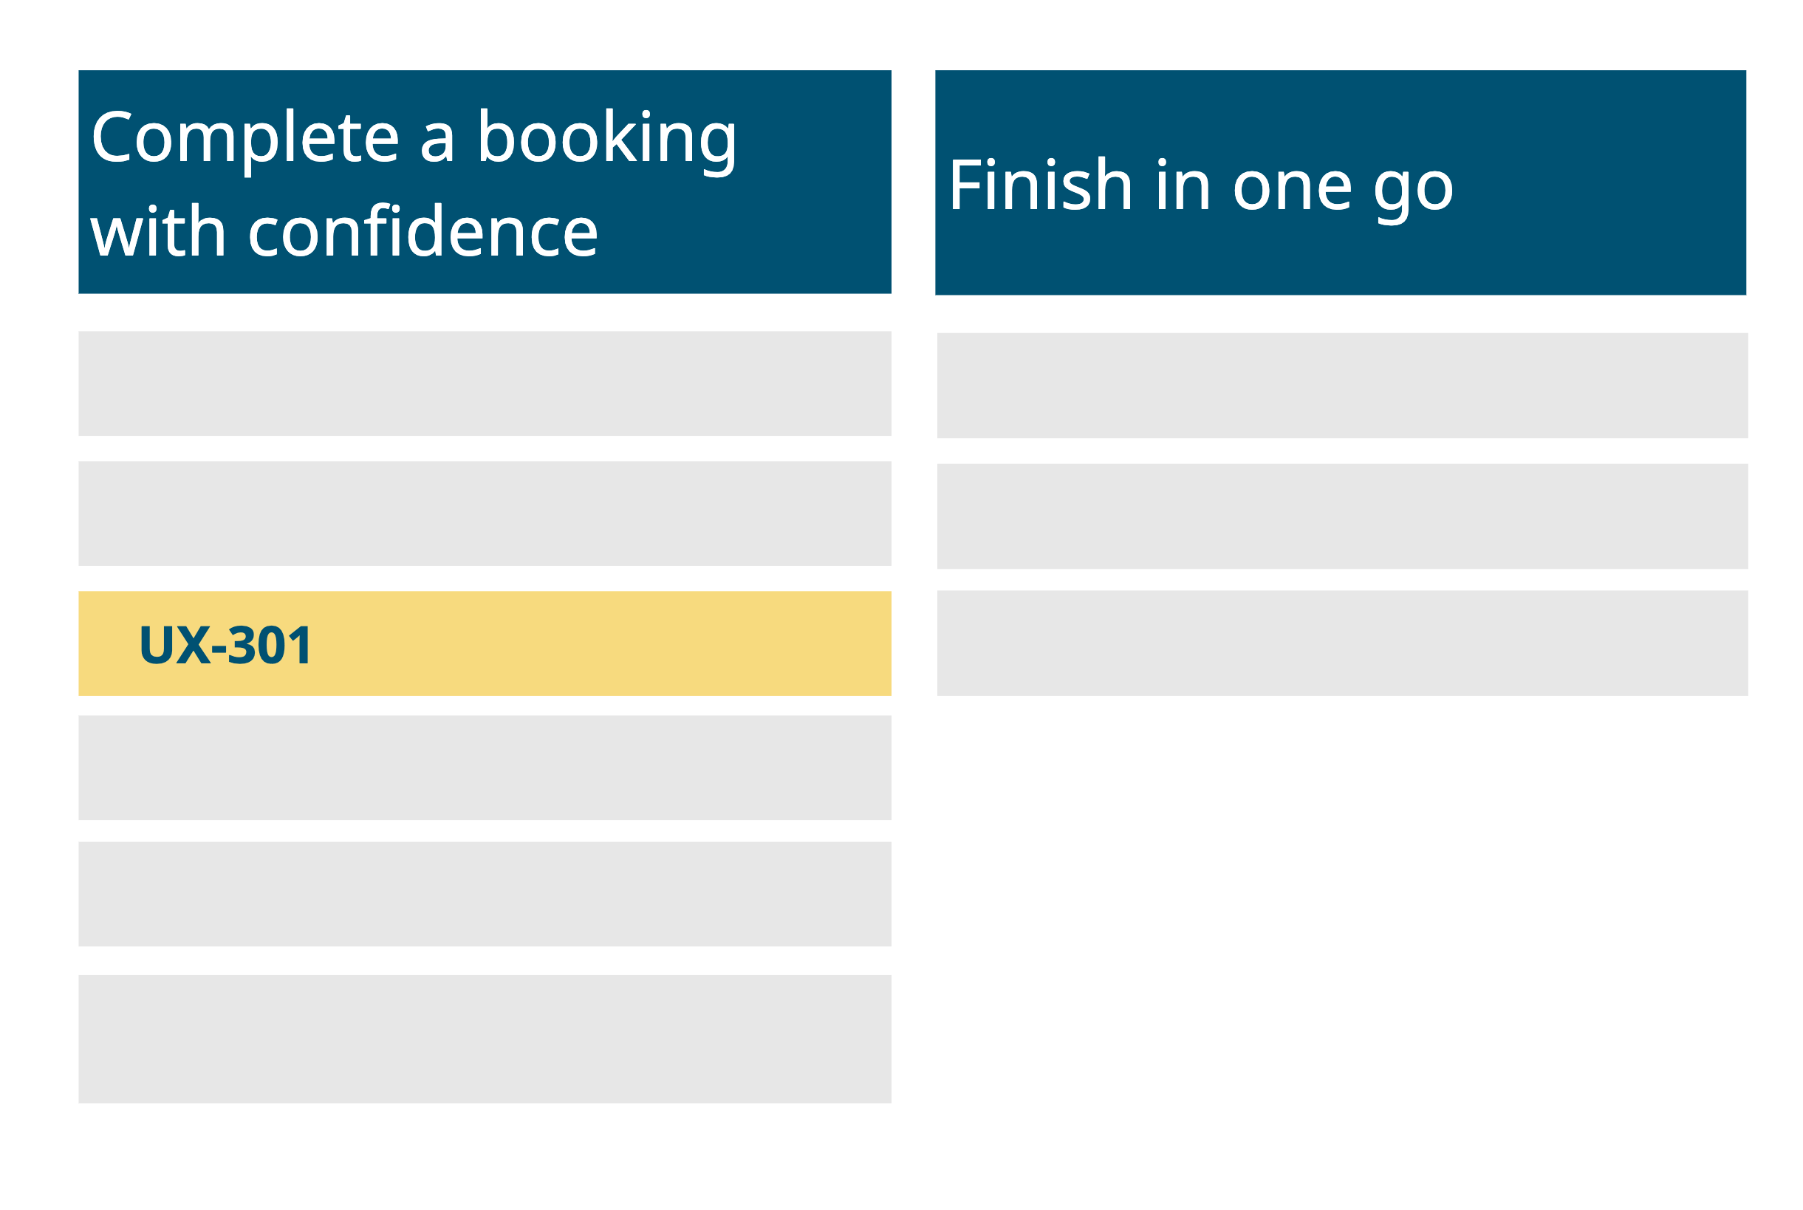
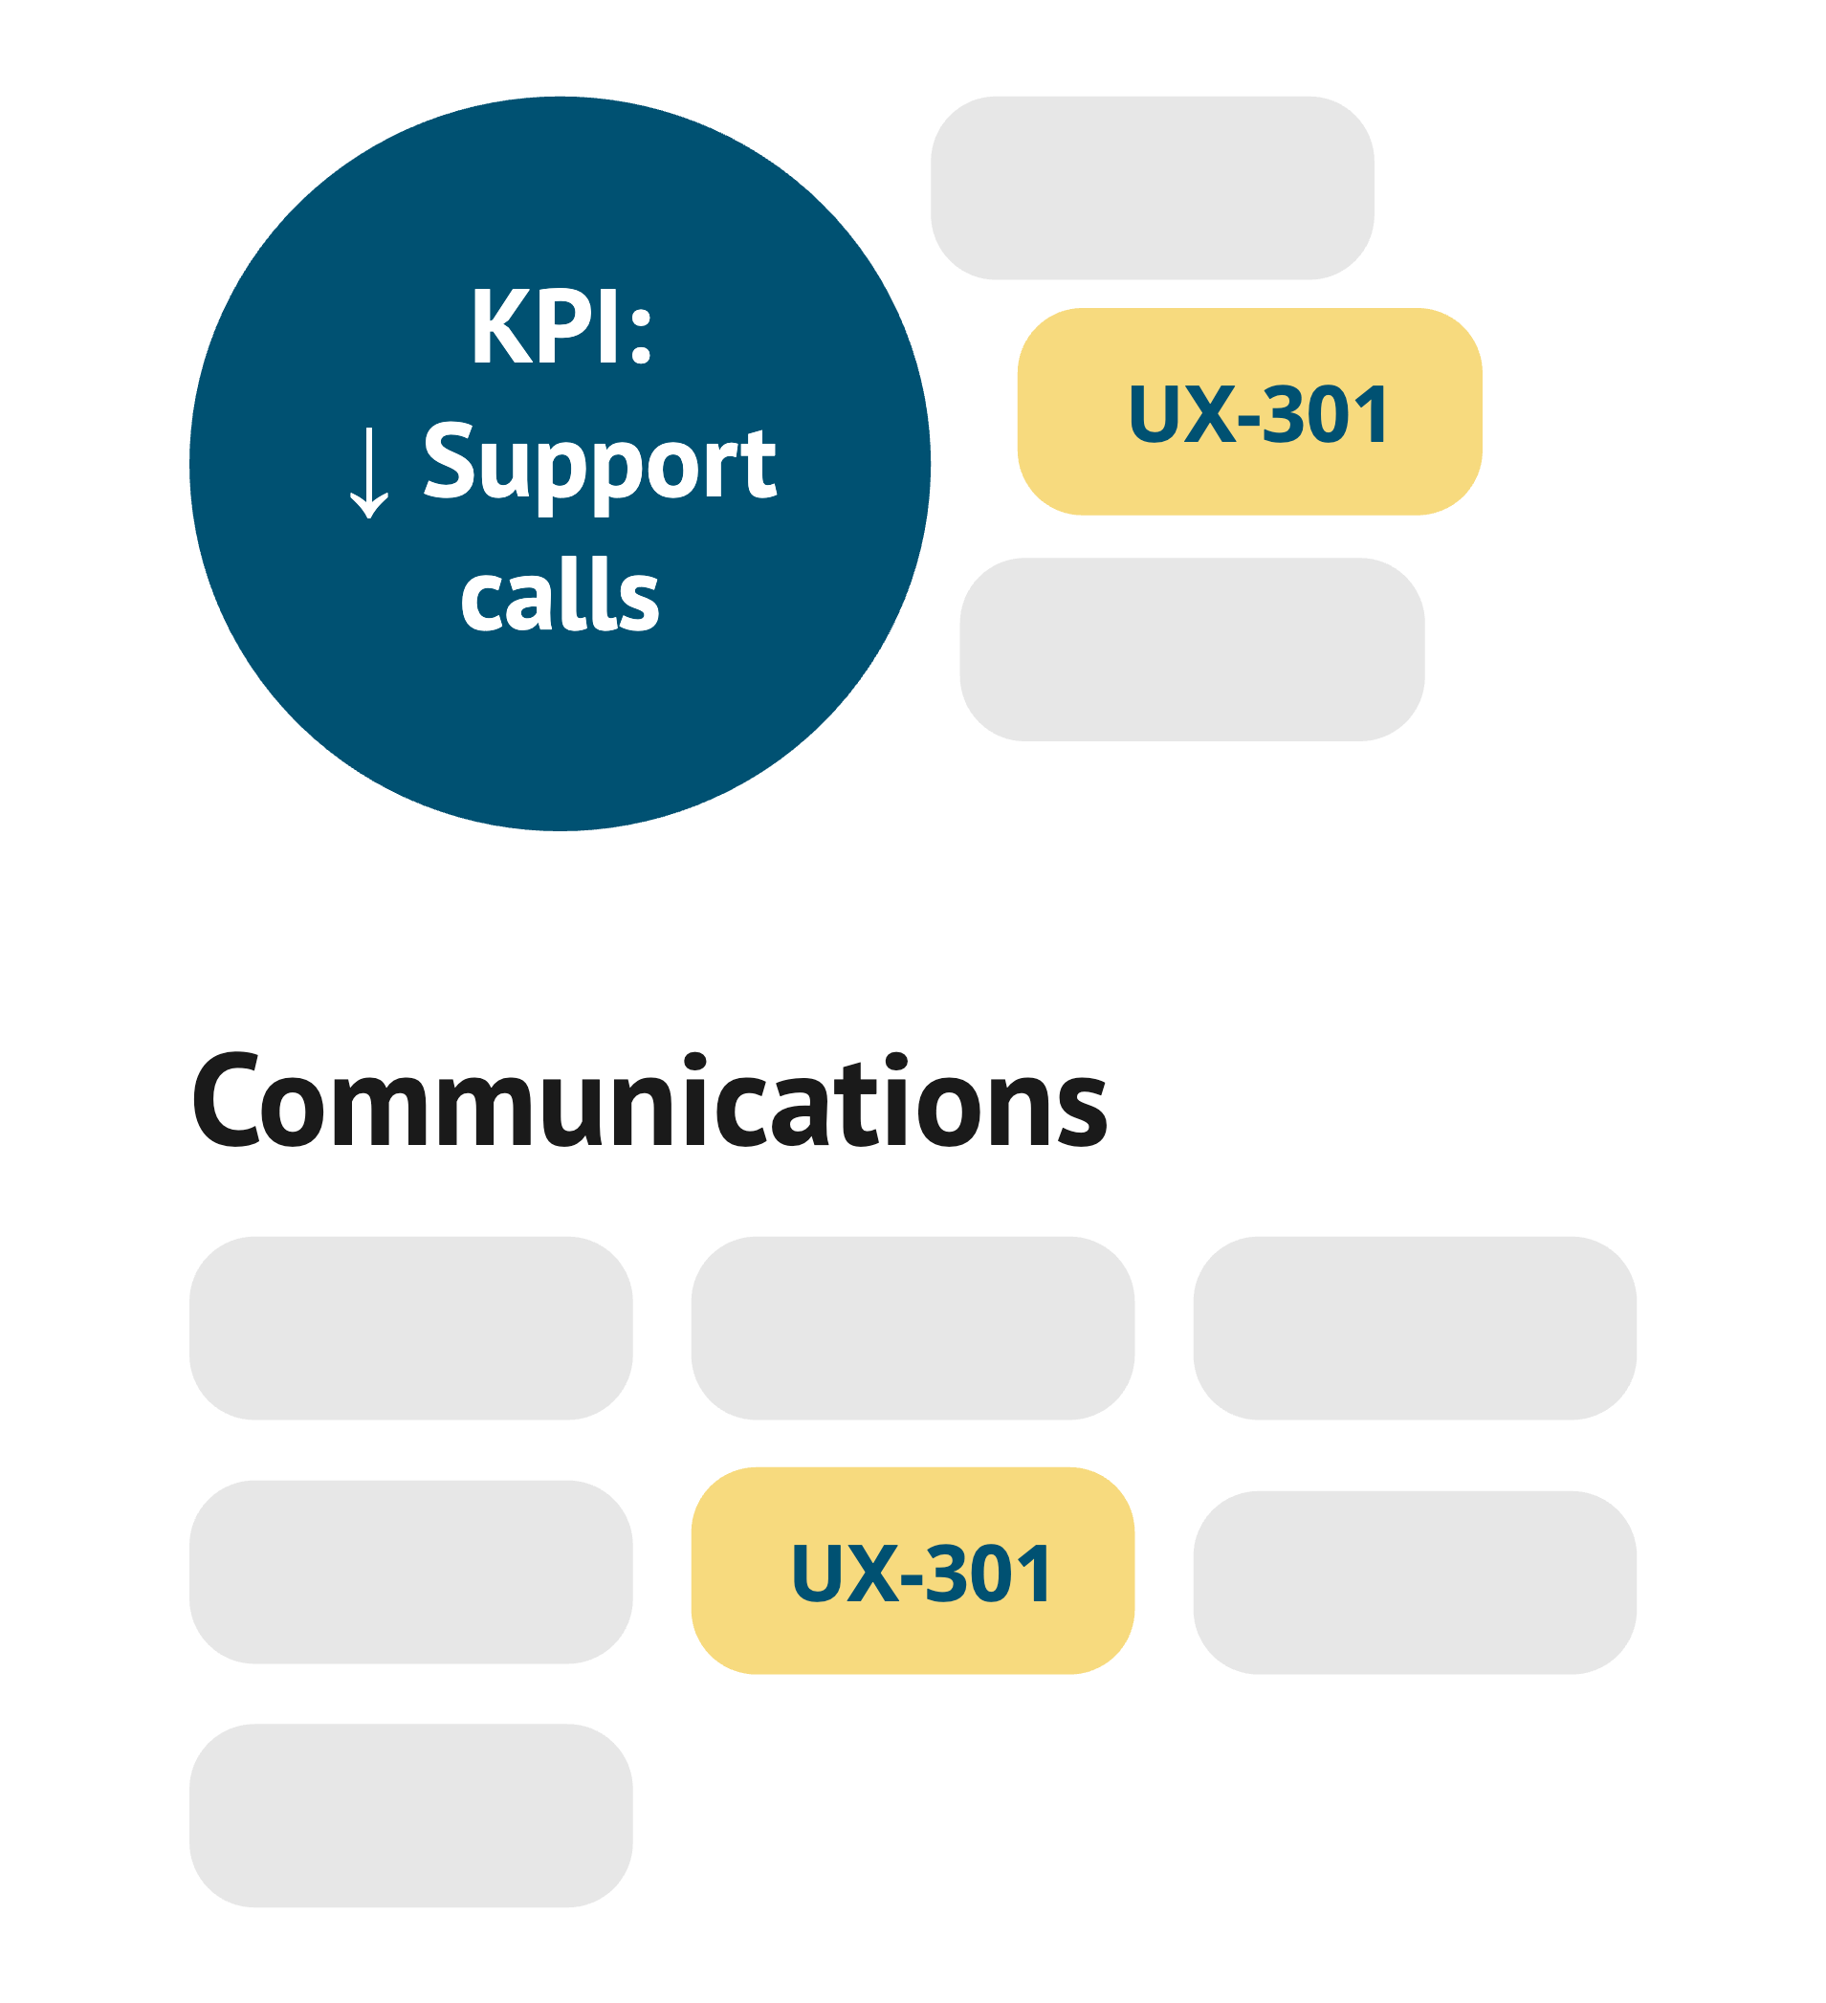
Multiple strategic assets as result of Connect
Cross-journey impact
JTBD view
Business maps

Slide 14
3. Resolve preserves the learning path and the outcome
UX-301
UX-301
UX-301
Guests cannot tell if their hotel reservation was successful.
Guests cannot tell if their hotel reservation was successful.
Guests cannot tell if their hotel reservation was successful.
In progress
In progress
Resolved
Solution 1
no changes
Solution 2
some impact
Solution 3
Problem resolved

Slide 15
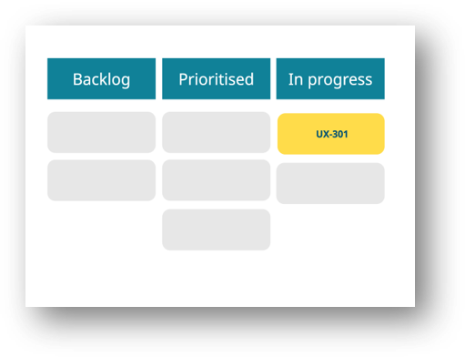
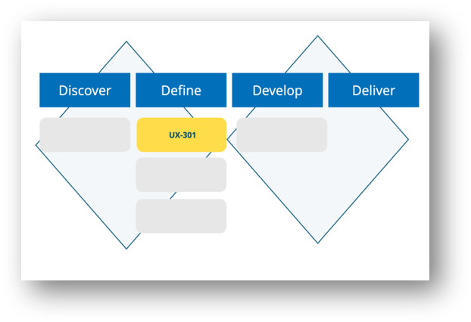
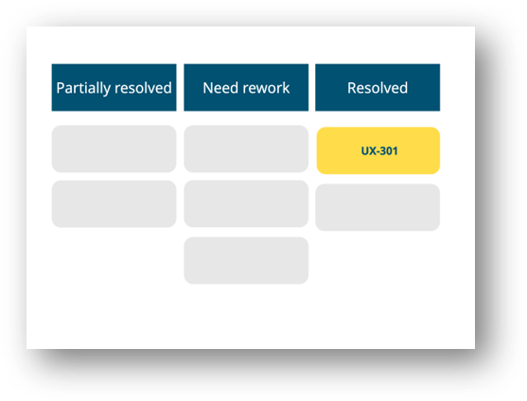
Visible problem progression as result of Resolve
Product view
Design view
Leadership view

Slide 16
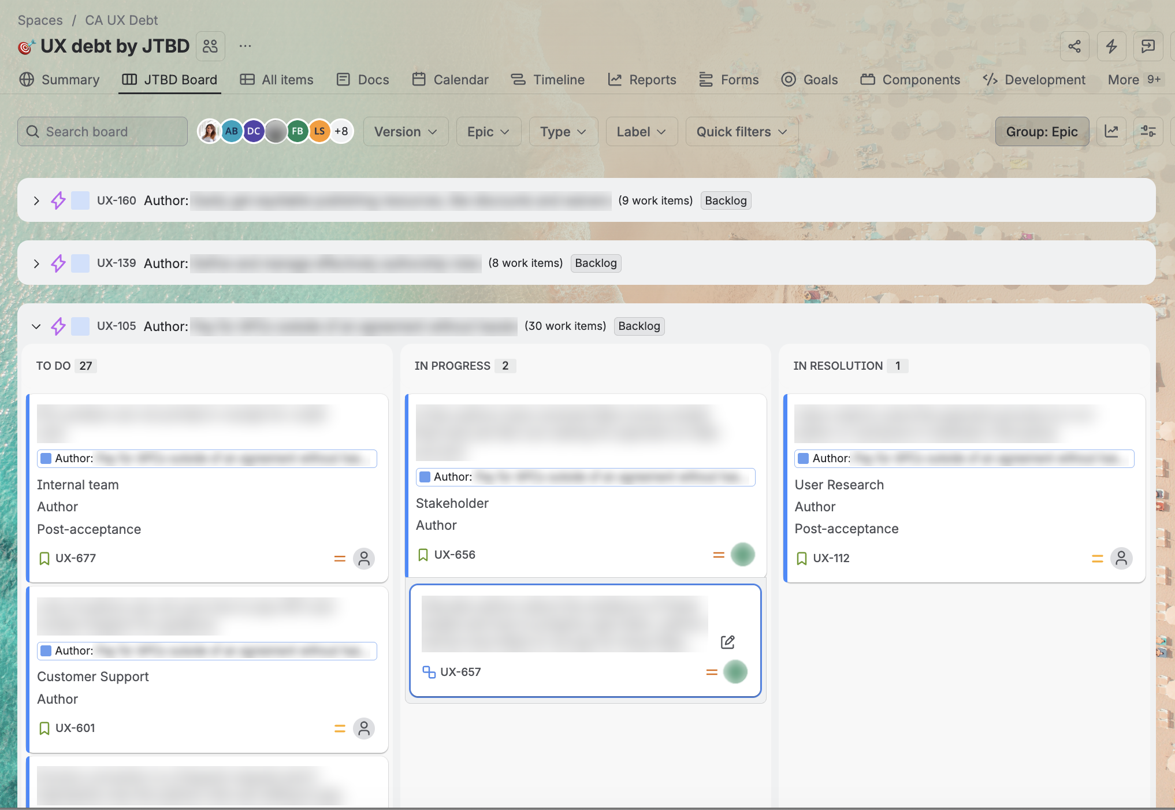
One debt, different ways to work with it - Structurally
Jira
What are the problems related to [user type, JTBD, source, etc.]?
What problems are active, dormant or resolved?

Slide 17
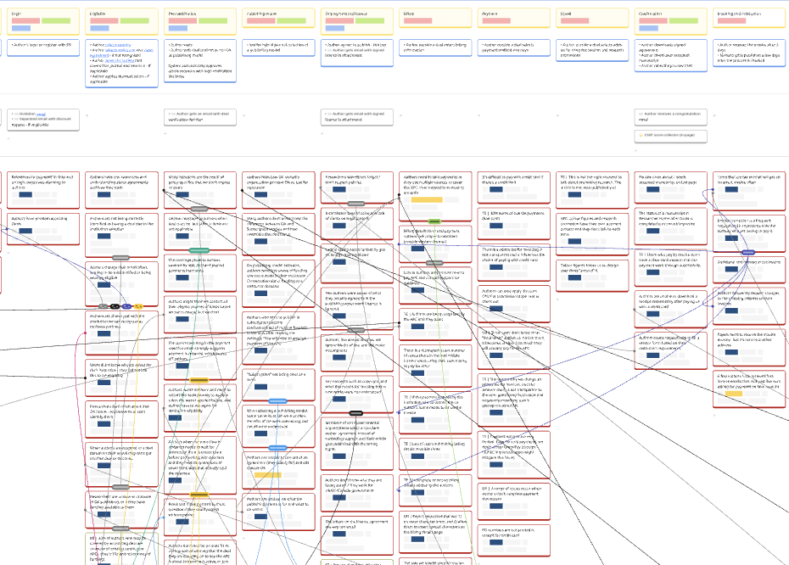
One debt, different ways to work with it - Visually
Miro
Where does the problem live in the journey?
What are the direct connections between experiences?

Slide 18
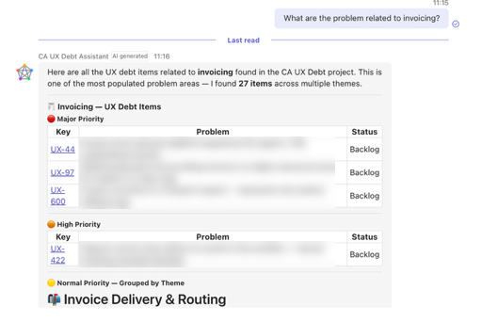
One debt, different ways to work with it - Conversationally
AI agent
What do we know about this issue?
What are the biggest systemic problems?
Is this piece of evidence new or does it relate to an existing issue?

Slide 19
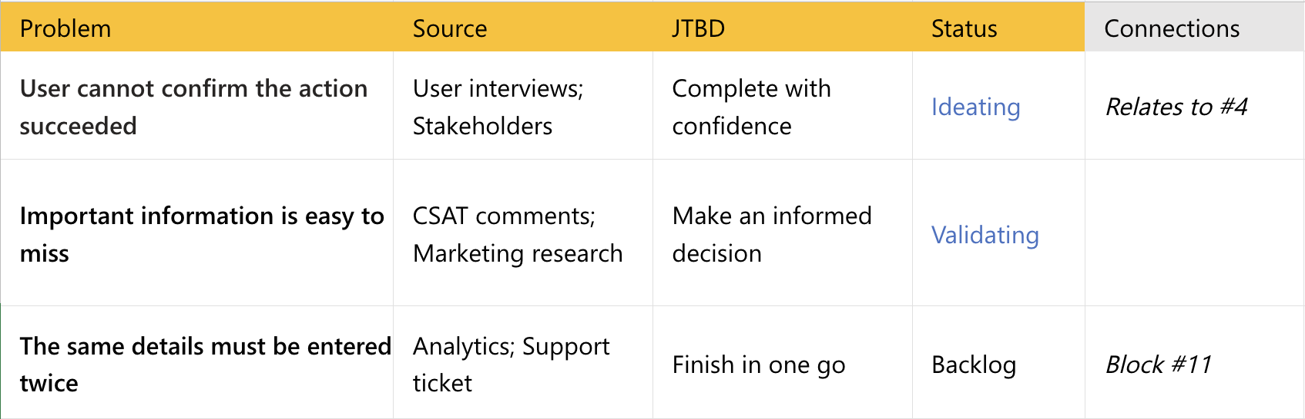
Start with four columns, then add connections
CAPTURE
RESOLVE
CONNECT

Slide 20
Build a habit, not just a database
01
Add more information when it arises
02
Bring your debt to product, colleagues' and leadership conversations
03
Keep each problem alive until you know it changed

Slide 21
New methods can emerge from the combination of existing ones

Slide 22
Debt not captured = debt not managed
Concept
The accumulated gap between what users need and what the experience enables
Method
Capture gives a problem an identity
Connect gives it a strategic meaning
Resolve gives it a learning path and outcome
Implementation
Jira, Miro, AI, or 4 columns in a spreadsheet

Slide 23
Thank you
Chiara Scarabotti · UX Brighton 2026

